Slide 1
ESOC 2026 Best of: Secondary prevention

Slide 2
Disclaimer
This slide deck is designed for personal educational purposes only and should not be utilised for making patient management decisions. It is important to verify all information provided before treating patients or applying any therapies mentioned in these materials.

Slide 3

Information
This slide deck showcases the latest data presented at the 12th European Stroke Organisation Conference (ESOC 2026). All abbreviations displayed on these slides, along with a complete copy of the original abstract text, can be found in the slide notes. Click on the Home symbol to return to the content page.
Supported with an unrestricted educational grant by Bayer AG

Slide 4
Content
Abstract number | Abstract title
ESOC2026A674 | NET CLINICAL BENEFIT OF STARTING ANTICOAGULATION EARLY AFTER ISCHEMIC STROKE IN ATRIAL FIBRILLATION: A META-ANALYSIS OF RANDOMIZED TRIALS FROM THE CATALYST COLLABORATION
ESOC2026A2408 | ISCHEMIC STROKE DESPITE PRIMARY PREVENTIVE ORAL ANTICOAGULATION IN ATRIAL FIBRILLATION – A NATIONAL REGISTRY STUDY
ESOC2026A1020 | LEFT ATRIAL APPENDAGE OCCLUSION FOR STROKE PREVENTION IN PATIENTS WITH ATRIAL FIBRILLATION AND MALIGNANCY: A SYSTEMATIC REVIEW AND META-ANALYSIS OF 177,896 PATIENTS
ESOC2026A2198 | THE RELATIONSHIP BETWEEN ACHIEVED BLOOD PRESSURE AND BLOOD PRESSURE VARIABILITY WITH RECURRENT VASCULAR EVENTS IN THE CONVINCE TRIAL POPULATION
ESOC2026A2114 | STROKE PREVENTION IN WOMEN (SERENE): AN INDIVIDUAL PATIENT DATA LEVEL META-ANALYSIS OF FOUR RANDOMIZED CONTROLLED TRIALS ON SECONDARY STROKE PREVENTION IN WOMEN
ESOC2026A1458 | BALANCING BENEFITS AND RISKS: LONG-TERM BLEEDING COMPLICATIONS IN YOUNG ADULTS AFTER ISCHEMIC STROKE OR TIA
ESOC2026A2195 | TIMING OF ANTICOAGULATION THERAPY IN PATIENTS WITH ACUTE ISCHEMIC STROKE AND ATRIAL FIBRILLATION: A GRADE-BASED EXPERT OPINION RECOMMENDATION.

Slide 5
Content
Abstract number | Abstract title
ESOC2026A1255 | HEALTH AND SOCIAL CARE COSTS OF RECURRENT STROKE: LONG-TERM FOLLOW-UP OF A POPULATION-BASED COHORT
ESOC2026A259 | COVERT SENTINEL INFARCTS ON NONCONTRAST CT: A HIGH-RISK CLINICAL SYNDROME PREDICTING STROKE ETIOLOGY AND OUTCOME
ESOC2026A508 | EFFECT OF ORAL ANTICOAGULATION ON STROKE RISK AFTER MYOCARDIAL INFARCTION DIFFERS BY THE PRESENCE OF ATRIAL FIBRILLATION
ESOC2026A2471 | PROGNOSTIC UTILITY OF DIFFUSION-WEIGHTED MRI IN POSTERIOR VERSUS ANTERIOR CIRCULATION MINOR ISCHAEMIC STROKE: A POPULATION-BASED STUDY
ESOC2026A313 | CILOSTAZOL FOR SECONDARY PREVENTION OF STROKE AND COGNITIVE DECLINE: AN UPDATED SYSTEMATIC REVIEW AND META-ANALYSIS
ESOC2026LB157 | INCIDENT ISCHAEMIC STROKE IN THE RANDOMISED, PLACEBO-CONTROLLED, EVENT-DRIVEN OCEANIC-STROKE TRIAL OF ASUNDEXIAN FOR SECONDARY STROKE PREVENTION: SEVERITY, TREATMENT AND OUTCOMES
ESOC2026LB160 | INTRACRANIAL HAEMORRHAGE IN PATIENTS WITH NON-CARDIOEMBOLIC ISCHAEMIC STROKE OR HIGH-RISK TIA: INSIGHTS FROM THE OCEANIC-STROKE RANDOMISED TRIAL OF ASUNDEXIAN FOR SECONDARY STROKE PREVENTION

Slide 6
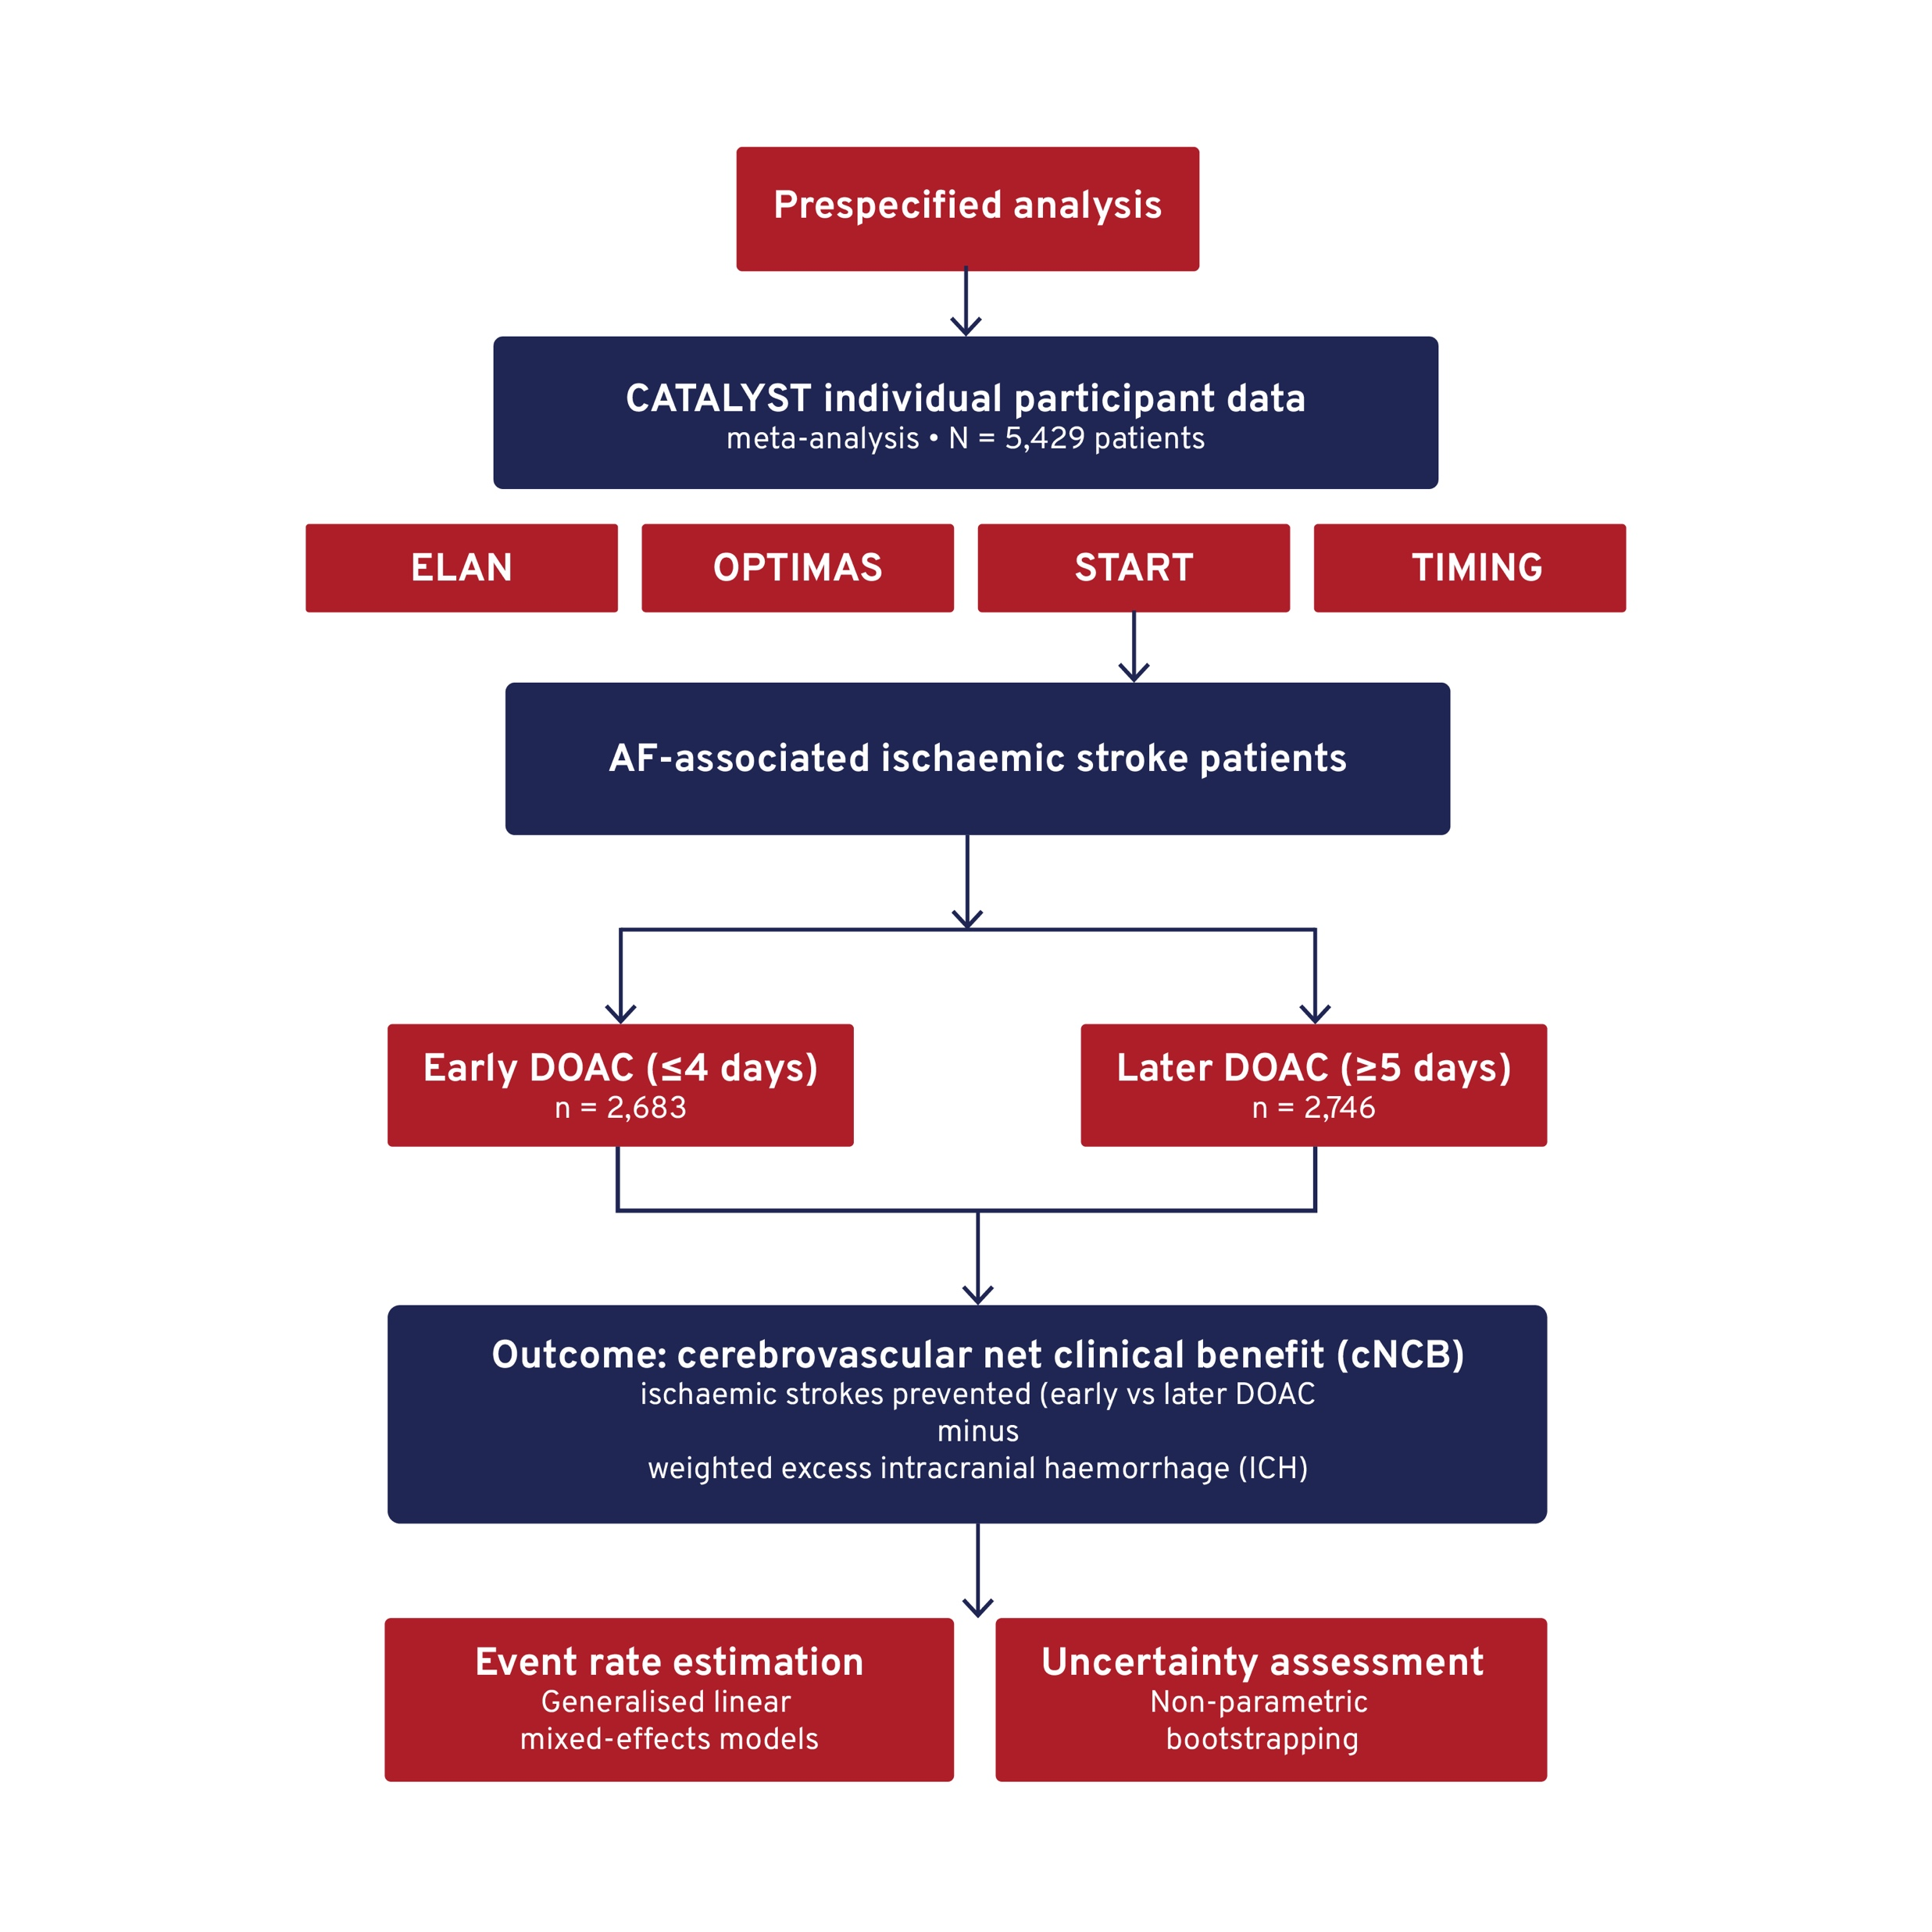
NET CLINICAL BENEFIT OF STARTING ANTICOAGULATION EARLY AFTER ISCHEMIC STROKE IN ATRIAL FIBRILLATION: A META-ANALYSIS OF RANDOMIZED TRIALS FROM THE CATALYST COLLABORATION
Background
Early initiation of direct oral anticoagulants (DOACs) after atrial fibrillation (AF)-associated ischaemic stroke reduces recurrent cerebrovascular events.
However, the net clinical benefit (NCB) remains uncertain when balancing prevention of ischaemic stroke against risk of intracerebral haemorrhage.
Aim
To assess the cerebrovascular net clinical benefit (cNCB) of early versus later DOAC initiation following AF-associated ischaemic stroke.
Methods
Notes:
Authorship: Alexandros Polymeris, Konstantina Chalkou, Georgia Salanti, Hakim-Moulay Dehbi, Jonas Oldgren4 , Truman Milling, Steven Warach, Signild Åsberg, David Werring, Urs Fischer
Abbreviations: AF, atrial fibrillation; DOAC, direct oral anticoagulant; ICH, intracerebral haemorrhage; IPD, independent participant data; cNCB, cerebrovascular net clinical benefit.
Abstract Number: ESOC2026A674
Abstract Title: NET CLINICAL BENEFIT OF STARTING ANTICOAGULATION EARLY AFTER ISCHEMIC STROKE IN ATRIAL FIBRILLATION: A META-ANALYSIS OF RANDOMIZED TRIALS FROM THE CATALYST COLLABORATION
Abstract Category: 05.00 - RISK FACTORS AND PREVENTION (PRIMARY AND SECONDARY) - 05.02 - SECONDARY PREVENTION
Background and aims:
Starting direct oral anticoagulants (DOAC) early after atrial fibrillation (AF)-associated ischaemic stroke reduces the composite of subsequent ischaemic or haemorrhagic stroke. However, whether early treatment confers net clinical benefit (NCB) after accounting for the different clinical importance of ischaemic and haemorrhagic events is unclear.
Methods:
Prespecified analysis of CATALYST pooling individual participant data from four trials (ELAN, OPTIMAS, START, TIMING). We included 5,429 participants randomized to start DOAC early (≤4 days; N=2,683) or later (≥5 days; N=2,746) after onset of AF-associated ischaemic stroke. We calculated the cerebrovascular NCB (cNCB) by subtracting the weighted rate of excess intracerebral haemorrhage (ICH) attributable to early treatment from the rate of excess ischaemic stroke prevented by early treatment within 30 days using an established event weighting scheme. We estimated event rates from generalized linear mixed-effects models, and quantified uncertainty using non-parametric bootstrapping.
Results:
We observed 115 recurrent ischaemic strokes (45 [1.7%] with early; 70 [2.5%] with later treatment) and 20 ICH (10 [0.4%] in each arm). The cNCB of early over later treatment ranged from +0.94 (95%-CI 0.00 to +2.08) to +0.92 (95%-CI -0.49 to +2.16) weighted cerebrovascular events prevented per 100 participants across ICH weights from 1.5 to 3.3 (number-needed-to-treat≈107). Subgroup analyses and global NCB analyses incorporating additional vascular events yielded consistent results.
Conclusions:
We estimated a modest NCB from starting DOAC early after AF-associated ischaemic stroke. Our findings add support to the early treatment approach, although estimates cannot exclude the possibility of no benefit or small net harm.

Slide 7
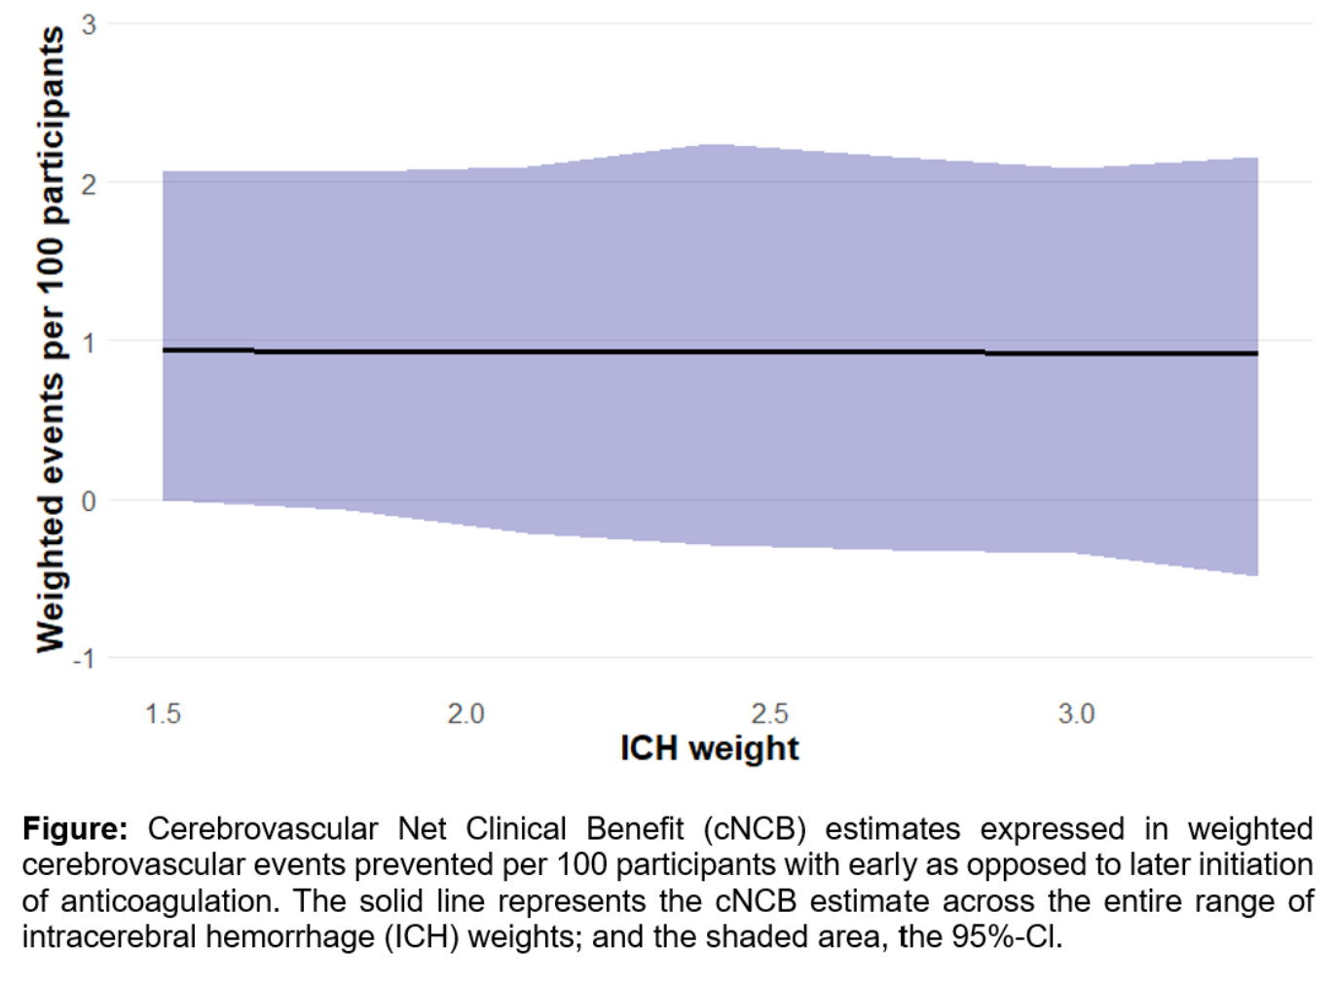
NET CLINICAL BENEFIT OF STARTING ANTICOAGULATION EARLY AFTER ISCHEMIC STROKE IN ATRIAL FIBRILLATION: A META-ANALYSIS OF RANDOMIZED TRIALS FROM THE CATALYST COLLABORATION
Results
Early DOAC initiation was associated with a lower rate of recurrent ischaemic stroke compared with later initiation (1.7% [45 patients] vs 2.5% [70 patients]).
Rates of ICH were similar between groups (0.4%; 10 patients in each group).
Overall, early DOAC initiation was associated with a modest net clinical benefit (+0.92 to +0.94 events prevented per 100 patients).
Findings were consistent across subgroup and global analyses, although confidence intervals included zero::
Primary analysis: 0.00 to +2.08
Sensitivity analysis: −0.49 to +2.16
The number needed to treat was approximately 107.
Conclusion
Early DOAC initiation was associated with lower recurrent ischaemic stroke and similar ICH rates.
Findings support early treatment as a potential strategy, although uncertainty remains.
Notes:
Authorship: Alexandros Polymeris, Konstantina Chalkou, Georgia Salanti, Hakim-Moulay Dehbi, Jonas Oldgren4 , Truman Milling, Steven Warach, Signild Åsberg, David Werring, Urs Fischer
Abbreviations: AF, atrial fibrillation; DOAC, direct oral anticoagulant; ICH, intracerebral haemorrhage; cNCB, cerebrovascular net clinical benefit.
Abstract Number: ESOC2026A674
Abstract Title: NET CLINICAL BENEFIT OF STARTING ANTICOAGULATION EARLY AFTER ISCHEMIC STROKE IN ATRIAL FIBRILLATION: A META-ANALYSIS OF RANDOMIZED TRIALS FROM THE CATALYST COLLABORATION
Abstract Category: 05.00 - RISK FACTORS AND PREVENTION (PRIMARY AND SECONDARY) - 05.02 - SECONDARY PREVENTION
Background and aims:
Starting direct oral anticoagulants (DOAC) early after atrial fibrillation (AF)-associated ischaemic stroke reduces the composite of subsequent ischaemic or haemorrhagic stroke. However, whether early treatment confers net clinical benefit (NCB) after accounting for the different clinical importance of ischaemic and haemorrhagic events is unclear.
Methods:
Prespecified analysis of CATALYST pooling individual participant data from four trials (ELAN, OPTIMAS, START, TIMING). We included 5,429 participants randomized to start DOAC early (≤4 days; N=2,683) or later (≥5 days; N=2,746) after onset of AF-associated ischaemic stroke. We calculated the cerebrovascular NCB (cNCB) by subtracting the weighted rate of excess intracerebral haemorrhage (ICH) attributable to early treatment from the rate of excess ischaemic stroke prevented by early treatment within 30 days using an established event weighting scheme. We estimated event rates from generalized linear mixed-effects models, and quantified uncertainty using non-parametric bootstrapping.
Results:
We observed 115 recurrent ischaemic strokes (45 [1.7%] with early; 70 [2.5%] with later treatment) and 20 ICH (10 [0.4%] in each arm). The cNCB of early over later treatment ranged from +0.94 (95%-CI 0.00 to +2.08) to +0.92 (95%-CI -0.49 to +2.16) weighted cerebrovascular events prevented per 100 participants across ICH weights from 1.5 to 3.3 (number-needed-to-treat≈107). Subgroup analyses and global NCB analyses incorporating additional vascular events yielded consistent results.
Conclusions:
We estimated a modest NCB from starting DOAC early after AF-associated ischaemic stroke. Our findings add support to the early treatment approach, although estimates cannot exclude the possibility of no benefit or small net harm.

Slide 8
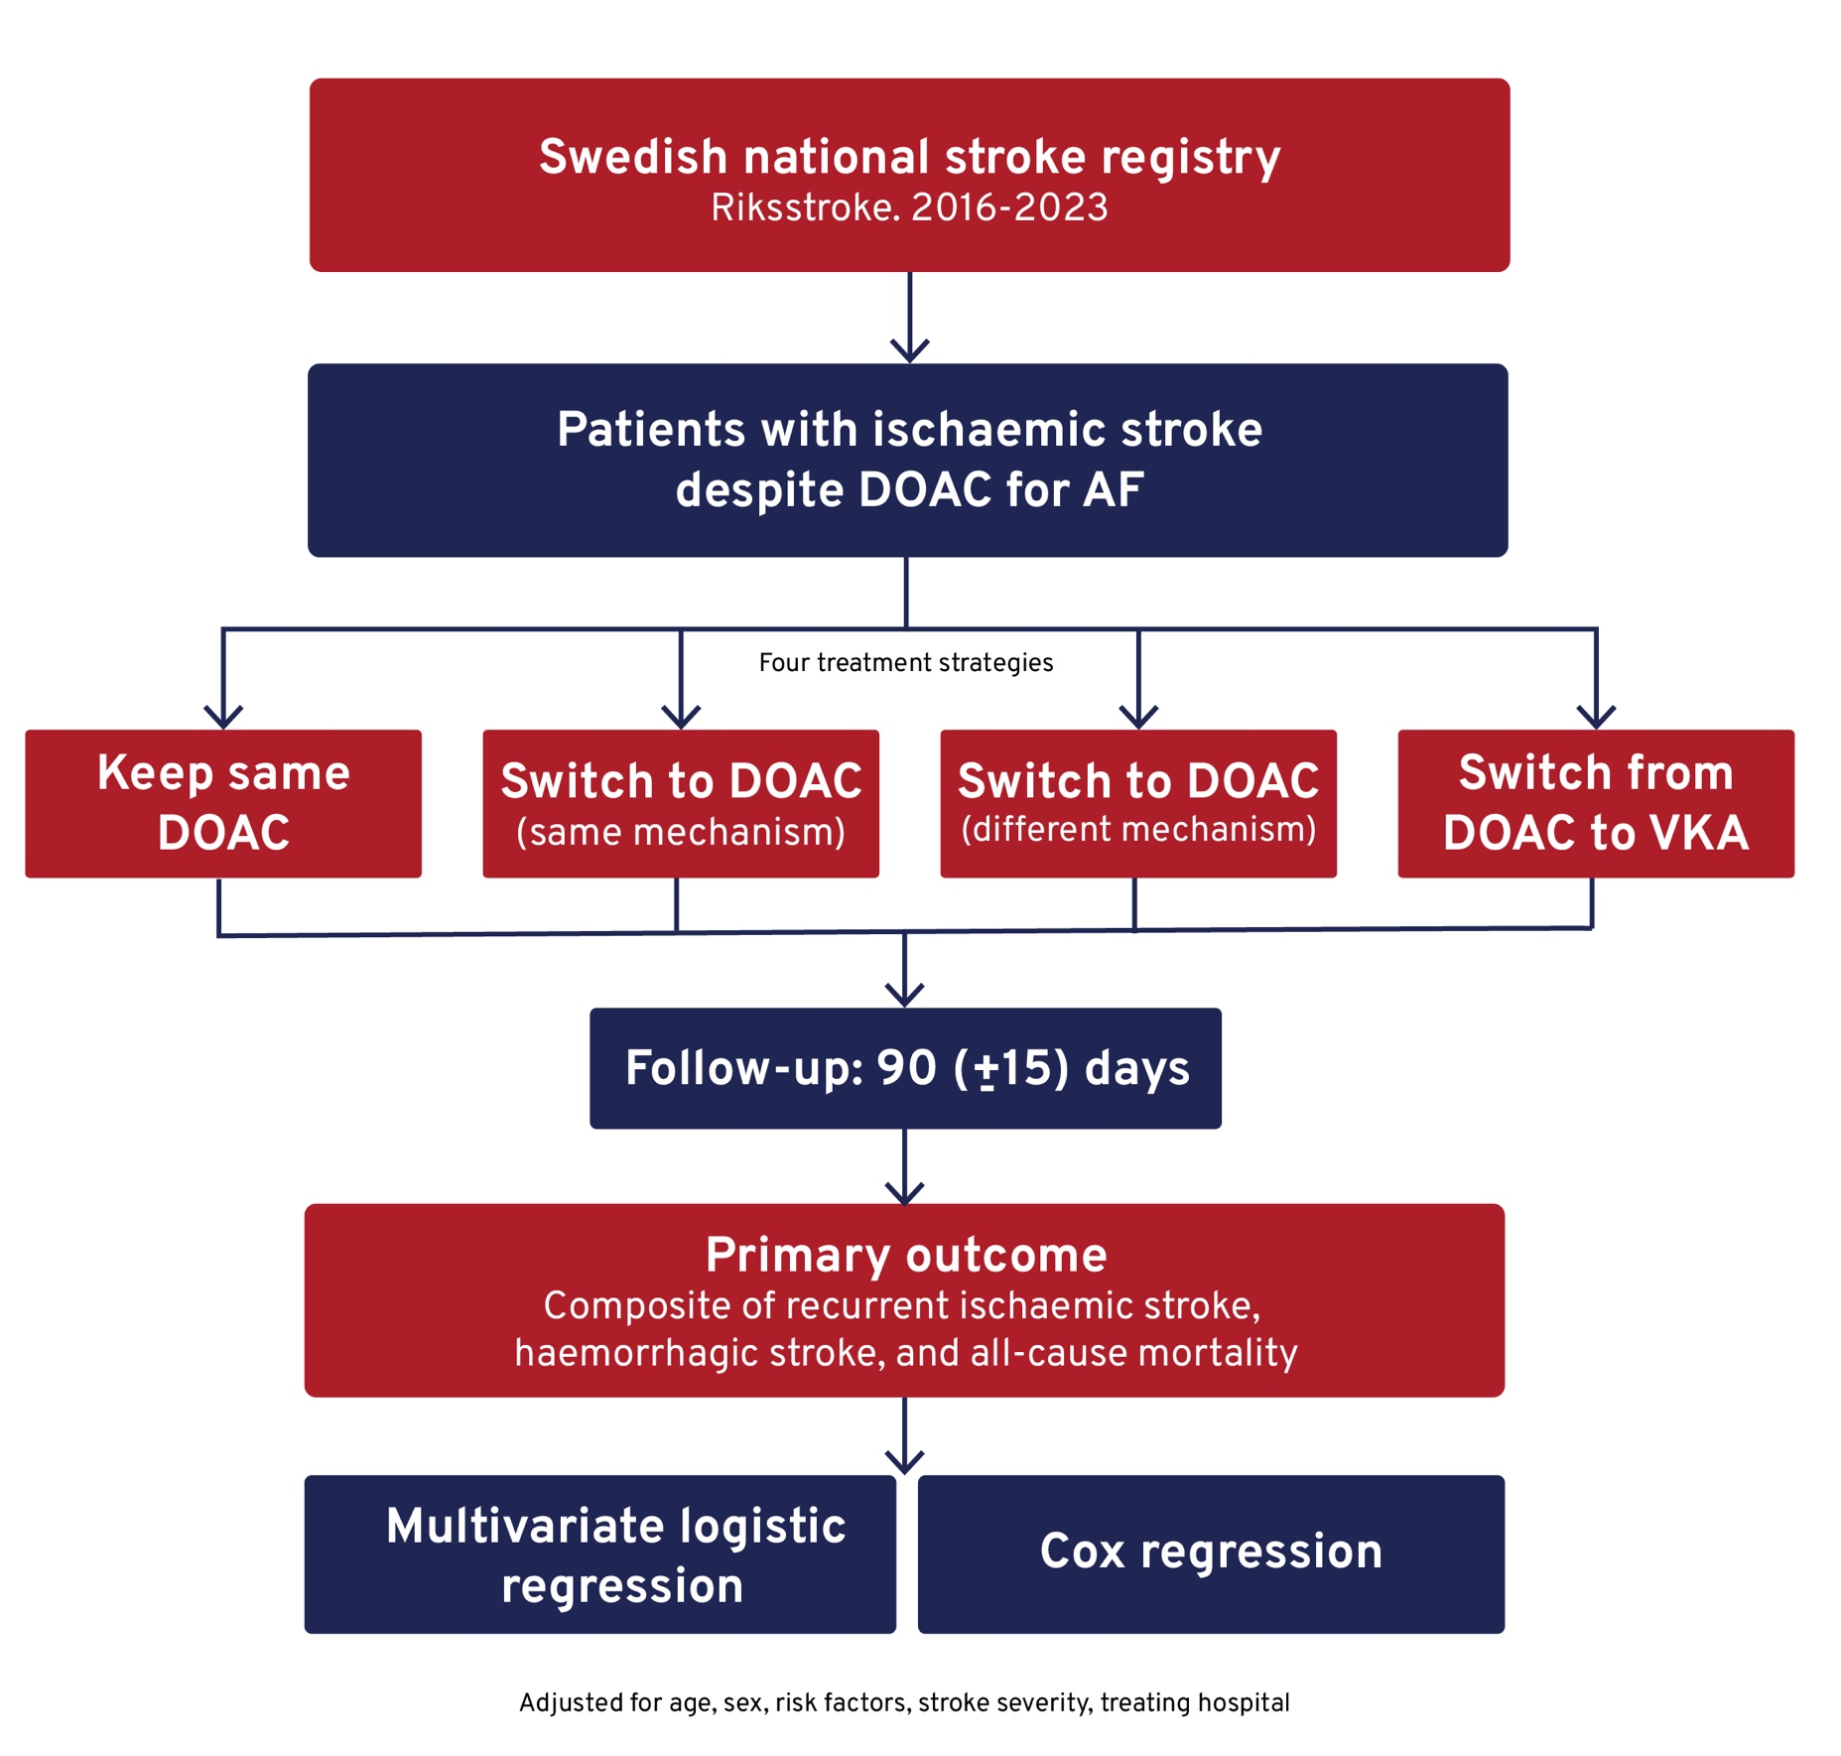
ISCHEMIC STROKE DESPITE PRIMARY PREVENTIVE ORAL ANTICOAGULATION IN ATRIAL FIBRILLATION – A NATIONAL REGISTRY STUDY
Background
Some patients with atrial fibrillation (AF) experience ischaemic stroke despite primary preventive DOAC therapy.
The optimal anticoagulation strategy after such events remains unclear.
Aim
To assess which post-stroke anticoagulation strategy is associated with recurrence-free survival.
Methods
Notes:
Authorship: Hannes Frejd, Michael Mazya, Boris Keselman
Abbreviations: AF, atrial fibrillation; CI, confidence interval; DOAC, direct oral anticoagulant; OR, odds ratio; VKA, vitamin K antagonists.
Abstract Number: ESOC2026A2408
Abstract Title: ISCHEMIC STROKE DESPITE PRIMARY PREVENTIVE ORAL ANTICOAGULATION IN ATRIAL FIBRILLATION – A NATIONAL REGISTRY STUDY
Abstract Category: 05.00 - RISK FACTORS AND PREVENTION (PRIMARY AND SECONDARY) - 05.02 - SECONDARY PREVENTION
Background and aims:
In patients with atrial fibrillation suffering an ischemic stroke despite primary preventive DOAC therapy, several strategies exist for subsequent anticoagulation. We aimed to investigate which strategy is associated with recurrence-free survival.
Methods:
We used data from the Swedish national stroke register Riksstroke on patients with ischemic stroke despite primary preventive DOAC treatment for atrial fibrillation during 2016-23. Patients were divided into four groups: Keeping the same DOAC, Switching to DOACs with the same mechanism, Switching to DOAC with different mechanism or Switching from DOAC to VKA. The primary outcome was the composite of recurrent ischemic stroke, hemorrhagic stroke and all-cause mortality within the follow-up period of 90 (+/- 15) days. Secondary outcomes were these components taken separately. Multivariate logistic regression and Cox regression were used adjusting for age, sex, common stroke risk factors, stroke severity and treating hospital.
Results:
Complete data for anticoagulant choice and follow-up was available in 4466 patients. Compared to keeping the same DOAC the group switching from DOAC to VKA showed a significantly worse primary outcome (adjusted OR 1.98, 95% CI 1.02–3.60, p = 0.032) and secondary outcome regarding mortality (adjusted OR 2.29, 95% CI 1.12–4.33, p = 0.016). The other DOAC switching strategies showed no significant differences versus keeping the same DOAC.
Conclusions:
In this large national registry-based analysis of outcomes in breakthrough ischemic stroke while on DOAC therapy, switching to VKA was associated with worse outcomes compared to keeping the initial DOAC. Further analyses will be performed and reported on long-term follow-up.

Slide 9
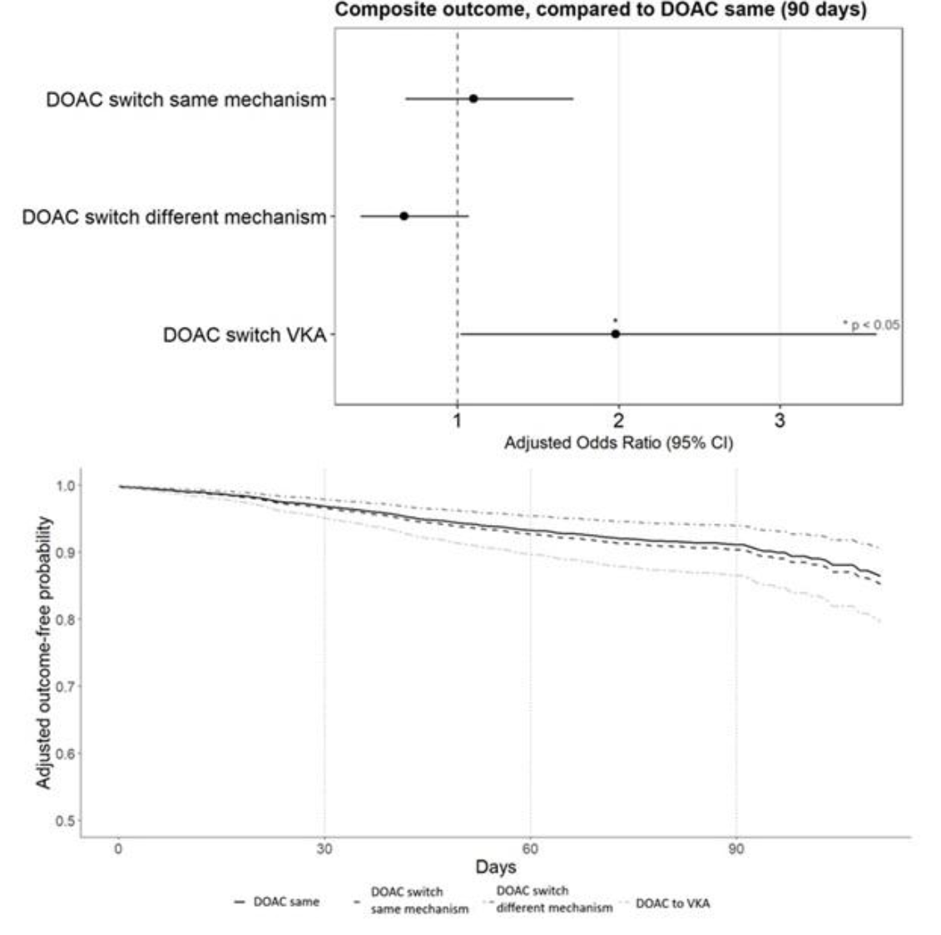
ISCHEMIC STROKE DESPITE PRIMARY PREVENTIVE ORAL ANTICOAGULATION IN ATRIAL FIBRILLATION – A NATIONAL REGISTRY STUDY
Results
N = 4,466 patients with complete data.
Switching from a DOAC to a VKA was associated with worse clinical outcomes, including:
Higher risk of the primary outcome (adjusted OR 1.98; 95% CI 1.02–3.60; p=0.032)
Higher mortality (adjusted OR 2.29; 95% CI 1.12–4.33; p=0.016)
No significant differences were observed for other DOAC switching strategies.
Conclusion
These findings suggest that continuing DOAC may be preferable to switching to VKA after ischaemic stroke.
Notes:
Authorship: Hannes Frejd, Michael Mazya, Boris Keselman
Abbreviations: AF, atrial fibrillation; CI, confidence interval; DOAC, direct oral anticoagulant; OR, odds ratio; VKA, vitamin K antagonists.
Abstract Number: ESOC2026A2408
Abstract Title: ISCHEMIC STROKE DESPITE PRIMARY PREVENTIVE ORAL ANTICOAGULATION IN ATRIAL FIBRILLATION – A NATIONAL REGISTRY STUDY
Abstract Category: 05.00 - RISK FACTORS AND PREVENTION (PRIMARY AND SECONDARY) - 05.02 - SECONDARY PREVENTION
Background and aims:
In patients with atrial fibrillation suffering an ischemic stroke despite primary preventive DOAC therapy, several strategies exist for subsequent anticoagulation. We aimed to investigate which strategy is associated with recurrence-free survival.
Methods:
We used data from the Swedish national stroke register Riksstroke on patients with ischemic stroke despite primary preventive DOAC treatment for atrial fibrillation during 2016-23. Patients were divided into four groups: Keeping the same DOAC, Switching to DOACs with the same mechanism, Switching to DOAC with different mechanism or Switching from DOAC to VKA. The primary outcome was the composite of recurrent ischemic stroke, hemorrhagic stroke and all-cause mortality within the follow-up period of 90 (+/- 15) days. Secondary outcomes were these components taken separately. Multivariate logistic regression and Cox regression were used adjusting for age, sex, common stroke risk factors, stroke severity and treating hospital.
Results:
Complete data for anticoagulant choice and follow-up was available in 4466 patients. Compared to keeping the same DOAC the group switching from DOAC to VKA showed a significantly worse primary outcome (adjusted OR 1.98, 95% CI 1.02–3.60, p = 0.032) and secondary outcome regarding mortality (adjusted OR 2.29, 95% CI 1.12–4.33, p = 0.016). The other DOAC switching strategies showed no significant differences versus keeping the same DOAC.
Conclusions:
In this large national registry-based analysis of outcomes in breakthrough ischemic stroke while on DOAC therapy, switching to VKA was associated with worse outcomes compared to keeping the initial DOAC. Further analyses will be performed and reported on long-term follow-up.

Slide 10
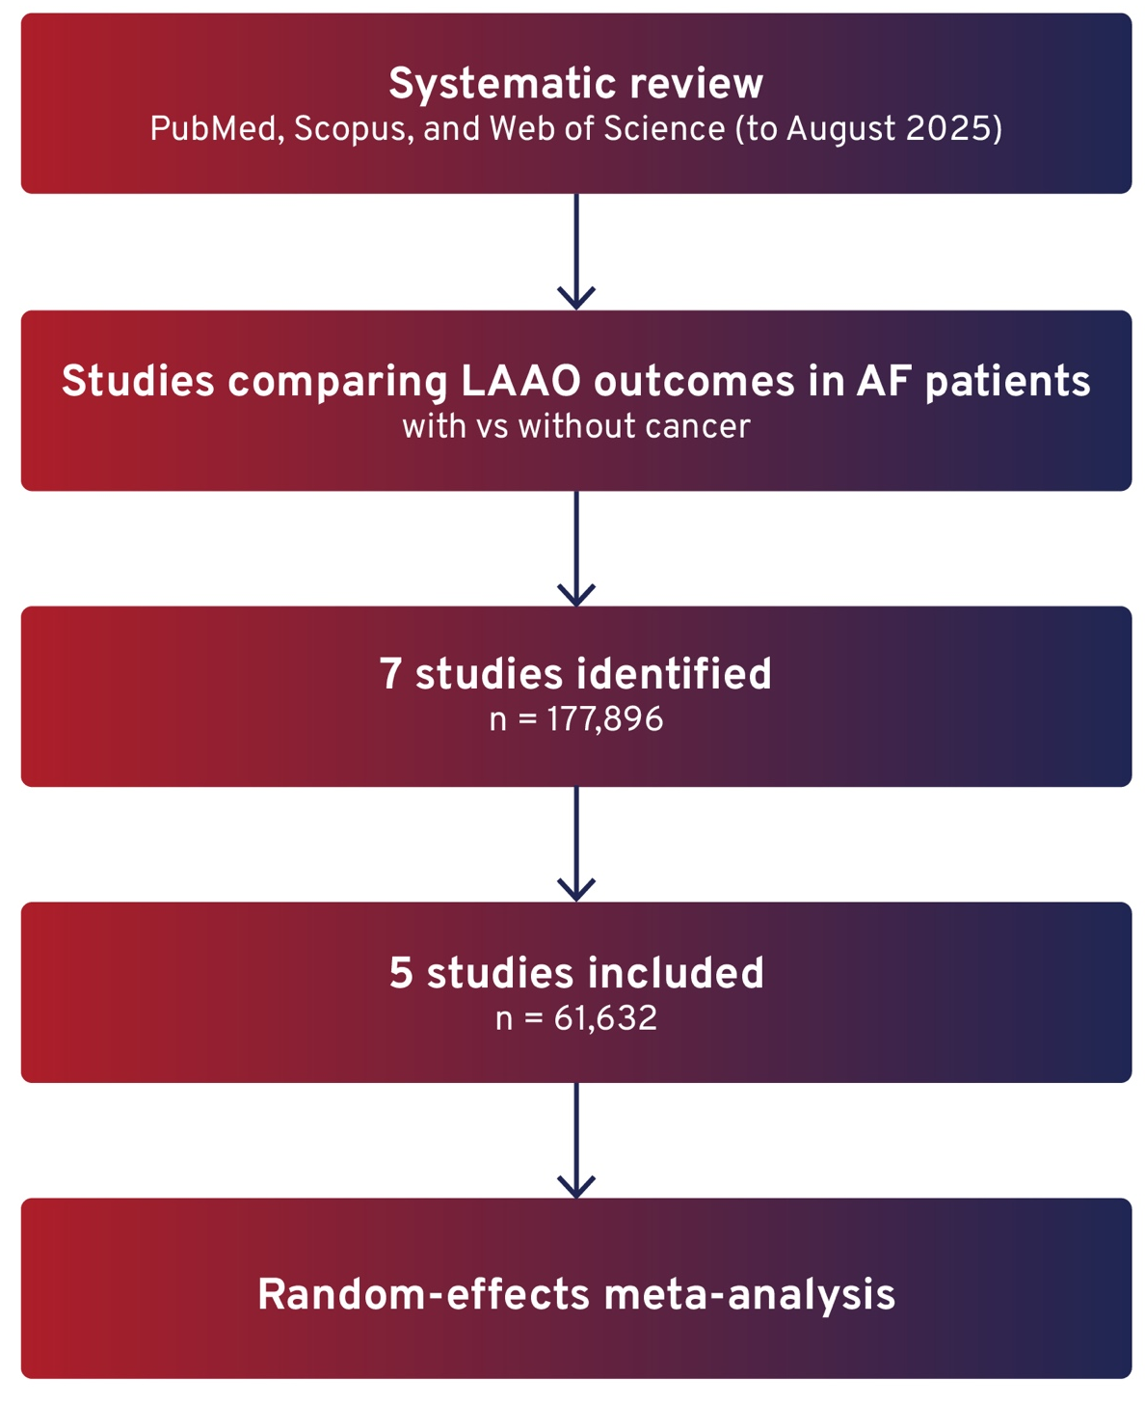
LEFT ATRIAL APPENDAGE OCCLUSION FOR STROKE PREVENTION IN PATIENTS WITH ATRIAL FIBRILLATION AND MALIGNANCY: A SYSTEMATIC REVIEW AND META-ANALYSIS OF 177,896 PATIENTS
Background
Atrial fibrillation (AF) is common in patients with malignancy, creating competing risks of thrombosis and bleeding.
Oral anticoagulation may increase bleeding risk due to cancer-related factors.
Left atrial appendage occlusion (LAAO) is a non-pharmacological alternative, but evidence in this population remains limited.
Aim
To evaluate the safety and efficacy of LAAO for stroke prevention in patients with AF and malignancy.
Methods
Notes:
Authorship: Omar Elkoumi, Ahmed Elkoumi, Mariam Khaled Elbairy, Ahmad Beddor, Mohamed Abdalla Rashed, Abdulqadir J. Nashwan
Abbreviations: AF, atrial fibrillation; CI, confidence interval; LAAO, left atrial appendage occlusion; OR, odds ratio.
Abstract Number: ESOC2026A1020
Abstract Title: LEFT ATRIAL APPENDAGE OCCLUSION FOR STROKE PREVENTION IN PATIENTS WITH ATRIAL FIBRILLATION AND MALIGNANCY: A SYSTEMATIC REVIEW AND META-ANALYSIS OF 177,896 PATIENTS
Abstract Category: 05.00 - RISK FACTORS AND PREVENTION (PRIMARY AND SECONDARY) - 05.02 - SECONDARY PREVENTION
Background and aims:
Atrial fibrillation (AF) is highly prevalent in cancer patients, creating a "competing risk" scenario where prothrombotic states increase stroke risk while malignancy-related factors (thrombocytopenia, mucosal fragility) amplify bleeding risks with oral anticoagulation. Percutaneous left atrial appendage occlusion (LAAO) is a non-pharmacological alternative, yet its safety and efficacy in this high-risk population are not fully established. We aimed to synthesize global evidence on LAAO outcomes in the cardio-oncology population.
Methods:
We searched PubMed, Scopus, and Web of Science through August 2025 for studies comparing LAAO outcomes in AF patients with and without cancer. Quantitative synthesis was performed using random-effects models.
Results:
Seven studies (n=177,896) were included, with five (n=61,632) contributing to the meta-analysis. LAAO demonstrated comparable stroke prevention in cancer versus non-cancer cohorts (OR 0.74; 95% CI, 0.41–1.34; p=0.32). While overall bleeding risk appeared similar (p=0.08), sensitivity analysis excluding a single large dataset revealed an increased risk in cancer patients (OR 1.62; 95% CI, 1.02–2.56; p=0.04). Cancer patients faced significantly higher risks of pericardial complications (OR 2.22; p<0.00001) and all-cause mortality (HR 1.57; p=0.002). Mortality likely reflects underlying oncological prognosis rather than procedural failure.
Conclusions:
LAAO provides effective stroke prevention for cancer patients with AF, achieving ischemic outcomes comparable to the general population. However, the increased risk of procedural complications and mortality necessitates meticulous patient selection and specialized periprocedural care in this complex cardio-oncology population.

Slide 11
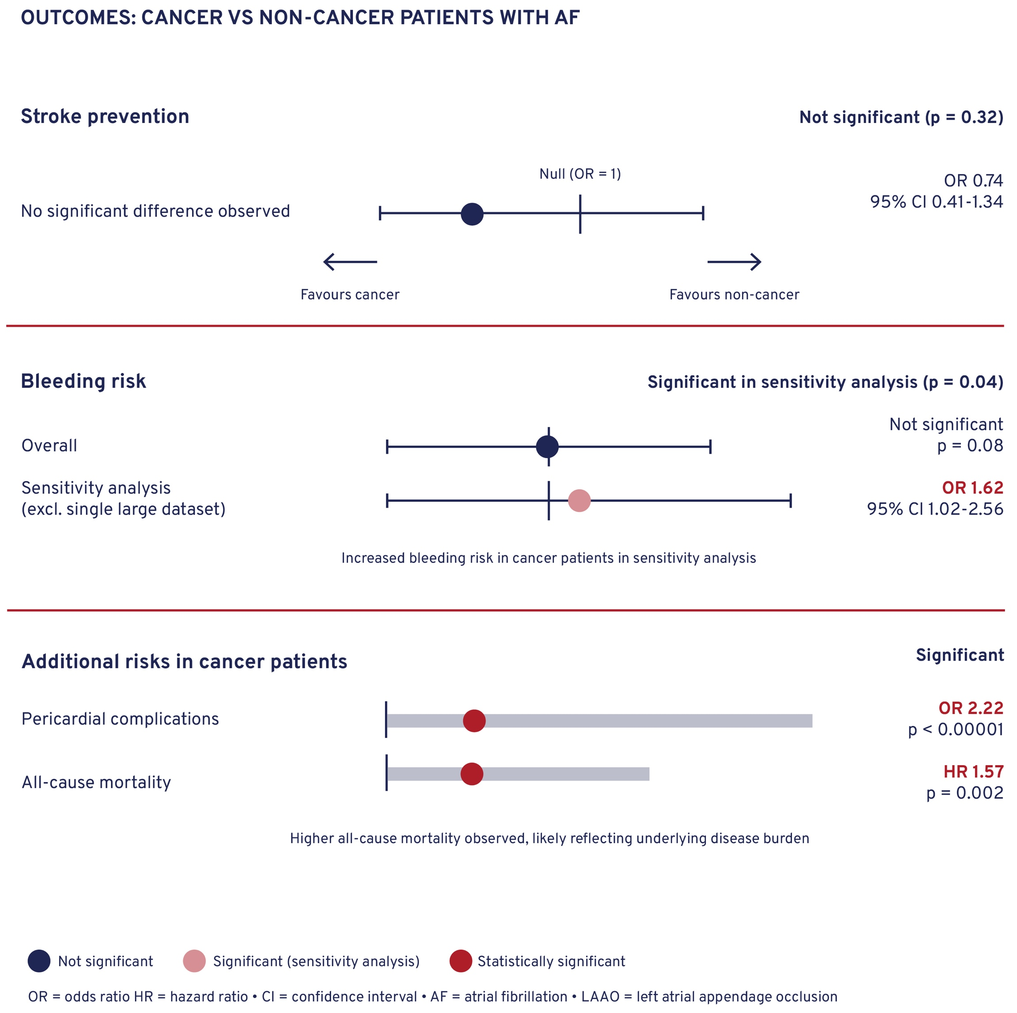
LEFT ATRIAL APPENDAGE OCCLUSION FOR STROKE PREVENTION IN PATIENTS WITH ATRIAL FIBRILLATION AND MALIGNANCY: A SYSTEMATIC REVIEW AND META-ANALYSIS OF 177,896 PATIENTS
Results
Conclusion
LAAO provides comparable stroke prevention in AF patients with malignancy.
However, higher risks of complications and mortality highlight the need for careful patient selection and specialised care.
Notes:
Authorship: Omar Elkoumi, Ahmed Elkoumi, Mariam Khaled Elbairy, Ahmad Beddor, Mohamed Abdalla Rashed, Abdulqadir J. Nashwan
Abbreviations: AF, atrial fibrillation; CI, confidence interval; LAAO, left atrial appendage occlusion; OR, odds ratio.
Abstract Number: ESOC2026A1020
Abstract Title: LEFT ATRIAL APPENDAGE OCCLUSION FOR STROKE PREVENTION IN PATIENTS WITH ATRIAL FIBRILLATION AND MALIGNANCY: A SYSTEMATIC REVIEW AND META-ANALYSIS OF 177,896 PATIENTS
Abstract Category: 05.00 - RISK FACTORS AND PREVENTION (PRIMARY AND SECONDARY) - 05.02 - SECONDARY PREVENTION
Background and aims:
Atrial fibrillation (AF) is highly prevalent in cancer patients, creating a "competing risk" scenario where prothrombotic states increase stroke risk while malignancy-related factors (thrombocytopenia, mucosal fragility) amplify bleeding risks with oral anticoagulation. Percutaneous left atrial appendage occlusion (LAAO) is a non-pharmacological alternative, yet its safety and efficacy in this high-risk population are not fully established. We aimed to synthesize global evidence on LAAO outcomes in the cardio-oncology population.
Methods:
We searched PubMed, Scopus, and Web of Science through August 2025 for studies comparing LAAO outcomes in AF patients with and without cancer. Quantitative synthesis was performed using random-effects models.
Results:
Seven studies (n=177,896) were included, with five (n=61,632) contributing to the meta-analysis. LAAO demonstrated comparable stroke prevention in cancer versus non-cancer cohorts (OR 0.74; 95% CI, 0.41–1.34; p=0.32). While overall bleeding risk appeared similar (p=0.08), sensitivity analysis excluding a single large dataset revealed an increased risk in cancer patients (OR 1.62; 95% CI, 1.02–2.56; p=0.04). Cancer patients faced significantly higher risks of pericardial complications (OR 2.22; p<0.00001) and all-cause mortality (HR 1.57; p=0.002). Mortality likely reflects underlying oncological prognosis rather than procedural failure.
Conclusions:
LAAO provides effective stroke prevention for cancer patients with AF, achieving ischemic outcomes comparable to the general population. However, the increased risk of procedural complications and mortality necessitates meticulous patient selection and specialized periprocedural care in this complex cardio-oncology population.

Slide 12
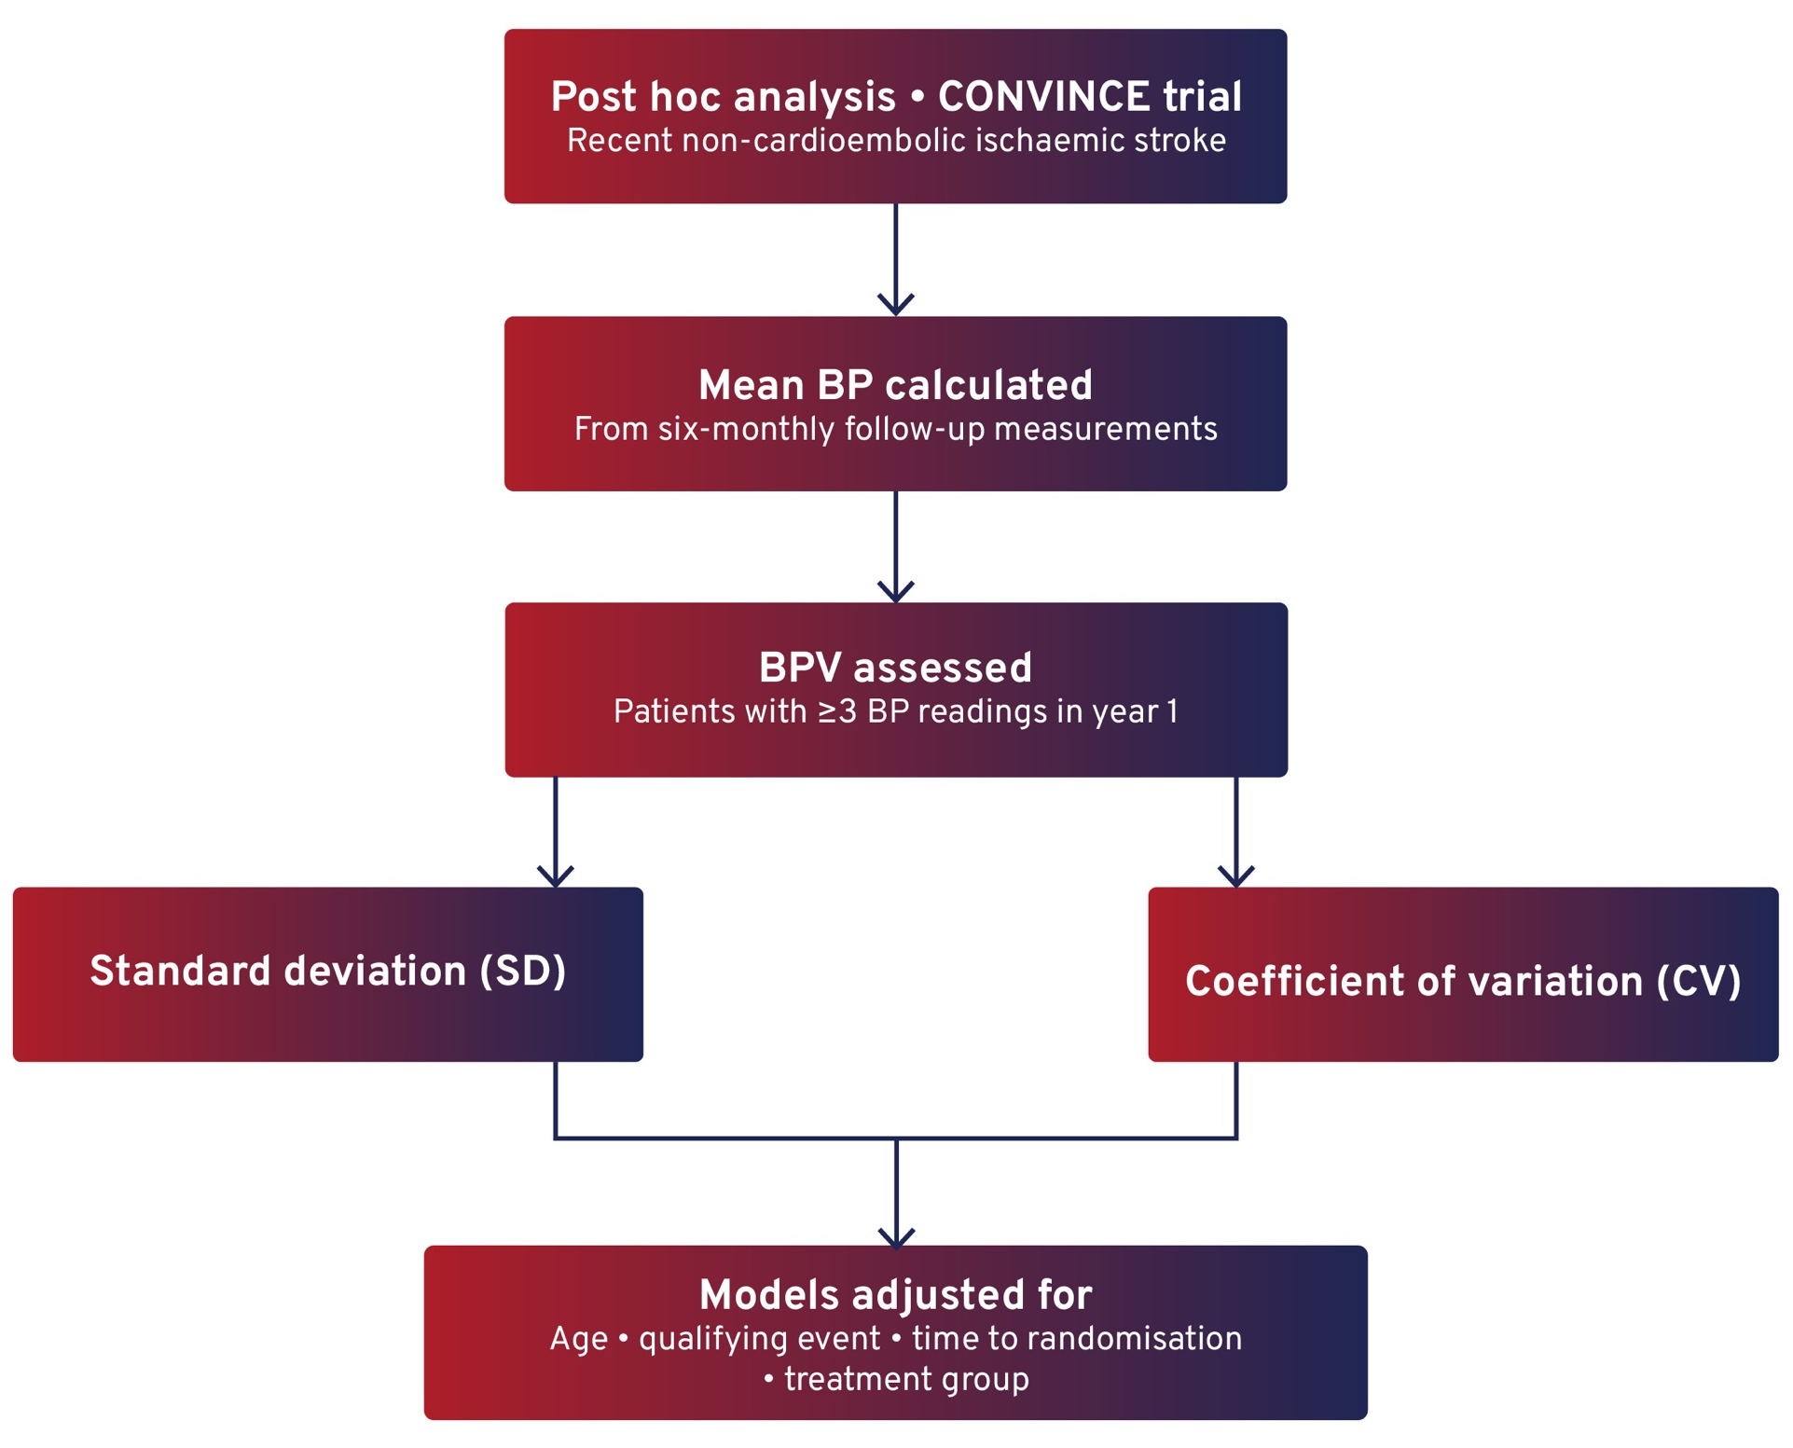
THE RELATIONSHIP BETWEEN ACHIEVED BLOOD PRESSURE AND BLOOD PRESSURE VARIABILITY WITH RECURRENT VASCULAR EVENTS IN THE CONVINCE TRIAL POPULATION
Background
Blood pressure variability (BPV) has been associated with recurrent stroke and major cardiovascular events (MACE).
However, contemporary data from large trial populations remain limited.
Aim
To assess the relationship between achieved blood pressure and BPV with recurrent vascular events and stroke in the CONVINCE trial population.
Methods
Notes:
Authorship: Pádraig Synnott, Cathal Walsh, Chris Price, Robin Lemmens, Christian Weimar, Francisco Purroy, Christina Kruuse, Urs Fischer, Ana Catarina Fonseca, Peter Kelly
Abbreviations: BP, blood pressure; BPV, blood pressure variability; CI, confidence interval; CV, coefficient of variation; DBP, diastolic blood pressure; HR, hazard ratio; MACE, major cardiovascular events; SD, standard deviation; SBP, systolic blood pressure.
Abstract Number: ESOC2026A2198
Abstract Title: THE RELATIONSHIP BETWEEN ACHIEVED BLOOD PRESSURE AND BLOOD PRESSURE VARIABILITY WITH RECURRENT VASCULAR EVENTS IN THE CONVINCE TRIAL POPULATION
Abstract Category: 05.00 - RISK FACTORS AND PREVENTION (PRIMARY AND SECONDARY) - 05.02 - SECONDARY PREVENTION
Background and aims:
Previous studies have proposed an association between BP variability (BPV) and recurrent stroke and major cardiovascular events (MACE) following ischaemic stroke. However, few recent data from large studies exist. We examined the association between mean BP and BPV during follow-up with recurrent vascular events and recurrent stroke in the CONVINCE trial, which randomised participants with recent non-cardioembolic ischaemic stroke to long term colchicine 0.5mg daily or usual care.
Methods:
Mean BP during follow-up was calculated using all available post-randomisation BP readings recorded at six-monthly trial visits. Analysis of BPV was conducted for all participants with ≥3 BP readings during the first year of follow-up. BPV was measured as standard deviation (SD) and coefficient of variation (CV), adjusting for age, qualifying event, time from qualifying event to randomisation and treatment group.
Results:
Amongst 2919 participants with post-randomisation BP readings, no association was observed between mean SBP or mean DBP during follow-up and recurrent vascular events or recurrent stroke. In 1629 participants who met pre-specified criteria for BPV analysis, on multivariate analysis of 174 events, each 10-point increase in SD of systolic BPV was associated with a one-fifth increased risk of MACE (adjusted HR 1.22, 95% CI 1.02-1.46, p=0.032). Similar findings were observed for BPV measured as CV (adjusted HR 1.34, 95% CI 1.02-1.75, p=0.035). There were no associations with recurrent stroke.
Conclusions:
Significant associations existed between BPV and vascular events in the CONVINCE trial population, highlighting the importance of further investigation into BPV as a target for secondary prevention.

Slide 13

THE RELATIONSHIP BETWEEN ACHIEVED BLOOD PRESSURE AND BLOOD PRESSURE VARIABILITY WITH RECURRENT VASCULAR EVENTS IN THE CONVINCE TRIAL POPULATION
Results
Post-randomisation blood pressure data were analysed, comparing mean BP and BP variability (BPV) in relation to outcomes.
Conclusion
Higher BP variability was associated with increased risk of vascular events.
Findings support further investigation of BPV as a potential target for secondary prevention.
Notes:
Authorship: Pádraig Synnott, Cathal Walsh, Chris Price, Robin Lemmens, Christian Weimar, Francisco Purroy, Christina Kruuse, Urs Fischer, Ana Catarina Fonseca, Peter Kelly
Abbreviations: BP, blood pressure; BPV, blood pressure variability; CI, confidence interval; CV, coefficient of variation; DBP, diastolic blood pressure; HR, hazard ratio; MACE, major cardiovascular events; SD, standard deviation; SBP, systolic blood pressure.
Abstract Number: ESOC2026A2198
Abstract Title: THE RELATIONSHIP BETWEEN ACHIEVED BLOOD PRESSURE AND BLOOD PRESSURE VARIABILITY WITH RECURRENT VASCULAR EVENTS IN THE CONVINCE TRIAL POPULATION
Abstract Category: 05.00 - RISK FACTORS AND PREVENTION (PRIMARY AND SECONDARY) - 05.02 - SECONDARY PREVENTION
Background and aims:
Previous studies have proposed an association between BP variability (BPV) and recurrent stroke and major cardiovascular events (MACE) following ischaemic stroke. However, few recent data from large studies exist. We examined the association between mean BP and BPV during follow-up with recurrent vascular events and recurrent stroke in the CONVINCE trial, which randomised participants with recent non-cardioembolic ischaemic stroke to long term colchicine 0.5mg daily or usual care.
Methods:
Mean BP during follow-up was calculated using all available post-randomisation BP readings recorded at six-monthly trial visits. Analysis of BPV was conducted for all participants with ≥3 BP readings during the first year of follow-up. BPV was measured as standard deviation (SD) and coefficient of variation (CV), adjusting for age, qualifying event, time from qualifying event to randomisation and treatment group.
Results:
Amongst 2919 participants with post-randomisation BP readings, no association was observed between mean SBP or mean DBP during follow-up and recurrent vascular events or recurrent stroke. In 1629 participants who met pre-specified criteria for BPV analysis, on multivariate analysis of 174 events, each 10-point increase in SD of systolic BPV was associated with a one-fifth increased risk of MACE (adjusted HR 1.22, 95% CI 1.02-1.46, p=0.032). Similar findings were observed for BPV measured as CV (adjusted HR 1.34, 95% CI 1.02-1.75, p=0.035). There were no associations with recurrent stroke.
Conclusions:
Significant associations existed between BPV and vascular events in the CONVINCE trial population, highlighting the importance of further investigation into BPV as a target for secondary prevention.

Slide 14
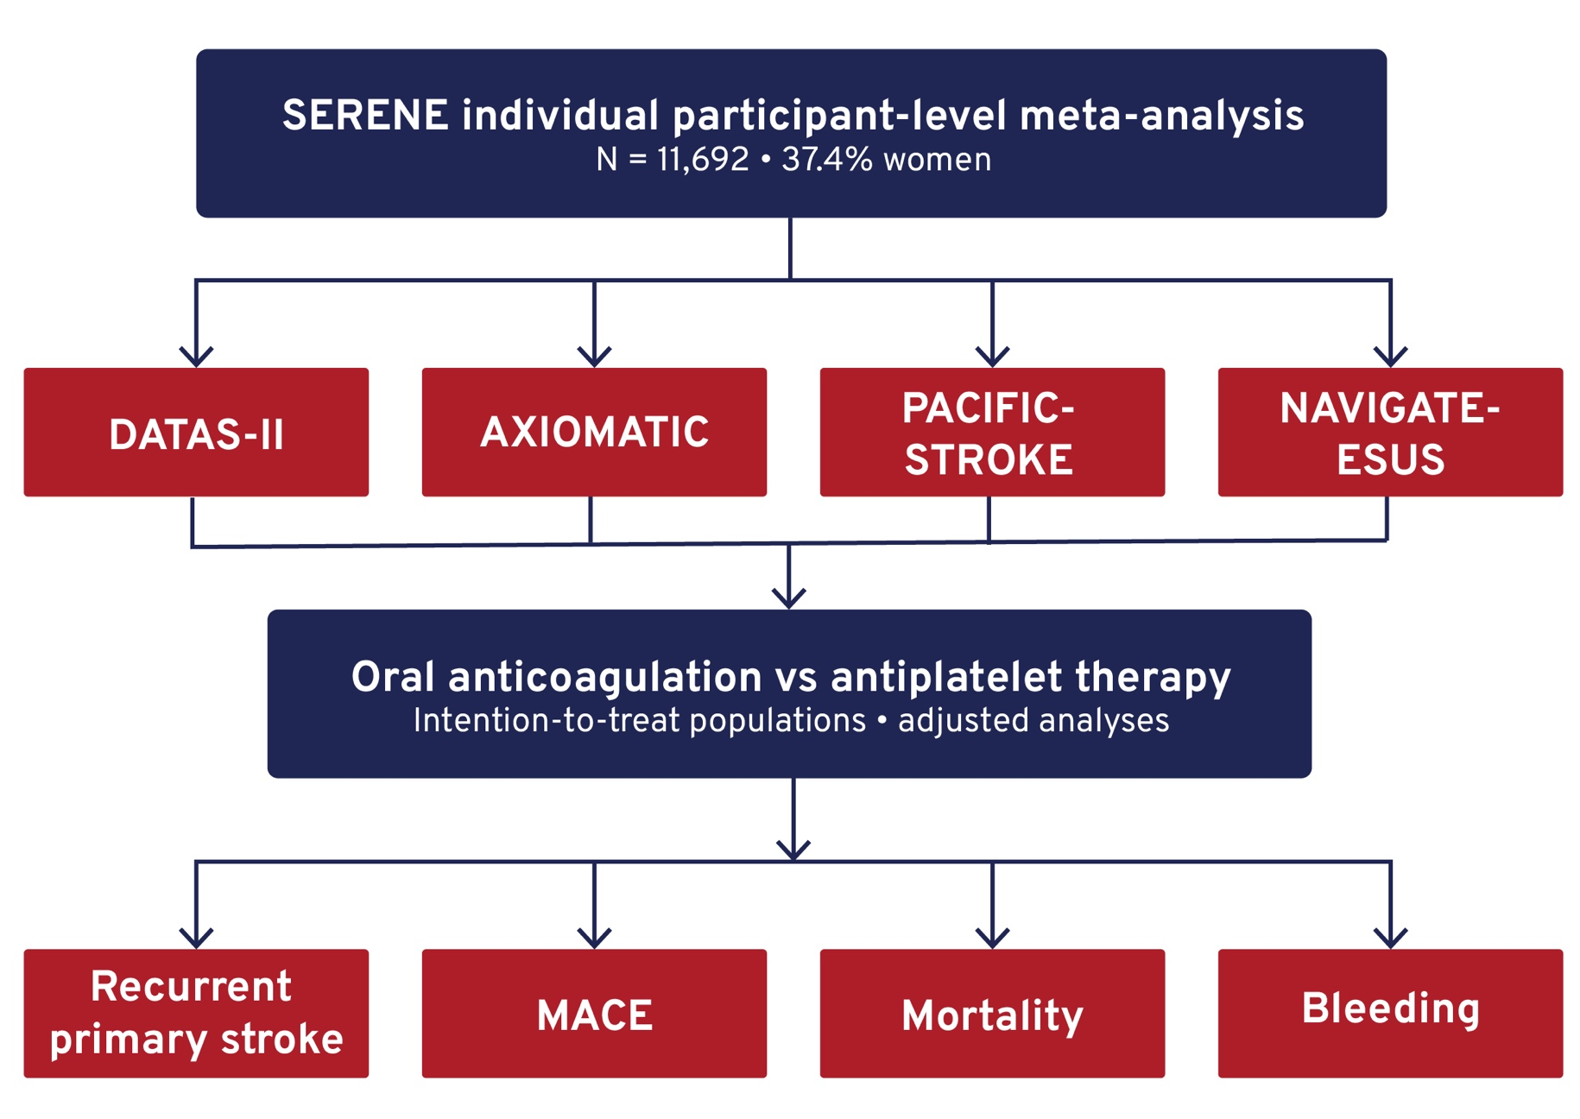
STROKE PREVENTION IN WOMEN (SERENE): AN INDIVIDUAL PATIENT DATA LEVEL META-ANALYSIS OF FOUR RANDOMIZED CONTROLLED TRIALS ON SECONDARY STROKE PREVENTION IN WOMEN
Background
Women experience worse outcomes after stroke, but evidence guiding optimal secondary stroke prevention (SSP) remains limited.
Sex-specific differences in recurrent risk and treatment response are not well established.
Aim
To evaluate sex-specific risks of recurrent stroke and potential differences in antithrombotic treatment effects.
Methods
Notes:
Authorship: Luciana Catanese, Abhilekh Srivastava, Angela Wang, Emillee York, Amanda Taylor, Lizhen Xu, Ariesteidis Katsanos, Mukul Sharma, Ashkan Shoamanesh, Kanjana Perera
Abbreviations: CAD, coronary artery disease; CI, confidence interval; HR, hazard ratio; MACE, major adverse cardiovascular events; PAD, peripheral arterial disease; SSP, secondary stroke prevention.
Abstract Number: ESOC2026A2114
Abstract Title: STROKE PREVENTION IN WOMEN (SERENE): AN INDIVIDUAL PATIENT DATA LEVEL META-ANALYSIS OF FOUR RANDOMIZED CONTROLLED TRIALS ON SECONDARY STROKE PREVENTION IN WOMEN
Abstract Category: 05.00 - RISK FACTORS AND PREVENTION (PRIMARY AND SECONDARY) - 05.02 - SECONDARY PREVENTION
Background and aims:
Women experience worse outcomes after stroke than men. Evidence guiding optimal secondary stroke prevention (SSP) in women remains limited. Using individual patient data from large randomized SSP trials, we evaluated gender-specific risks of recurrent stroke and the potential heterogeneity in antithrombotic treatment effects.
Methods:
SERENE is an individual participant–level meta-analysis of four randomized trials comparing oral anticoagulation with antiplatelet therapy for SSP (DATAS-II, AXIOMATIC, PACIFIC-STROKE, and NAVIGATE-ESUS). The primary outcome was recurrent stroke in women versus men; secondary outcomes included all-cause mortality, major adverse cardiovascular events (MACE), and bleeding. Analyses were adjusted for confounders and were performed on the intention-to-treat populations.
Results:
Among 11,692 patients (37.4% women), 58.4%, anticoagulation and 42.2% received antiplatelets. Women were older, more hypertensive, smoked less, and had less CAD and PAD than men. Over a median follow-up of 7.9 months, women had lower rates of recurrent stroke (4.24% vs. 5.37%; HR 0.83, 95% CI 0.68–0.96; p=0.014) and MACE (4.97% vs. 6.36%; HR 0.80, 95% CI 0.68–0.93; p<0.01) compared with men, with no differences in all-cause mortality or major bleeding. Women experienced fewer ischemic (HR 0.83, 95% CI 0.70–1.00; p=0.045) and hemorrhagic strokes (HR 0.19, 95% CI 0.04–0.81; p=0.02). Gender differences in these outcomes were consistent across antithrombotic treatment strategies, and no heterogeneity in treatment effect was observed.
Conclusions:
In a large cohort of SSP trials, women demonstrated lower rates of recurrent stroke and MACE than men, with no differences in mortality or bleeding. These findings were consistent across antithrombotic strategies.

Slide 15
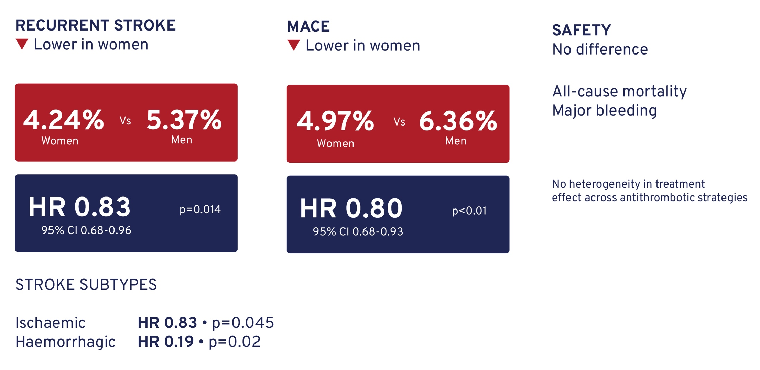
STROKE PREVENTION IN WOMEN (SERENE): AN INDIVIDUAL PATIENT DATA LEVEL META-ANALYSIS OF FOUR RANDOMIZED CONTROLLED TRIALS ON SECONDARY STROKE PREVENTION IN WOMEN
Results
Conclusion
Women had lower rates of recurrent stroke and MACE compared with men.
Outcomes were consistent across antithrombotic strategies, with no differences in mortality or bleeding.
Notes:
Authorship: Luciana Catanese, Abhilekh Srivastava, Angela Wang, Emillee York, Amanda Taylor, Lizhen Xu, Ariesteidis Katsanos, Mukul Sharma, Ashkan Shoamanesh, Kanjana Perera
Abbreviations: CAD, coronary artery disease; CI, confidence interval; HR, hazard ratio; MACE, major adverse cardiovascular events; PAD, peripheral arterial disease; SSP, secondary stroke prevention.
Abstract Number: ESOC2026A2114
Abstract Title: STROKE PREVENTION IN WOMEN (SERENE): AN INDIVIDUAL PATIENT DATA LEVEL META-ANALYSIS OF FOUR RANDOMIZED CONTROLLED TRIALS ON SECONDARY STROKE PREVENTION IN WOMEN
Abstract Category: 05.00 - RISK FACTORS AND PREVENTION (PRIMARY AND SECONDARY) - 05.02 - SECONDARY PREVENTION
Background and aims:
Women experience worse outcomes after stroke than men. Evidence guiding optimal secondary stroke prevention (SSP) in women remains limited. Using individual patient data from large randomized SSP trials, we evaluated gender-specific risks of recurrent stroke and the potential heterogeneity in antithrombotic treatment effects.
Methods:
SERENE is an individual participant–level meta-analysis of four randomized trials comparing oral anticoagulation with antiplatelet therapy for SSP (DATAS-II, AXIOMATIC, PACIFIC-STROKE, and NAVIGATE-ESUS). The primary outcome was recurrent stroke in women versus men; secondary outcomes included all-cause mortality, major adverse cardiovascular events (MACE), and bleeding. Analyses were adjusted for confounders and were performed on the intention-to-treat populations.
Results:
Among 11,692 patients (37.4% women), 58.4%, anticoagulation and 42.2% received antiplatelets. Women were older, more hypertensive, smoked less, and had less CAD and PAD than men. Over a median follow-up of 7.9 months, women had lower rates of recurrent stroke (4.24% vs. 5.37%; HR 0.83, 95% CI 0.68–0.96; p=0.014) and MACE (4.97% vs. 6.36%; HR 0.80, 95% CI 0.68–0.93; p<0.01) compared with men, with no differences in all-cause mortality or major bleeding. Women experienced fewer ischemic (HR 0.83, 95% CI 0.70–1.00; p=0.045) and hemorrhagic strokes (HR 0.19, 95% CI 0.04–0.81; p=0.02). Gender differences in these outcomes were consistent across antithrombotic treatment strategies, and no heterogeneity in treatment effect was observed.
Conclusions:
In a large cohort of SSP trials, women demonstrated lower rates of recurrent stroke and MACE than men, with no differences in mortality or bleeding. These findings were consistent across antithrombotic strategies.

Slide 16
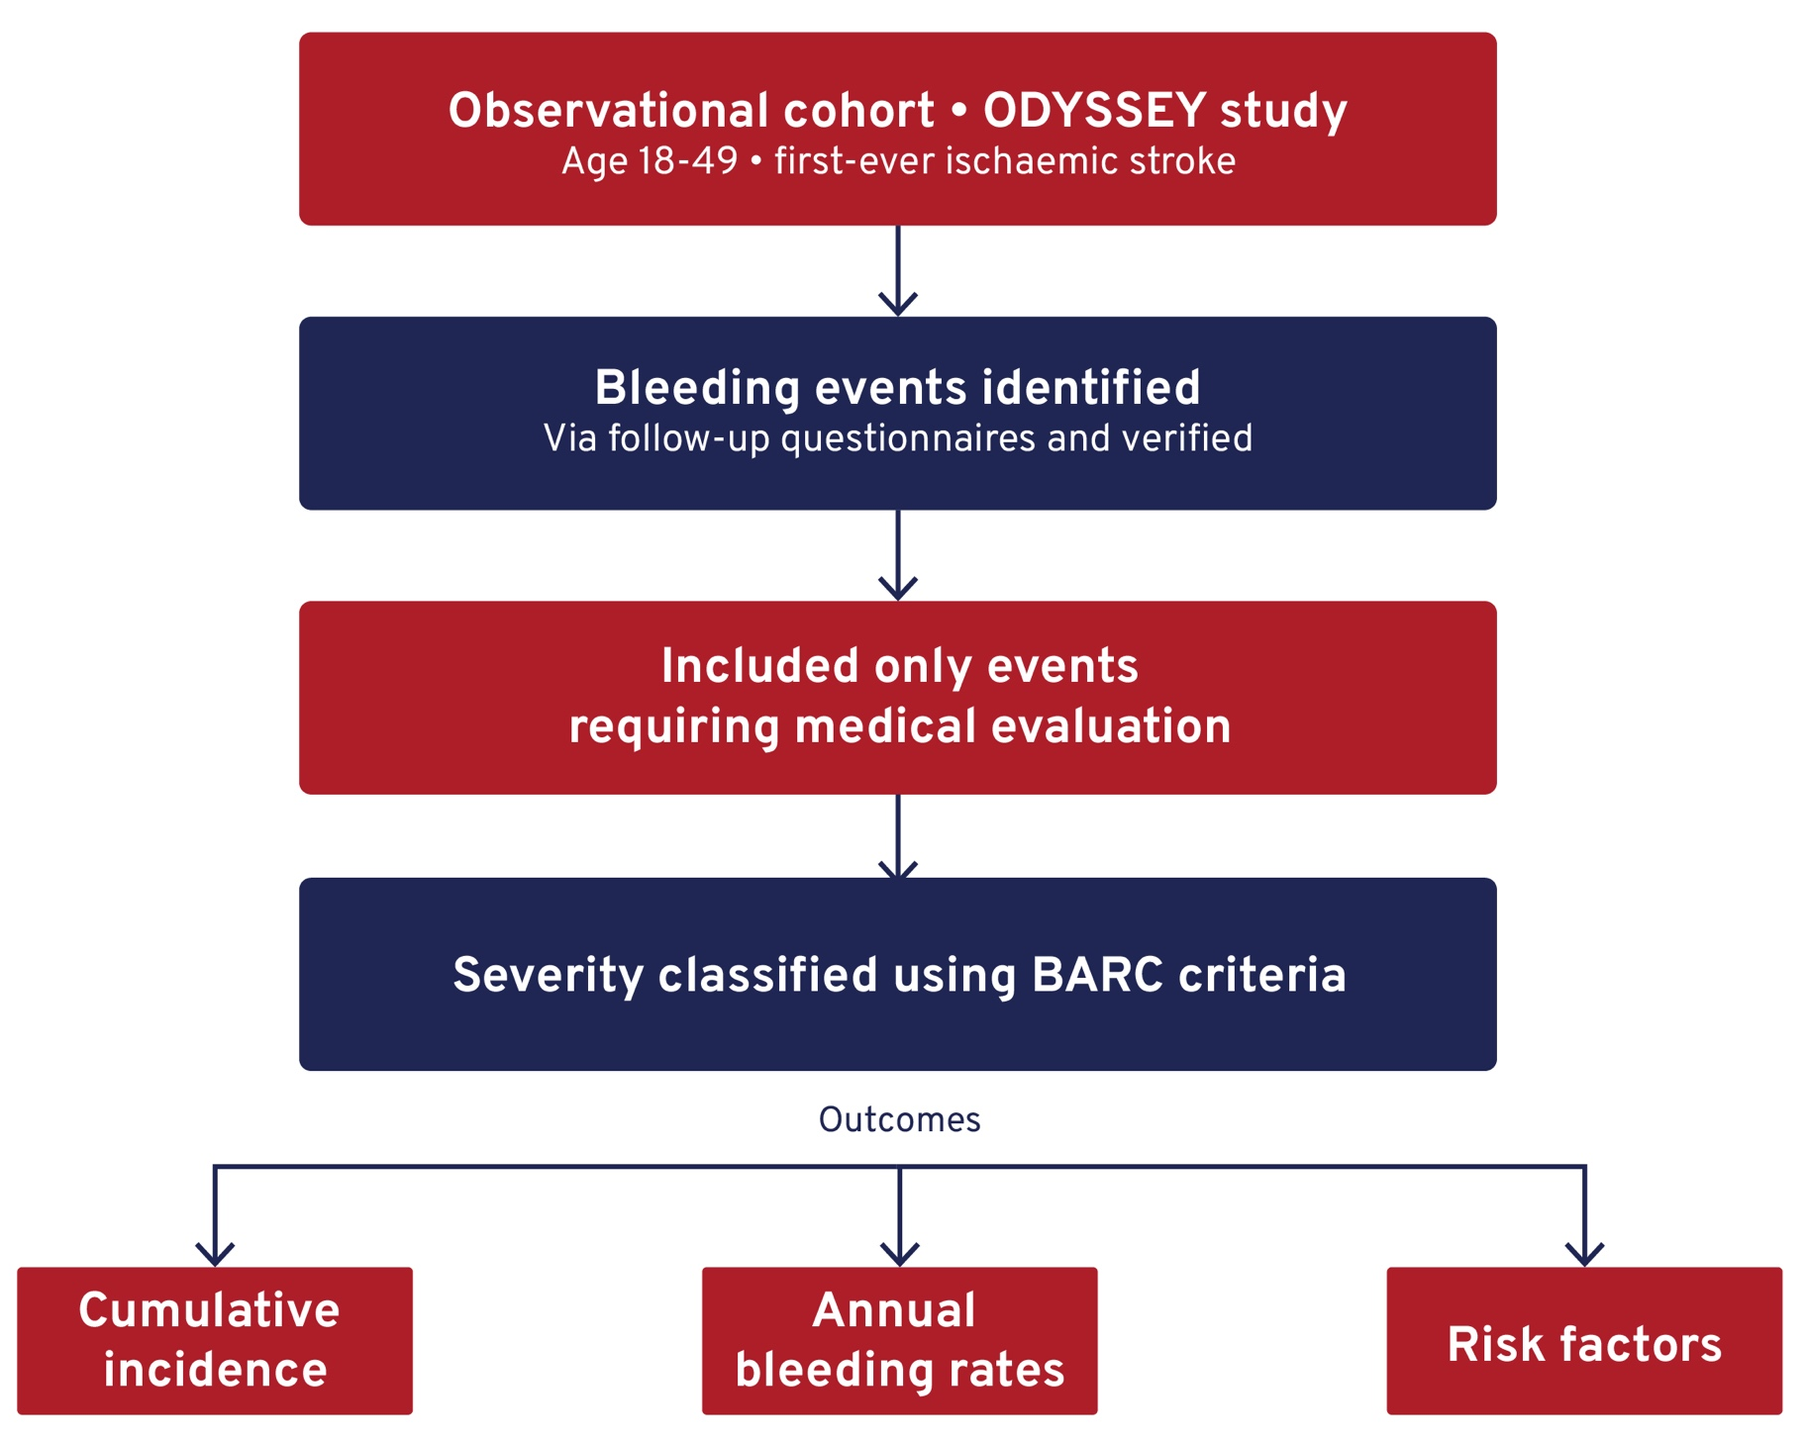
BALANCING BENEFITS AND RISKS: LONG-TERM BLEEDING COMPLICATIONS IN YOUNG ADULTS AFTER ISCHEMIC STROKE OR TIA
Background
Antithrombotic therapy is routinely used after ischaemic stroke to prevent recurrence.
In young adults, the long-term balance between benefit and bleeding risk remains uncertain.
Aim
To evaluate the long-term bleeding risk associated with antithrombotic therapy in young stroke survivors.
Methods
Notes:
Authorship: Anne Rasing, Edo Richard, Frank-Erik De Leeuw, Nina Hilkens, on Behalf of the Odyssey Investigators
Abbreviations: BARC, Bleeding Academic Research Consortium; CI, confidence interval; HR, hazard ratio; IQR, interquartile range; ODYSSEY, Observational Dutch Young Symptomatic StrokE study.
Abstract Number: ESOC2026A1458
Abstract Title: BALANCING BENEFITS AND RISKS: LONG-TERM BLEEDING COMPLICATIONS IN YOUNG ADULTS AFTER ISCHEMIC STROKE OR TIA
Abstract Category: 05.00 - RISK FACTORS AND PREVENTION (PRIMARY AND SECONDARY) - 05.02 - SECONDARY PREVENTION
Background and aims:
Antithrombotic therapy is routinely prescribed to young adults after ischemic stroke to prevent recurrent vascular events. Whether the long-term benefit-risk balance of antithrombotic therapy is favorable in young patients, remains unknown. We investigated the long-term risk of bleeding associated with antithrombotic therapy in young stroke survivors.
Methods:
We included patients aged 18-49 years with a first-ever ischemic stroke from the Observational Dutch Young Symptomatic StrokE studY (ODYSSEY). Bleeding events were identified through standardized follow-up questionnaires, with subsequent verification. Only bleeding events requiring medical evaluation were included. Bleeding severity was classified according to the Bleeding Academic Research Consortium (BARC) criteria. We assessed cumulative incidence, annual bleeding rates and associated risk factors.
Results:
1,226 patients were included (median age 44 years [38-48]; 52% male), with a median follow-up of 4.22 years [IQR 2.22-5.87]. During follow-up, 129 patients experienced at least one bleeding event, corresponding to a five-year cumulative risk of 10.7%. The annual bleeding rate was 2.52 per 100 person-years. Bleeding events were most frequently gynecologic (55.8%) and gastrointestinal (21.7%). Female sex (HR 3.39; CI 2.29-5.01), cardioembolic etiology (HR 2.17; CI 1.27-3.71), and anticoagulant use (HR 3.07; CI 1.24-7.65) were associated with increased bleeding risk.
Conclusions:
Young stroke survivors face a substantial long-term risk of bleeding while receiving antithrombotic therapy. These findings underscore the need to carefully weigh bleeding risks, as in selected cases, the long-term bleeding risk may exceed the risk of recurrent ischemic events. The ongoing STOP trial will provide further evidence to support individualized risk assessment in young patients with cryptogenic stroke.

Slide 17
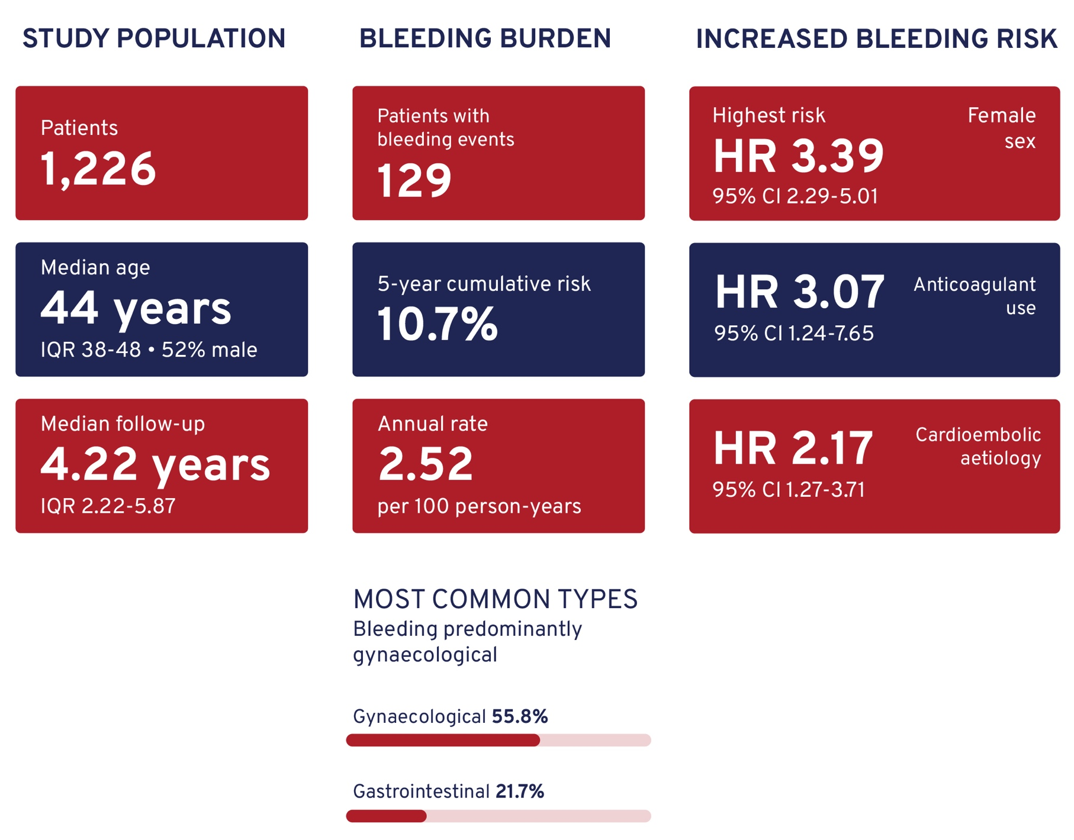
BALANCING BENEFITS AND RISKS: LONG-TERM BLEEDING COMPLICATIONS IN YOUNG ADULTS AFTER ISCHEMIC STROKE OR TIA
Results
Bleeding affected approximately 1 in 10 patients over 5 years and was associated with specific clinical risk factors:
Conclusion
Young stroke survivors face a substantial long-term bleeding risk on antithrombotic therapy.
Findings highlight the importance of individualised risk–benefit assessment, particularly where bleeding risk may outweigh recurrence risk.
Notes:
Authorship: Anne Rasing, Edo Richard, Frank-Erik De Leeuw, Nina Hilkens, on Behalf of the Odyssey Investigators
Abbreviations: BARC, Bleeding Academic Research Consortium; CI, confidence interval; HR, hazard ratio; IQR, interquartile range; ODYSSEY, Observational Dutch Young Symptomatic StrokE study.
Abstract Number: ESOC2026A1458
Abstract Title: BALANCING BENEFITS AND RISKS: LONG-TERM BLEEDING COMPLICATIONS IN YOUNG ADULTS AFTER ISCHEMIC STROKE OR TIA
Abstract Category: 05.00 - RISK FACTORS AND PREVENTION (PRIMARY AND SECONDARY) - 05.02 - SECONDARY PREVENTION
Background and aims:
Antithrombotic therapy is routinely prescribed to young adults after ischemic stroke to prevent recurrent vascular events. Whether the long-term benefit-risk balance of antithrombotic therapy is favorable in young patients, remains unknown. We investigated the long-term risk of bleeding associated with antithrombotic therapy in young stroke survivors.
Methods:
We included patients aged 18-49 years with a first-ever ischemic stroke from the Observational Dutch Young Symptomatic StrokE studY (ODYSSEY). Bleeding events were identified through standardized follow-up questionnaires, with subsequent verification. Only bleeding events requiring medical evaluation were included. Bleeding severity was classified according to the Bleeding Academic Research Consortium (BARC) criteria. We assessed cumulative incidence, annual bleeding rates and associated risk factors.
Results:
1,226 patients were included (median age 44 years [38-48]; 52% male), with a median follow-up of 4.22 years [IQR 2.22-5.87]. During follow-up, 129 patients experienced at least one bleeding event, corresponding to a five-year cumulative risk of 10.7%. The annual bleeding rate was 2.52 per 100 person-years. Bleeding events were most frequently gynecologic (55.8%) and gastrointestinal (21.7%). Female sex (HR 3.39; CI 2.29-5.01), cardioembolic etiology (HR 2.17; CI 1.27-3.71), and anticoagulant use (HR 3.07; CI 1.24-7.65) were associated with increased bleeding risk.
Conclusions:
Young stroke survivors face a substantial long-term risk of bleeding while receiving antithrombotic therapy. These findings underscore the need to carefully weigh bleeding risks, as in selected cases, the long-term bleeding risk may exceed the risk of recurrent ischemic events. The ongoing STOP trial will provide further evidence to support individualized risk assessment in young patients with cryptogenic stroke.

Slide 18
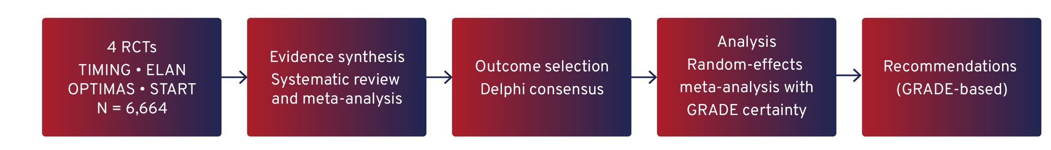
TIMING OF ANTICOAGULATION THERAPY IN PATIENTS WITH ACUTE ISCHEMIC STROKE AND ATRIAL FIBRILLATION: A GRADE-BASED EXPERT OPINION RECOMMENDATION
Background
The optimal timing of DOAC initiation after acute ischaemic stroke or transient ischemic attack (TIA) in nonvalvular atrial fibrillation (NVAF) remains uncertain.
Balancing early prevention of recurrent events with bleeding risk is a key clinical challenge.
Aim
To assess whether early DOAC initiation is superior to delayed initiation for preventing new vascular events.
Methods
GRADE-based guideline informed by a systematic review and meta-analysis of four RCTs (n=6,664), supported by an individual patient data meta-analysis (CATALYST collaboration).
Notes:
Authorship: Emanuele Spina, Michele Romoli, Maria Giulia Mosconi, Marina Padroni, Isabella Canavero, Marina Mannino, Marialuisa Zedde, Stefano Ricci, Maurizio Paciaroni
Abbreviations: CI, confidence interval; DOACs, direct oral anticoagulants; GRADE, Grading of Recommendations, Assessment, Development and Evaluation; NVAF, nonvalvular atrial fibrillation; RR, risk ratio; TIA, transient ischemic attack.
Abstract Number: ESOC2026A2195
Abstract Title: TIMING OF ANTICOAGULATION THERAPY IN PATIENTS WITH ACUTE ISCHEMIC STROKE AND ATRIAL FIBRILLATION: A GRADE-BASED EXPERT OPINION RECOMMENDATION.
Abstract Category: 05.00 - RISK FACTORS AND PREVENTION (PRIMARY AND SECONDARY) - 05.02 - SECONDARY PREVENTION
Background: The optimal timing for initiating direct oral anticoagulants (DOACs) after acute ischemic stroke or transient ischemic attack (TIA) in patients with nonvalvular atrial fibrillation (NVAF) remains uncertain.
Objective: To determine whether early initiation of DOACs is superior to delayed initiation in preventing new vascular events
Methods: This guideline was developed using the GRADE approach and includes a systematic review and meta-analysis of four randomized controlled trials (TIMING, ELAN, OPTIMAS, START) enrolling 6,664 patients. Outcomes were selected via Delphi consensus. Meta-analyses used random-effects models, with certainty of evidence rated per GRADE methodology.
Results: Early DOAC initiation was associated with a trend toward fewer recurrent ischemic events (RR 0.77, 95% CI 0.52–1.14) and thromboembolic events (RR 0.73, 95% CI 0.50–1.06), with no increase in symptomatic intracranial hemorrhage (RR 0.93, 95% CI 0.44–1.97) or major extracranial bleeding (RR 0.84, 95% CI 0.42–1.69). Certainty of evidence was low due to imprecision. An individual patient data meta-analysis from CATALYST collaboration further supported early treatment in patients with minor to moderate stroke.
Recommendations: We recommend early DOAC initiation within 4 days in patients with minor to moderate stroke to prevent new vascular events. Early DOAC initiation over delayed treatment is indicated in patients with severe acute ischemic stroke to prevent new vascular events.
Conclusion: Early DOAC initiation appears safe and potentially more effective than delayed treatment, supporting a shift toward earlier anticoagulation in selected patients with NVAF and recent ischemic stroke.

Slide 19
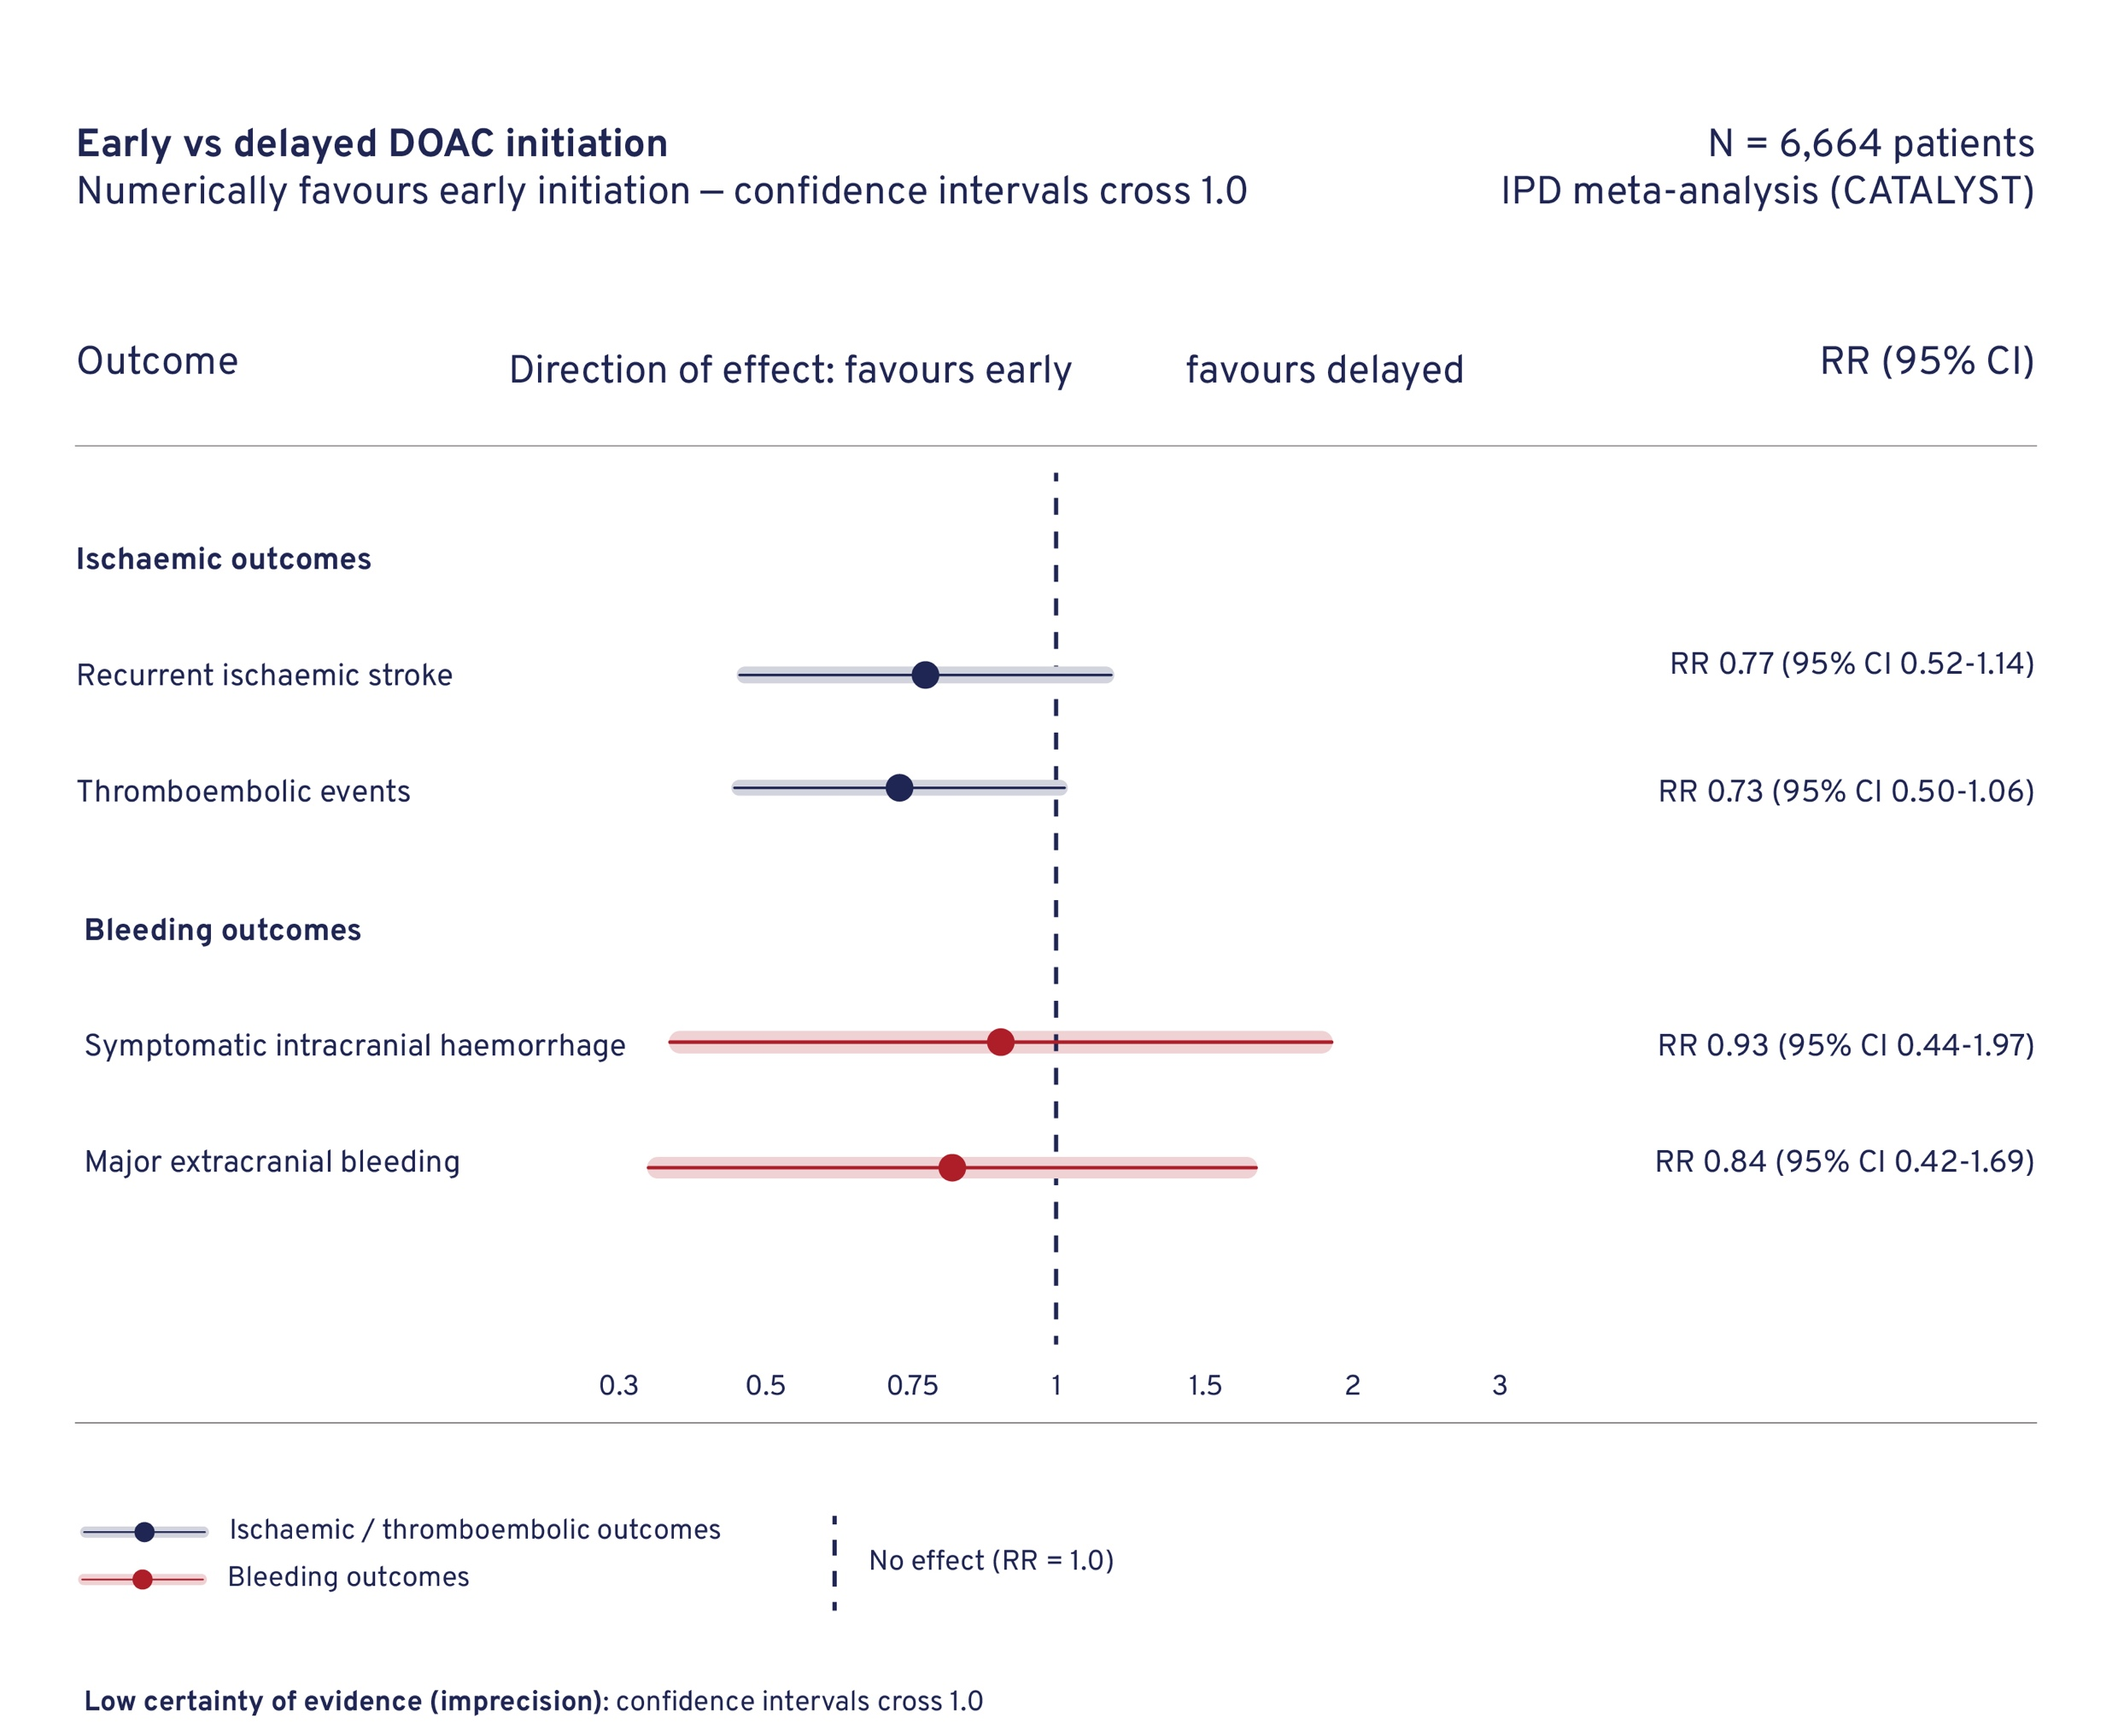
TIMING OF ANTICOAGULATION THERAPY IN PATIENTS WITH ACUTE ISCHEMIC STROKE AND ATRIAL FIBRILLATION: A GRADE-BASED EXPERT OPINION RECOMMENDATION
Results
Conclusion
Early DOAC initiation appears safe and may be associated with improved outcomes versus delayed treatment, supporting earlier anticoagulation in selected patients with NVAF and recent ischaemic stroke.
Recommendations
Consider DOAC initiation within 4 days in patients with minor to moderate stroke.
Careful patient selection remains essential, particularly in more severe stroke.
Notes:
Authorship: Emanuele Spina, Michele Romoli, Maria Giulia Mosconi, Marina Padroni, Isabella Canavero, Marina Mannino, Marialuisa Zedde, Stefano Ricci, Maurizio Paciaroni
Abbreviations: CI, confidence interval; DOACs, direct oral anticoagulants; GRADE, Grading of Recommendations, Assessment, Development and Evaluation; NVAF, nonvalvular atrial fibrillation; RR, risk ratio; TIA, transient ischemic attack.
Abstract Number: ESOC2026A2195
Abstract Title: TIMING OF ANTICOAGULATION THERAPY IN PATIENTS WITH ACUTE ISCHEMIC STROKE AND ATRIAL FIBRILLATION: A GRADE-BASED EXPERT OPINION RECOMMENDATION.
Abstract Category: 05.00 - RISK FACTORS AND PREVENTION (PRIMARY AND SECONDARY) - 05.02 - SECONDARY PREVENTION
Background: The optimal timing for initiating direct oral anticoagulants (DOACs) after acute ischemic stroke or transient ischemic attack (TIA) in patients with nonvalvular atrial fibrillation (NVAF) remains uncertain.
Objective: To determine whether early initiation of DOACs is superior to delayed initiation in preventing new vascular events
Methods: This guideline was developed using the GRADE approach and includes a systematic review and meta-analysis of four randomized controlled trials (TIMING, ELAN, OPTIMAS, START) enrolling 6,664 patients. Outcomes were selected via Delphi consensus. Meta-analyses used random-effects models, with certainty of evidence rated per GRADE methodology.
Results: Early DOAC initiation was associated with a trend toward fewer recurrent ischemic events (RR 0.77, 95% CI 0.52–1.14) and thromboembolic events (RR 0.73, 95% CI 0.50–1.06), with no increase in symptomatic intracranial hemorrhage (RR 0.93, 95% CI 0.44–1.97) or major extracranial bleeding (RR 0.84, 95% CI 0.42–1.69). Certainty of evidence was low due to imprecision. An individual patient data meta-analysis from CATALYST collaboration further supported early treatment in patients with minor to moderate stroke.
Recommendations: We recommend early DOAC initiation within 4 days in patients with minor to moderate stroke to prevent new vascular events. Early DOAC initiation over delayed treatment is indicated in patients with severe acute ischemic stroke to prevent new vascular events.
Conclusion: Early DOAC initiation appears safe and potentially more effective than delayed treatment, supporting a shift toward earlier anticoagulation in selected patients with NVAF and recent ischemic stroke.

Slide 20
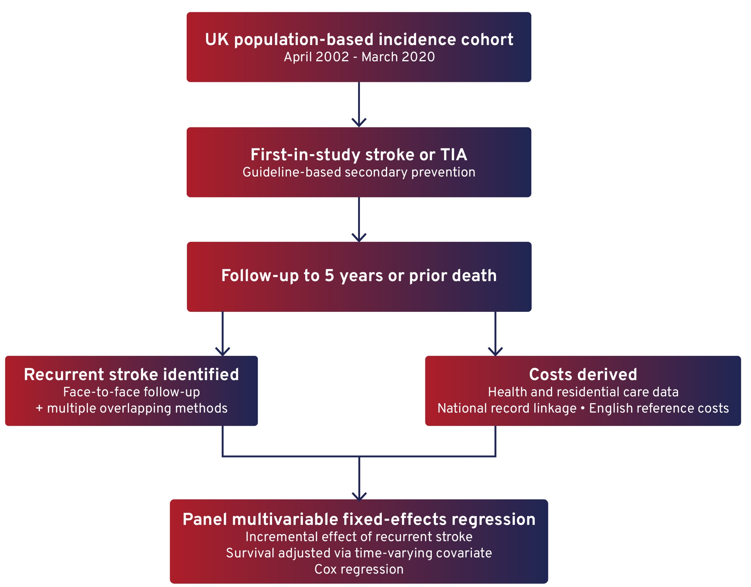
HEALTH AND SOCIAL CARE COSTS OF RECURRENT STROKE: LONG-TERM FOLLOW-UP OF A POPULATION-BASED COHORT
Background
Improved life expectancy after TIA or stroke has increased the time patients live at risk of recurrent stroke.
Data on long-term recurrence rates and associated care costs under current best medical treatment (BMT) remain limited.
Aim
To quantify the long-term cost burden of recurrent stroke following an initial TIA or stroke.
Methods
Notes:
Authorship: Ramon Luengo-Fernandez, Louise Silver, Peter Rothwell
Abbreviations: BMT, best medical treatment; CI, confidence interval; TIA, transient ischemic attack ; TOAST, Trial of Org 10172 in Acute Stroke Treatment.
Abstract Number: ESOC2026A1255
Abstract Title: HEALTH AND SOCIAL CARE COSTS OF RECURRENT STROKE: LONG-TERM FOLLOW-UP OF A POPULATION-BASED COHORT
Abstract Category: 05.00 - RISK FACTORS AND PREVENTION (PRIMARY AND SECONDARY) - 05.02 - SECONDARY PREVENTION
Background and aims:
Improved life-expectancy after TIA/stroke has increased the patient-years lived at risk of recurrent stroke. There are few reliable data on recurrence rates on current best medical treatment (BMT) or on the long-term impact on care costs. We aimed to quantify the long-term cost burden of recurrent stroke after an initial TIA or stroke.
Methods:
In a UK population-based incidence cohort (04/2002–03/2020), all patients with first-in-study stroke/TIA were given guideline-based secondary prevention and followed to 5-years or prior death. Recurrent stroke was identified by face-to-face follow-up and other multiple overlapping methods. Data on health and residential care resource were supplemented by national record linkage and costed using English reference costs. The incremental effect of recurrent stroke was assessed using panel multivariable fixed-effects regression, adjusted by survival obtained through time varying covariate Cox-regression.
Results:
Among 3,159 stroke and 2,007 TIA patients, 434(14%) and 236(12%) respectively experienced ≥1 recurrent stroke within 5-years. Without recurrent stroke, 5-year hospital costs averaged €17,233 (95%CI=16,443–17,982) after an initial stroke and €12,032 (11,212-12,913) after an initial TIA. Each recurrent stroke increased hospital costs by €6,124 (2,150-11,573;p<0.001) and €9,532 (3,765-14,752,p<0.001), respectively and total hospital/residential care costs by €13,235 (3,901–26,536;p<0.001) and €20,154 (6,633-32,487;p<0.001) respectively. Further analyses by TOAST subtype, stroke severity, age, high-risk TIA, and other characteristics will be presented.
Conclusions:
The costs of recurrent stroke on current BMT remain substantial, highlighting the economic case for further investment in secondary prevention.

Slide 21
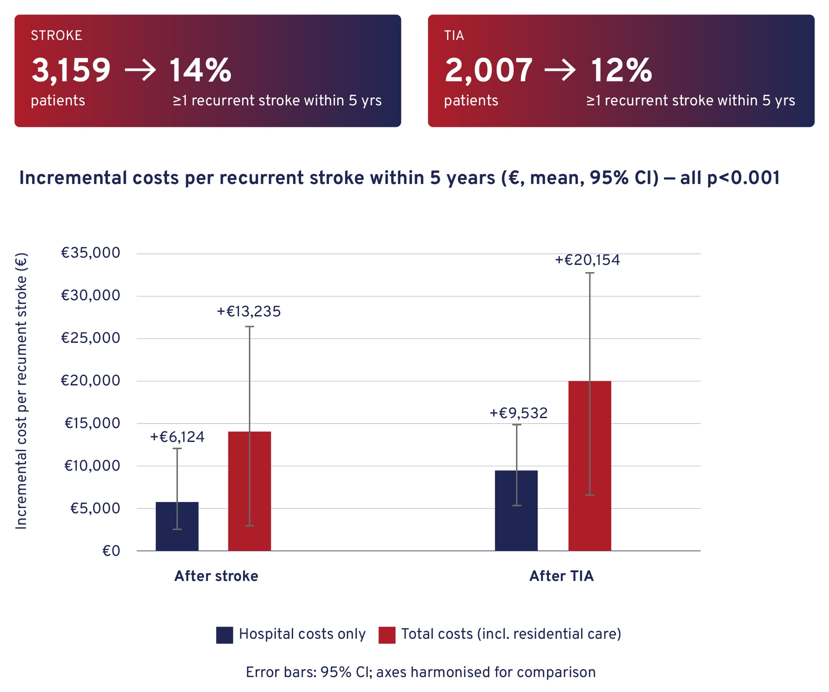
HEALTH AND SOCIAL CARE COSTS OF RECURRENT STROKE: LONG-TERM FOLLOW-UP OF A POPULATION-BASED COHORT
Results
Recurrent stroke was associated with substantial increases in 5-year healthcare costs. These increases were higher for total costs and were greater after TIA than stroke.
Further analyses by TOAST subtype, stroke severity, age, and high-risk TIA will be presented.
Conclusion
Recurrent stroke is associated with a substantial increase in long-term healthcare and social care costs.
Findings highlight the economic importance of optimising secondary prevention strategies.
Notes:
Authorship: Ramon Luengo-Fernandez, Louise Silver, Peter Rothwell
Abbreviations: BMT, best medical treatment; CI, confidence interval; TIA, transient ischemic attack ; TOAST, Trial of Org 10172 in Acute Stroke Treatment.
Abstract Number: ESOC2026A1255
Abstract Title: HEALTH AND SOCIAL CARE COSTS OF RECURRENT STROKE: LONG-TERM FOLLOW-UP OF A POPULATION-BASED COHORT
Abstract Category: 05.00 - RISK FACTORS AND PREVENTION (PRIMARY AND SECONDARY) - 05.02 - SECONDARY PREVENTION
Background and aims:
Improved life-expectancy after TIA/stroke has increased the patient-years lived at risk of recurrent stroke. There are few reliable data on recurrence rates on current best medical treatment (BMT) or on the long-term impact on care costs. We aimed to quantify the long-term cost burden of recurrent stroke after an initial TIA or stroke.
Methods:
In a UK population-based incidence cohort (04/2002–03/2020), all patients with first-in-study stroke/TIA were given guideline-based secondary prevention and followed to 5-years or prior death. Recurrent stroke was identified by face-to-face follow-up and other multiple overlapping methods. Data on health and residential care resource were supplemented by national record linkage and costed using English reference costs. The incremental effect of recurrent stroke was assessed using panel multivariable fixed-effects regression, adjusted by survival obtained through time varying covariate Cox-regression.
Results:
Among 3,159 stroke and 2,007 TIA patients, 434(14%) and 236(12%) respectively experienced ≥1 recurrent stroke within 5-years. Without recurrent stroke, 5-year hospital costs averaged €17,233 (95%CI=16,443–17,982) after an initial stroke and €12,032 (11,212-12,913) after an initial TIA. Each recurrent stroke increased hospital costs by €6,124 (2,150-11,573;p<0.001) and €9,532 (3,765-14,752,p<0.001), respectively and total hospital/residential care costs by €13,235 (3,901–26,536;p<0.001) and €20,154 (6,633-32,487;p<0.001) respectively. Further analyses by TOAST subtype, stroke severity, age, high-risk TIA, and other characteristics will be presented.
Conclusions:
The costs of recurrent stroke on current BMT remain substantial, highlighting the economic case for further investment in secondary prevention.

Slide 22
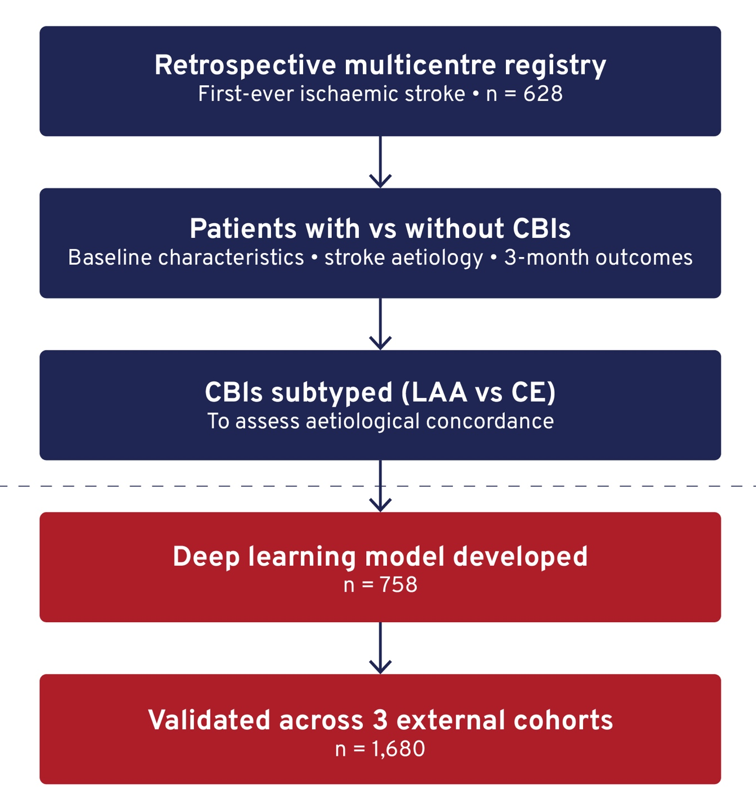
COVERT SENTINEL INFARCTS ON NONCONTRAST CT: A HIGH-RISK CLINICAL SYNDROME PREDICTING STROKE ETIOLOGY AND OUTCOME
Background
Non-lacunar covert brain infarcts (CBIs) may indicate high-risk stroke aetiologies such as large-artery atherosclerosis (LAA) or cardioembolism (CE).
However, these lesions are often overlooked on noncontrast CT.
Aim
To assess the clinical and aetiological significance of non-lacunar CBIs and develop a model for automated detection.
Methods
Notes:
Authorship: Seunghan Yeom, Wi-Sun Ryu, Myungjae Lee, Dongmin Kim, Gihun Park, Leonard Sunwoo, Chi Kyung Kim, Beom Joon Kim
Abbreviations: CBIs, covert brain infarcts; CE, cardioembolism; CT, computed tomography; LAA, large-artery atherosclerosis; mRS, modified Rankin Scale; NCCT, noncontrast computed tomography.
Abstract Number: ESOC2026A259
Abstract Title: COVERT SENTINEL INFARCTS ON NONCONTRAST CT: A HIGH-RISK CLINICAL SYNDROME PREDICTING STROKE ETIOLOGY AND OUTCOME
Abstract Category: 05.00 - RISK FACTORS AND PREVENTION (PRIMARY AND SECONDARY) - 05.02 - SECONDARY PREVENTION
Background and aims:
Non-lacunar covert brain infarcts (CBIs) on noncontrast CT (NCCT) are frequently overlooked due to subtle hypoattenuation and unclear clinical implication, yet they often indicate high-risk etiologies such as large-artery atherosclerosis (LAA) or cardioembolism (CE). We investigated the clinical-etiological significance of non-lacunar CBIs and developed a deep learning–based model for automated detection.
Methods:
We analyzed 628 patients with first-ever symptomatic ischemic stroke from a retrospective multicenter registry. We compared baseline characteristics, stroke etiology, and 3-month modified Rankin Scale (mRS) scores between patients with and without non-lacunar CBIs. Non-lacunar CBIs were subtyped as LAA- or CE-related to evaluate etiological concordance with the index stroke. A deep learning model was developed using a separate cohort (n=758) and validated in three independent external cohorts (n=1,680).
Results:
Non-lacunar CBIs were identified in 13.5% (85/628) of patients. Their presence was associated with older age (75 vs 70 years; p=0.014), atrial fibrillation (34.1% vs 17.5%; p=0.002) and arterial occlusion (14.6% vs 7.0%; p=0.004). Etiological concordance was substantial: 48.5% of LAA-related CBIs matched a symptomatic LAA stroke, and 46.2% of CE-related CBIs matched a symptomatic CE stroke. Patients with non-lacunar CBIs had worse 3-month outcomes (mRS<3: 51.8% vs. 73.1%; adjusted p=0.002) and impaired recovery trajectories (p<0.001). The detection model achieved sensitivities 0.722–0.755 and specificities 0.797–0.932 across validation cohorts.
Conclusions:
Non-lacunar CBIs on NCCT serve as sentinel markers showing high rate of etiological concordance with future devastating strokes and associated with poorer outcomes. An NCCT-based deep learning model shows robust generalization, enabling early identification and etiologic work-up.

Slide 23
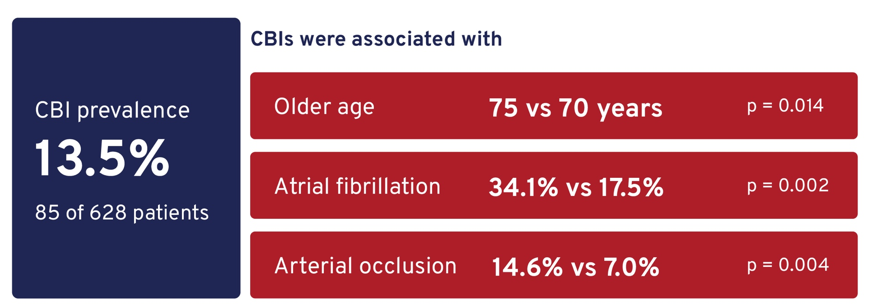
COVERT SENTINEL INFARCTS ON NONCONTRAST CT: A HIGH-RISK CLINICAL SYNDROME PREDICTING STROKE ETIOLOGY AND OUTCOME
Results
High aetiological concordance was observed: LAA: 48.5% and CE: 46.2%.
There were lower rates of favourable outcome (mRS <3) at 3 months: 51.8% vs 73.1% (p=0.002).
Model performance:
Sensitivity: 0.722–0.755
Specificity: 0.797–0.932.
Conclusion
Non-lacunar CBIs act as sentinel markers of high-risk stroke aetiology and poorer outcomes.
Automated detection using NCCT may support earlier identification and targeted work-up.
Notes:
Authorship: Seunghan Yeom, Wi-Sun Ryu, Myungjae Lee, Dongmin Kim, Gihun Park, Leonard Sunwoo, Chi Kyung Kim, Beom Joon Kim
Abbreviations: CBIs, covert brain infarcts; CE, cardioembolism; CT, computed tomography; LAA, large-artery atherosclerosis; mRS, modified Rankin Scale; NCCT, noncontrast computed tomography.
Abstract Number: ESOC2026A259
Abstract Title: COVERT SENTINEL INFARCTS ON NONCONTRAST CT: A HIGH-RISK CLINICAL SYNDROME PREDICTING STROKE ETIOLOGY AND OUTCOME
Abstract Category: 05.00 - RISK FACTORS AND PREVENTION (PRIMARY AND SECONDARY) - 05.02 - SECONDARY PREVENTION
Background and aims:
Non-lacunar covert brain infarcts (CBIs) on noncontrast CT (NCCT) are frequently overlooked due to subtle hypoattenuation and unclear clinical implication, yet they often indicate high-risk etiologies such as large-artery atherosclerosis (LAA) or cardioembolism (CE). We investigated the clinical-etiological significance of non-lacunar CBIs and developed a deep learning–based model for automated detection.
Methods:
We analyzed 628 patients with first-ever symptomatic ischemic stroke from a retrospective multicenter registry. We compared baseline characteristics, stroke etiology, and 3-month modified Rankin Scale (mRS) scores between patients with and without non-lacunar CBIs. Non-lacunar CBIs were subtyped as LAA- or CE-related to evaluate etiological concordance with the index stroke. A deep learning model was developed using a separate cohort (n=758) and validated in three independent external cohorts (n=1,680).
Results:
Non-lacunar CBIs were identified in 13.5% (85/628) of patients. Their presence was associated with older age (75 vs 70 years; p=0.014), atrial fibrillation (34.1% vs 17.5%; p=0.002) and arterial occlusion (14.6% vs 7.0%; p=0.004). Etiological concordance was substantial: 48.5% of LAA-related CBIs matched a symptomatic LAA stroke, and 46.2% of CE-related CBIs matched a symptomatic CE stroke. Patients with non-lacunar CBIs had worse 3-month outcomes (mRS<3: 51.8% vs. 73.1%; adjusted p=0.002) and impaired recovery trajectories (p<0.001). The detection model achieved sensitivities 0.722–0.755 and specificities 0.797–0.932 across validation cohorts.
Conclusions:
Non-lacunar CBIs on NCCT serve as sentinel markers showing high rate of etiological concordance with future devastating strokes and associated with poorer outcomes. An NCCT-based deep learning model shows robust generalization, enabling early identification and etiologic work-up.

Slide 24
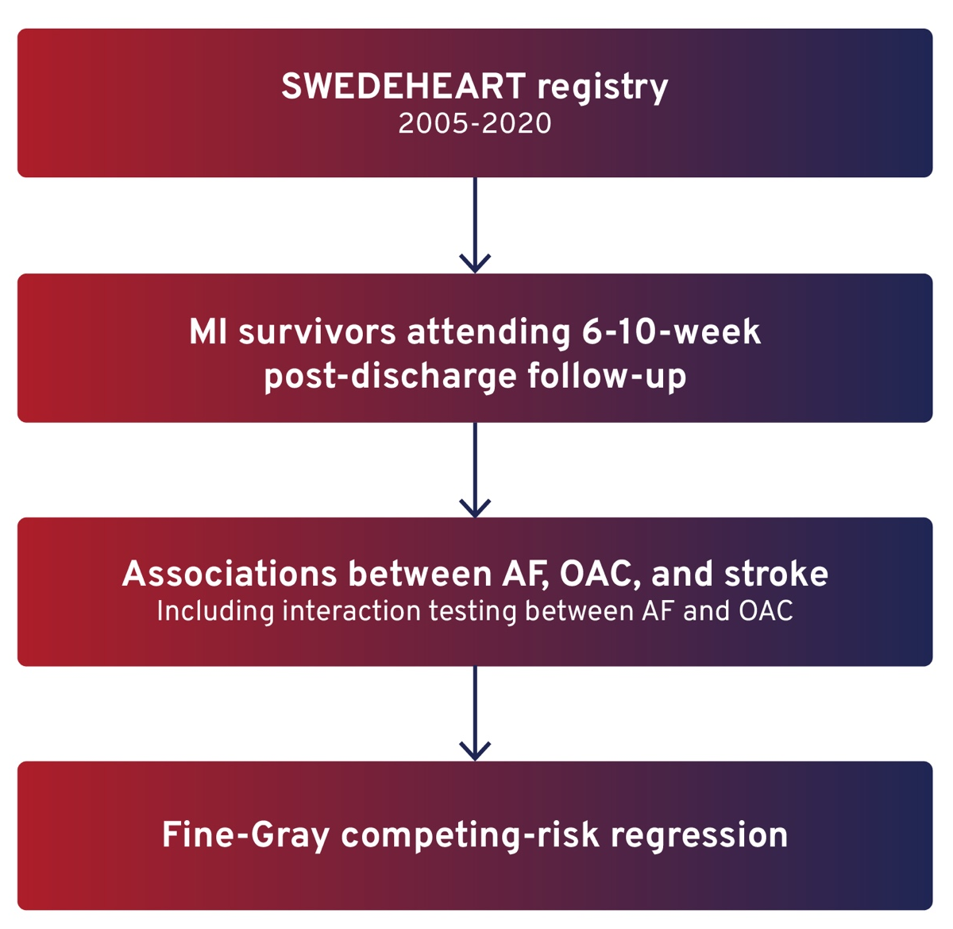
EFFECT OF ORAL ANTICOAGULATION ON STROKE RISK AFTER MYOCARDIAL INFARCTION DIFFERS BY THE PRESENCE OF ATRIAL FIBRILLATION
Background
Stroke risk remains elevated after myocardial infarction (MI).
Oral anticoagulation (OAC) is recommended in patients with atrial fibrillation (AF), but its benefit in those without AF is unclear.
Aim
To assess whether the association between OAC and stroke risk after MI differs by AF status.
Methods
Notes:
Authorship: Putu Ayuwidia Ekaputri, Adam Viktorisson, Petra Redfors, Margrét Leósdóttir, Katharina Stibrant Sunnerhagen
Abbreviations: AF, atrial fibrillation; aHR, adjusted hazard ratio; CI, confidence interval; MI, myocardial infarction; OAC, oral anticoagulation; SWEDEHEART, Swedish Web-system for Evidence-based Care in Heart Disease.
Abstract Number: ESOC2026A508
Abstract Title: EFFECT OF ORAL ANTICOAGULATION ON STROKE RISK AFTER MYOCARDIAL INFARCTION DIFFERS BY THE PRESENCE OF ATRIAL FIBRILLATION
Abstract Category: 05.00 - RISK FACTORS AND PREVENTION (PRIMARY AND SECONDARY) - 05.02 - SECONDARY PREVENTION
Background and aims:
Stroke risk remains elevated after myocardial infarction (MI). Oral anticoagulation (OAC) is recommended in survivors with atrial fibrillation (AF) and is also used in some patients without AF, for other indications such as left ventricular thrombus. However, whether OAC reduces stroke risk independently or only among patients with AF remains uncertain. This study examined whether the association between OAC and stroke risk after MI differs by AF history.
Methods:
MI survivors from the national SWEDEHEART registry (Swedish Web-system for Evidence-based Care in Heart Disease) who attended a 6–10-week post-discharge follow-up between 2005 and 2020 were included. Fine–Gray competing-risk regression assessed associations between AF, OAC, and stroke, including interaction testing between AF and OAC.
Results:
Among 85,360 MI survivors (mean age 64 ± 9 years, 74.3% men), 7,285 (8.5%) received OAC; 4,978 (68.3%) had AF and 2,307 (31.7%) did not. During follow-up, 4,275 (5.0%) experienced ischemic or hemorrhagic stroke. AF increased ischemic stroke risk (aHR 1.40, 95% CI 1.19–1.64), while OAC use alone showed no significant benefit (aHR 1.18, 95% CI 0.92–1.51). A significant AF–OAC interaction showed reduced ischemic stroke risk in patients with AF (aHR 0.56, 95% CI 0.41– 0.77), with a similar trend for hemorrhagic stroke.
Conclusions:
OAC was associated with reduced stroke risk in MI patients with AF, but not in those without AF. These findings highlight the absence of a stroke-preventive effect in non-AF patients and underscore the need to better understand the rationale for extended OAC use in this group.

Slide 25
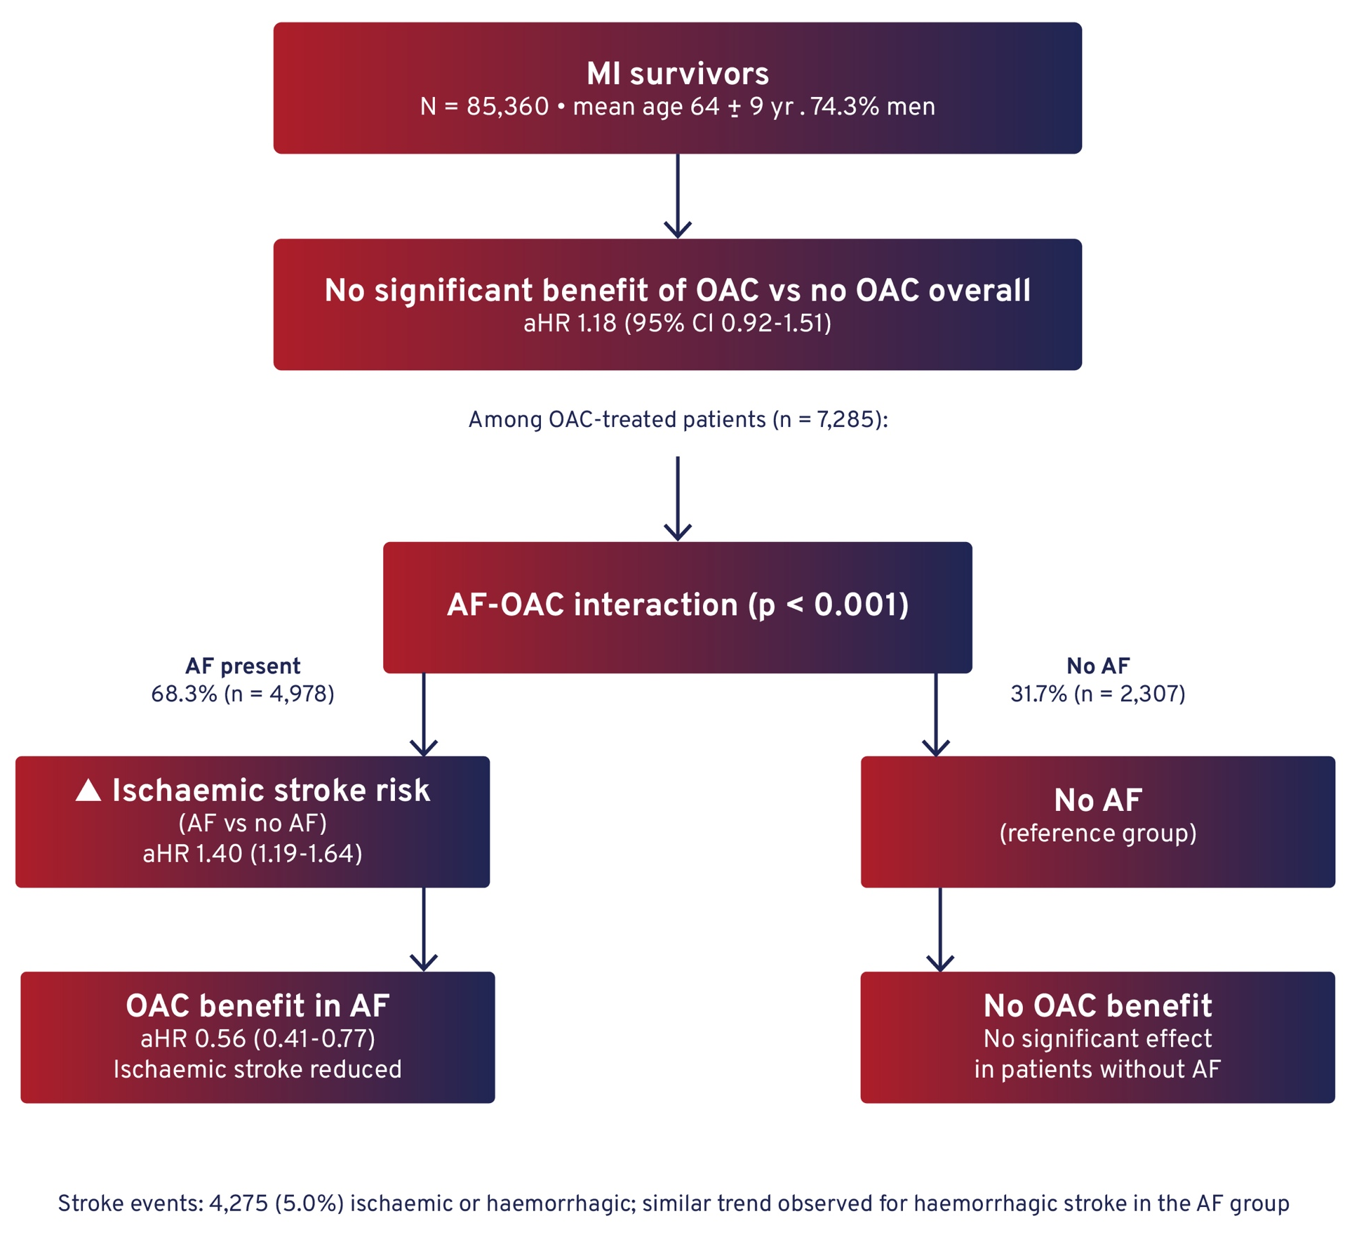
EFFECT OF ORAL ANTICOAGULATION ON STROKE RISK AFTER MYOCARDIAL INFARCTION DIFFERS BY THE PRESENCE OF ATRIAL FIBRILLATION
Results
Conclusion
OAC reduced stroke risk only in patients with AF, with no benefit in those without AF.
Findings highlight the need to refine patient selection for OAC after MI.
Notes:
Authorship: Putu Ayuwidia Ekaputri, Adam Viktorisson, Petra Redfors, Margrét Leósdóttir, Katharina Stibrant Sunnerhagen
Abbreviations: AF, atrial fibrillation; aHR, adjusted hazard ratio; CI, confidence interval; MI, myocardial infarction; OAC, oral anticoagulation; SWEDEHEART, Swedish Web-system for Evidence-based Care in Heart Disease.
Abstract Number: ESOC2026A508
Abstract Title: EFFECT OF ORAL ANTICOAGULATION ON STROKE RISK AFTER MYOCARDIAL INFARCTION DIFFERS BY THE PRESENCE OF ATRIAL FIBRILLATION
Abstract Category: 05.00 - RISK FACTORS AND PREVENTION (PRIMARY AND SECONDARY) - 05.02 - SECONDARY PREVENTION
Background and aims:
Stroke risk remains elevated after myocardial infarction (MI). Oral anticoagulation (OAC) is recommended in survivors with atrial fibrillation (AF) and is also used in some patients without AF, for other indications such as left ventricular thrombus. However, whether OAC reduces stroke risk independently or only among patients with AF remains uncertain. This study examined whether the association between OAC and stroke risk after MI differs by AF history.
Methods:
MI survivors from the national SWEDEHEART registry (Swedish Web-system for Evidence-based Care in Heart Disease) who attended a 6–10-week post-discharge follow-up between 2005 and 2020 were included. Fine–Gray competing-risk regression assessed associations between AF, OAC, and stroke, including interaction testing between AF and OAC.
Results:
Among 85,360 MI survivors (mean age 64 ± 9 years, 74.3% men), 7,285 (8.5%) received OAC; 4,978 (68.3%) had AF and 2,307 (31.7%) did not. During follow-up, 4,275 (5.0%) experienced ischemic or hemorrhagic stroke. AF increased ischemic stroke risk (aHR 1.40, 95% CI 1.19–1.64), while OAC use alone showed no significant benefit (aHR 1.18, 95% CI 0.92–1.51). A significant AF–OAC interaction showed reduced ischemic stroke risk in patients with AF (aHR 0.56, 95% CI 0.41– 0.77), with a similar trend for hemorrhagic stroke.
Conclusions:
OAC was associated with reduced stroke risk in MI patients with AF, but not in those without AF. These findings highlight the absence of a stroke-preventive effect in non-AF patients and underscore the need to better understand the rationale for extended OAC use in this group.

Slide 26
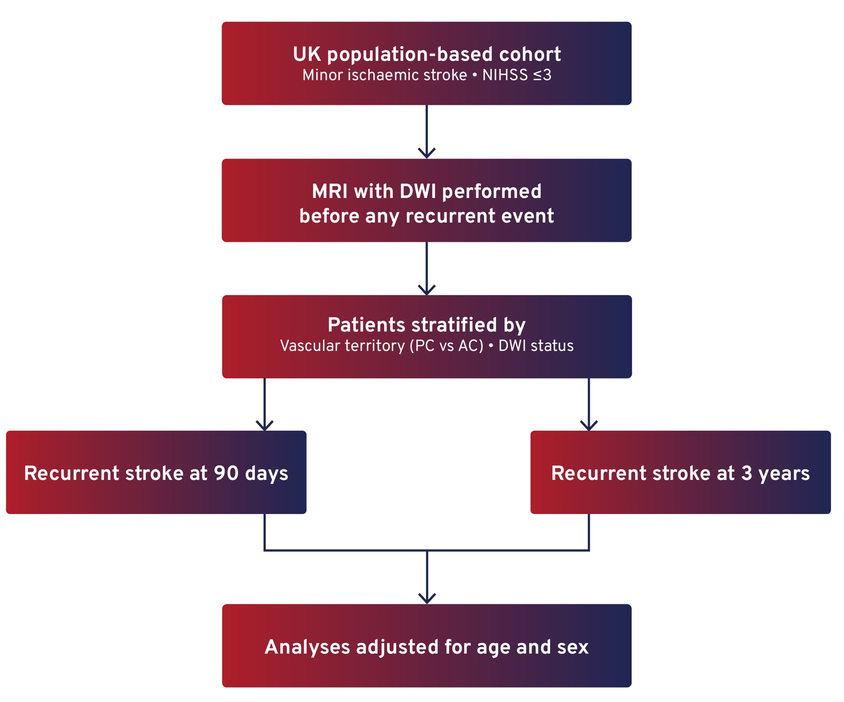
PROGNOSTIC UTILITY OF DIFFUSION-WEIGHTED MRI IN POSTERIOR VERSUS ANTERIOR CIRCULATION MINOR ISCHAEMIC STROKE: A POPULATION-BASED STUDY
Background
DWI is less sensitive in posterior circulation minor ischaemic stroke (PC-MIS) than in anterior events.
This may result in under-recognition and under-treatment.
However, the prognosis of DWI-negative PC-MIS remains uncertain. We aimed to assess recurrence risk according to DWI findings.
Aim
To assess the prognostic utility of DWI in posterior versus anterior circulation minor ischaemic stroke.
Methods
Notes:
Authorship: Effrosyni Grosi, Maria Tuna, Wilhelm Kuker, Peter Rothwell
Abbreviations: aHR, adjusted hazard ratio; AC, anterior circulation; DWI, diffusion-weighted imaging; MRI, magnetic resonance imaging; MIS, minor ischaemic stroke; NIHSS, National Institutes of Health Stroke Scale; OR, odds ratio; PC, posterior circulation.
Abstract Number: ESOC2026A2471
Abstract Title: PROGNOSTIC UTILITY OF DIFFUSION-WEIGHTED MRI IN POSTERIOR VERSUS ANTERIOR CIRCULATION MINOR ISCHAEMIC STROKE: A POPULATION-BASED STUDY
Abstract Category: 05.00 - RISK FACTORS AND PREVENTION (PRIMARY AND SECONDARY) - 05.02 - SECONDARY PREVENTION
Background and aims:
Diffusion-weighted imaging (DWI) is less sensitive to minor ischaemic stroke (MIS) in the posterior circulation (PC-MIS) versus in anterior circulation events (AC-MIS), potentially risking under-treatment of PC-MIS by non-specialists. However, it uncertain whether patients with DWI-negative PC-MIS have a high risk of recurrent stroke. In the absence of previous prospective studies, we aimed to determine the prognosis of PC-MIS in relation to DWI findings.
Methods:
In a UK population-study based study of all vascular events, consecutive eligible patients with MIS (NIHSS≤3 at first assessment) underwent brain MRI/DWI before any recurrent event. Vascular territory was determined based on symptoms/examination/imaging. Risks of recurrent stroke at 90-days and at 90-days to 3-years follow-up were stratified by vascular territory and DWI-findings and adjusted for age and sex.
Results:
Among 809 patients with MIS (343 PC-MIS; 466 AC-MIS), 452 (55.9%) were DWI-negative. PC-MIS were more frequently DWI-negative than AC-MIS (237/343 vs 215/466; OR=2.6;95%CI=2.0–3.5;p<0.001). However, although a positive DWI predicted 90-day stroke risk irrespective of vascular territory (overall aHR=7.8,1.76-34.9,p=0.007), it was a poor predictor of the subsequent 3-year risk (aHR=1.39,0.79-2.47,p=0.25), driven particularly by lack of predictive value in patients with PC-MIS (aHR=1.07,0.43-2.67,p=0.88).
Conclusions:
DWI is often negative in suspected PC-MIS, but although patients with a positive DWI have an increased early risk of recurrent stroke, normal imaging does not indicate a low long-term risk. Treatment decisions in patients with PC-MIS should reflect the low sensitivity of DWI and the poor long-term predictive value.

Slide 27
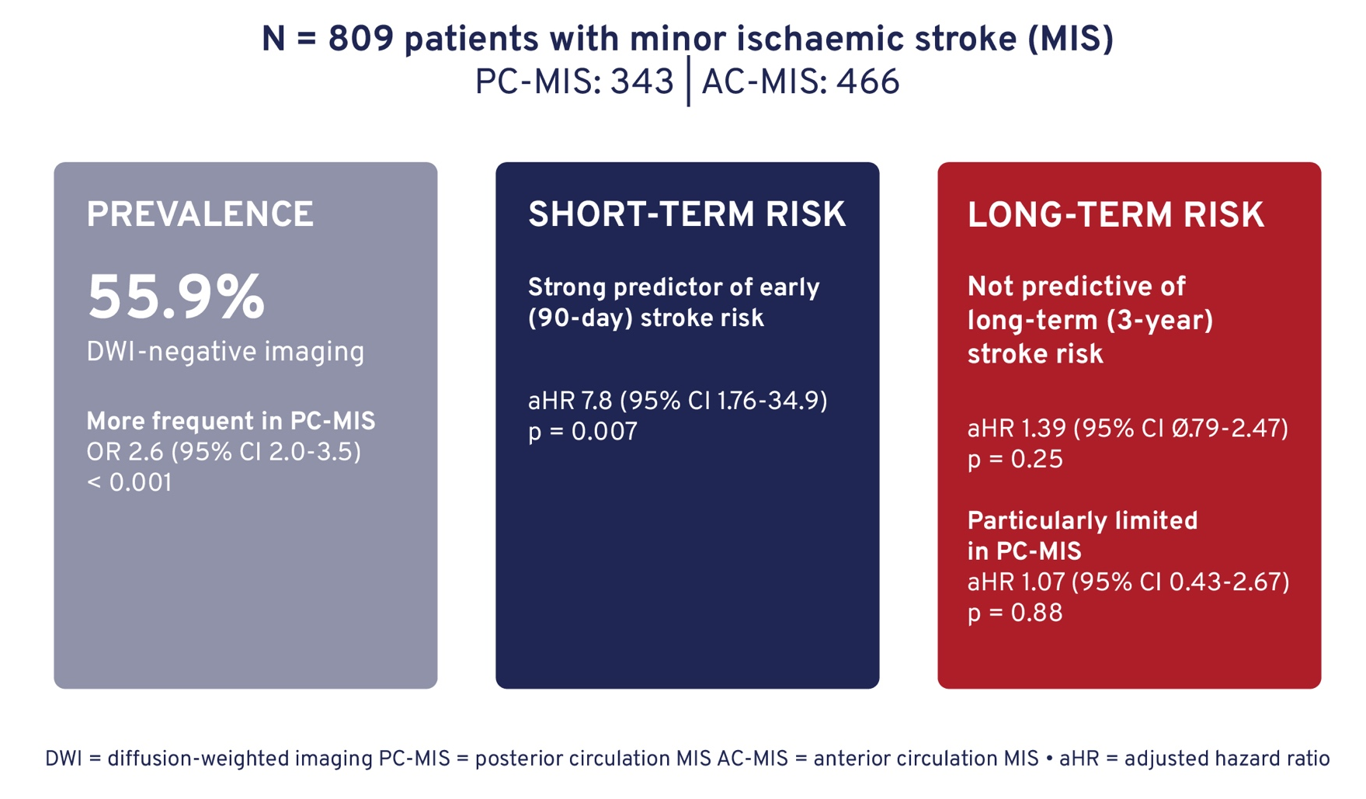
PROGNOSTIC UTILITY OF DIFFUSION-WEIGHTED MRI IN POSTERIOR VERSUS ANTERIOR CIRCULATION MINOR ISCHAEMIC STROKE: A POPULATION-BASED STUDY
Results
Conclusion
DWI is frequently negative in posterior circulation minor stroke.
While a positive DWI predicts early recurrence risk, a negative scan does not indicate low long-term risk.
Clinical decision-making should account for the limited sensitivity and prognostic value of DWI in PC-MIS.
Notes:
Authorship: Effrosyni Grosi, Maria Tuna, Wilhelm Kuker, Peter Rothwell
Abbreviations: aHR, adjusted hazard ratio; AC, anterior circulation; DWI, diffusion-weighted imaging; MRI, magnetic resonance imaging; MIS, minor ischaemic stroke; NIHSS, National Institutes of Health Stroke Scale; OR, odds ratio; PC, posterior circulation.
Abstract Number: ESOC2026A2471
Abstract Title: PROGNOSTIC UTILITY OF DIFFUSION-WEIGHTED MRI IN POSTERIOR VERSUS ANTERIOR CIRCULATION MINOR ISCHAEMIC STROKE: A POPULATION-BASED STUDY
Abstract Category: 05.00 - RISK FACTORS AND PREVENTION (PRIMARY AND SECONDARY) - 05.02 - SECONDARY PREVENTION
Background and aims:
Diffusion-weighted imaging (DWI) is less sensitive to minor ischaemic stroke (MIS) in the posterior circulation (PC-MIS) versus in anterior circulation events (AC-MIS), potentially risking under-treatment of PC-MIS by non-specialists. However, it uncertain whether patients with DWI-negative PC-MIS have a high risk of recurrent stroke. In the absence of previous prospective studies, we aimed to determine the prognosis of PC-MIS in relation to DWI findings.
Methods:
In a UK population-study based study of all vascular events, consecutive eligible patients with MIS (NIHSS≤3 at first assessment) underwent brain MRI/DWI before any recurrent event. Vascular territory was determined based on symptoms/examination/imaging. Risks of recurrent stroke at 90-days and at 90-days to 3-years follow-up were stratified by vascular territory and DWI-findings and adjusted for age and sex.
Results:
Among 809 patients with MIS (343 PC-MIS; 466 AC-MIS), 452 (55.9%) were DWI-negative. PC-MIS were more frequently DWI-negative than AC-MIS (237/343 vs 215/466; OR=2.6;95%CI=2.0–3.5;p<0.001). However, although a positive DWI predicted 90-day stroke risk irrespective of vascular territory (overall aHR=7.8,1.76-34.9,p=0.007), it was a poor predictor of the subsequent 3-year risk (aHR=1.39,0.79-2.47,p=0.25), driven particularly by lack of predictive value in patients with PC-MIS (aHR=1.07,0.43-2.67,p=0.88).
Conclusions:
DWI is often negative in suspected PC-MIS, but although patients with a positive DWI have an increased early risk of recurrent stroke, normal imaging does not indicate a low long-term risk. Treatment decisions in patients with PC-MIS should reflect the low sensitivity of DWI and the poor long-term predictive value.

Slide 28
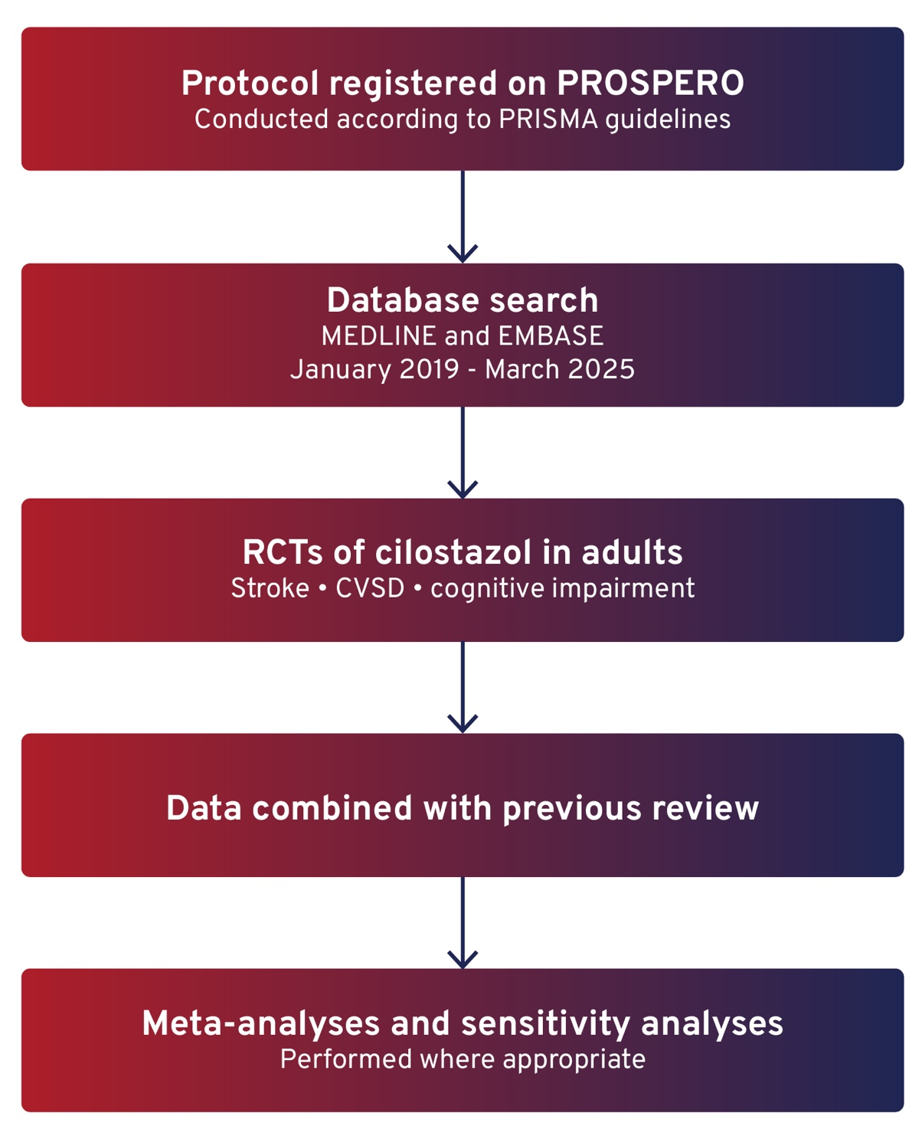
CILOSTAZOL FOR SECONDARY PREVENTION OF STROKE AND COGNITIVE DECLINE: AN UPDATED SYSTEMATIC REVIEW AND META-ANALYSIS
Background
Cilostazol has antiplatelet and vascular effects that may benefit cerebral small vessel disease (CSVD).
Evidence for its role in secondary stroke prevention and cognitive outcomes limited but evolving.
Aim
To evaluate the effects of cilostazol on recurrent stroke and cognitive outcomes.
Methods
Notes:
Authorship: Yulu Shi, Mona Eskandaripour, Joanna Wardlaw
Abbreviations: CSVD, cerebral small vessel disease; MMSE, Mini Mental Status Examination; OR, odds ratio; RCTs, randomised controlled trials; RR, risk ratio; SMD, standardised mean differences.
Abstract Number: ESOC2026A313
Abstract Title: CILOSTAZOL FOR SECONDARY PREVENTION OF STROKE AND COGNITIVE DECLINE: AN UPDATED SYSTEMATIC REVIEW AND META-ANALYSIS
Abstract Category: 05.00 - RISK FACTORS AND PREVENTION (PRIMARY AND SECONDARY) - 05.02 - SECONDARY PREVENTION
Background and aims:
Cilostazol is a phosphodiesterase-3 inhibitor with antiplatelet and pleiotropic vascular effects that may benefit cerebral small vessel disease (CSVD). Evidence for its role in secondary prevention of stroke and cognitive decline is limited but evolving. We updated a previous systematic review (from 2019) to evaluate the effects of cilostazol on recurrent stroke and cognition.
Methods:
The protocol was registered on PROSPERO and conducted according to PRISMA guidelines. MEDLINE and EMBASE were searched from January 2019 to March 2025 for randomised controlled trials (RCTs) of cilostazol in adults with stroke, CVSD, or cognitive impairment. Meta-analyses and sensitivity analyses were performed where appropriate, combining data from the previous review.
Results:
Sixteen publications were identified since 2019, including nine new RCTs in: stroke (4), chronic CSVD (3), mild cognitive impairment (1) and carotid stenosis (1). In meta-analyses (n=13,853), cilostazol, alone or plus other antiplatelets, reduced recurrence of ischemic (OR 0.70[0.59,0.82]) and haemorrhagic stroke (OR 0.60[0.40,0.89]), the ischemic stroke reduction mainly attributable to longer-duration (OR 0.67[0.56,0.80])studies or with >40% lacunar stroke (OR 0.64[0.52,0.79]). Cilostazol increased headache (OR 2[1.78,2.25]), palpitation (OR 2.05[1.71,2.45]) and diarrhoea (OR 2.35[1.97,2.82]). It did not improve MMSE scores (SMD -0.21[-0.33, -0.08]), largely driven by one large secondary analysis, but showed a trend towards reduced cognitive deterioration (RR 0.89[0.73,1.09]) and improved mood (SMD -0.16 [-0.40,0.08]).
Conclusions:
Cilostazol appears effective and safe for long term secondary stroke prevention, including after lacunar stroke, while its effects on cognition and mood require confirmation in further randomised trials.

Slide 29
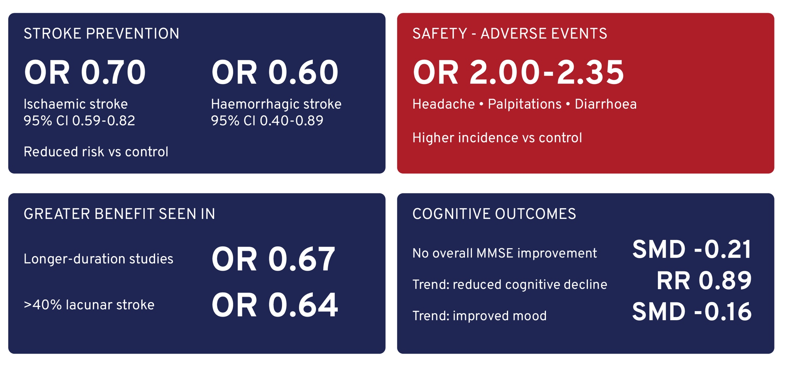
CILOSTAZOL FOR SECONDARY PREVENTION OF STROKE AND COGNITIVE DECLINE: AN UPDATED SYSTEMATIC REVIEW AND META-ANALYSIS
Results
16 publications since 2019, including 9 RCTs (n=13,853).
Conclusion
Cilostazol appears effective for secondary stroke prevention, including in lacunar stroke populations.
Effects on cognition remain uncertain and require further study
Notes:
Authorship: Yulu Shi, Mona Eskandaripour, Joanna Wardlaw
Abbreviations: CSVD, cerebral small vessel disease; MMSE, Mini Mental Status Examination; OR, odds ratio; RCTs, randomised controlled trials; RR, risk ratio; SMD, standardised mean differences.
Abstract Number: ESOC2026A313
Abstract Title: CILOSTAZOL FOR SECONDARY PREVENTION OF STROKE AND COGNITIVE DECLINE: AN UPDATED SYSTEMATIC REVIEW AND META-ANALYSIS
Abstract Category: 05.00 - RISK FACTORS AND PREVENTION (PRIMARY AND SECONDARY) - 05.02 - SECONDARY PREVENTION
Background and aims:
Cilostazol is a phosphodiesterase-3 inhibitor with antiplatelet and pleiotropic vascular effects that may benefit cerebral small vessel disease (CSVD). Evidence for its role in secondary prevention of stroke and cognitive decline is limited but evolving. We updated a previous systematic review (from 2019) to evaluate the effects of cilostazol on recurrent stroke and cognition.
Methods:
The protocol was registered on PROSPERO and conducted according to PRISMA guidelines. MEDLINE and EMBASE were searched from January 2019 to March 2025 for randomised controlled trials (RCTs) of cilostazol in adults with stroke, CVSD, or cognitive impairment. Meta-analyses and sensitivity analyses were performed where appropriate, combining data from the previous review.
Results:
Sixteen publications were identified since 2019, including nine new RCTs in: stroke (4), chronic CSVD (3), mild cognitive impairment (1) and carotid stenosis (1). In meta-analyses (n=13,853), cilostazol, alone or plus other antiplatelets, reduced recurrence of ischemic (OR 0.70[0.59,0.82]) and haemorrhagic stroke (OR 0.60[0.40,0.89]), the ischemic stroke reduction mainly attributable to longer-duration (OR 0.67[0.56,0.80])studies or with >40% lacunar stroke (OR 0.64[0.52,0.79]). Cilostazol increased headache (OR 2[1.78,2.25]), palpitation (OR 2.05[1.71,2.45]) and diarrhoea (OR 2.35[1.97,2.82]). It did not improve MMSE scores (SMD -0.21[-0.33, -0.08]), largely driven by one large secondary analysis, but showed a trend towards reduced cognitive deterioration (RR 0.89[0.73,1.09]) and improved mood (SMD -0.16 [-0.40,0.08]).
Conclusions:
Cilostazol appears effective and safe for long term secondary stroke prevention, including after lacunar stroke, while its effects on cognition and mood require confirmation in further randomised trials.

Slide 30
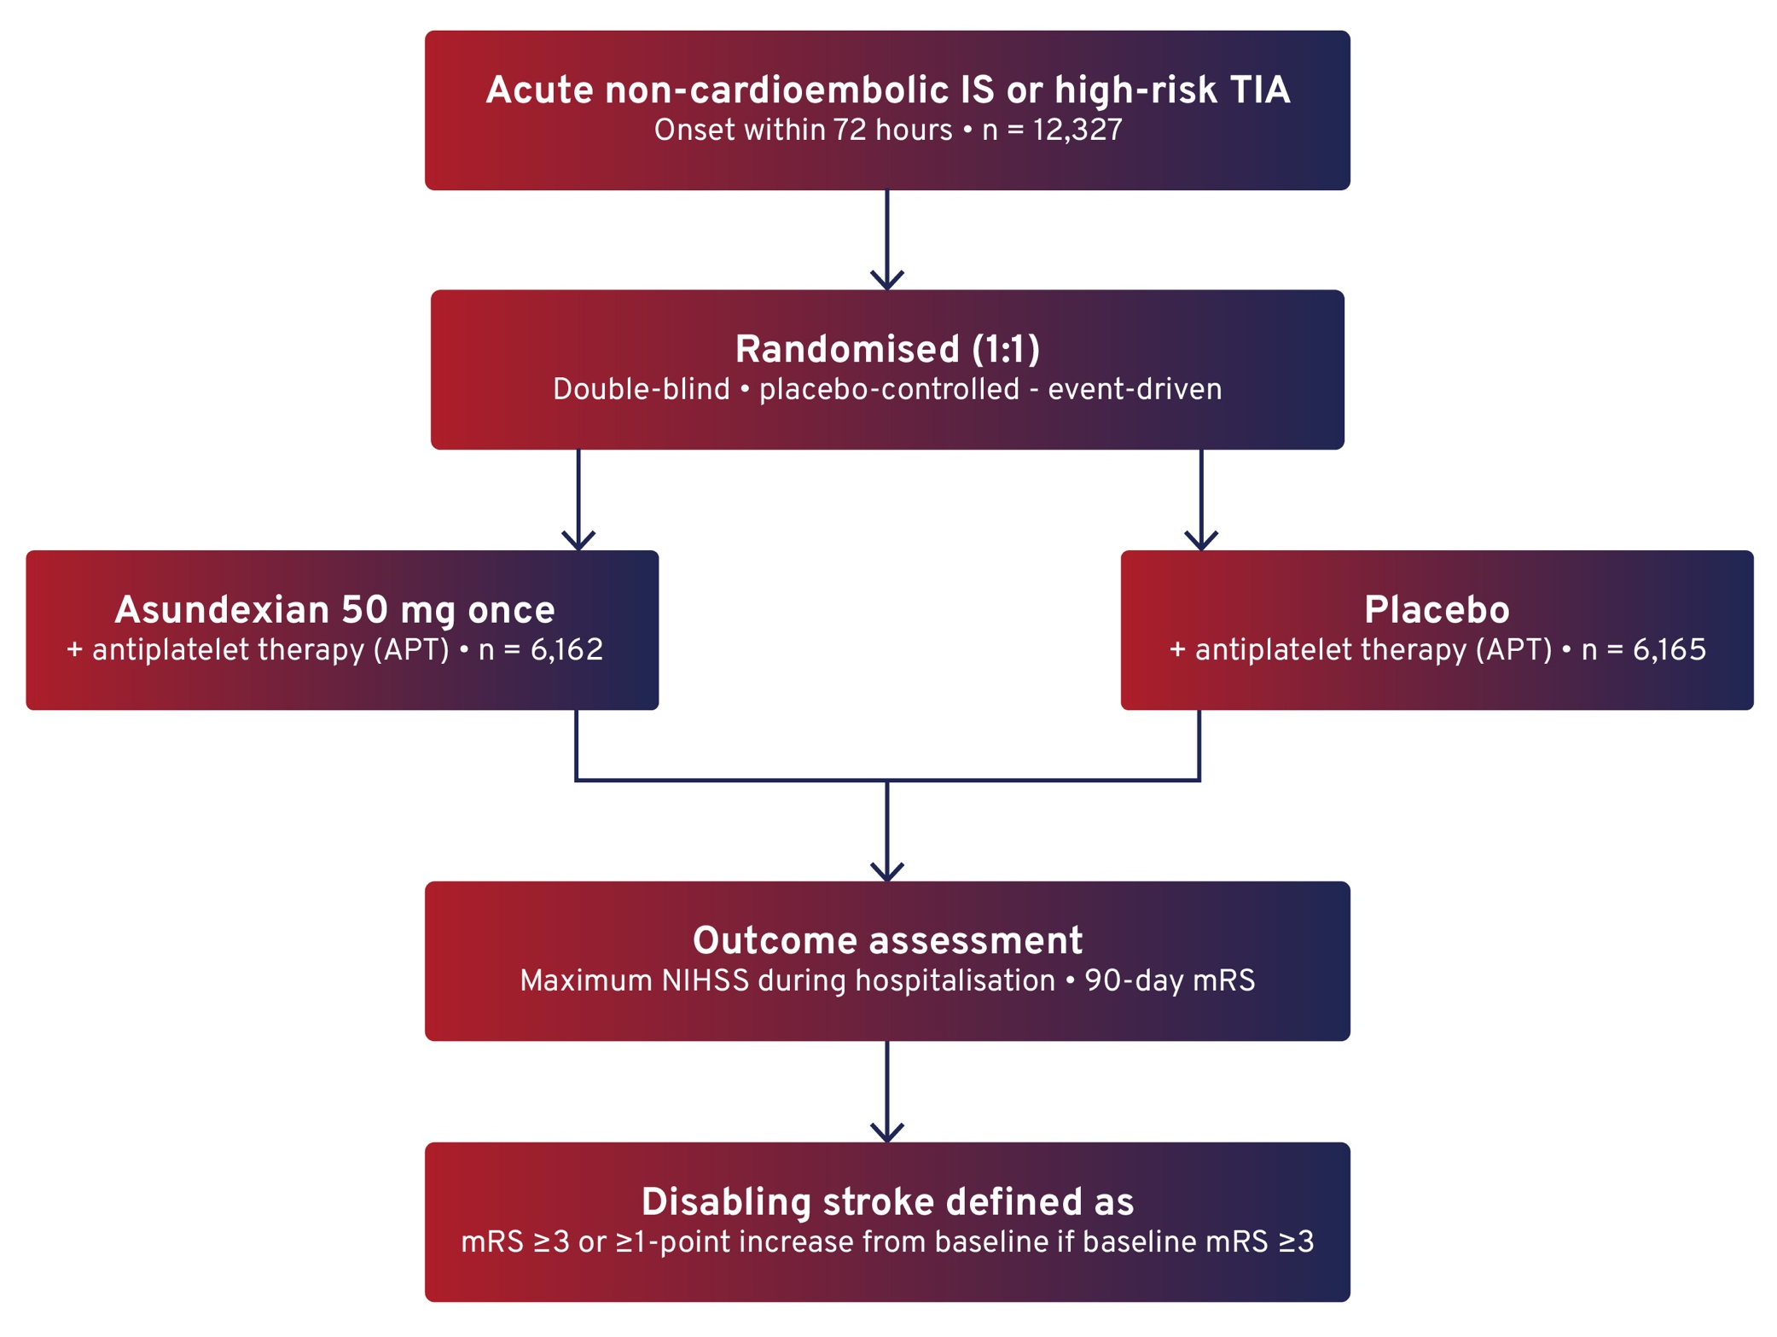
INCIDENT ISCHAEMIC STROKE IN THE RANDOMISED, PLACEBO-CONTROLLED, EVENT-DRIVEN OCEANIC-STROKE TRIAL OF ASUNDEXIAN FOR SECONDARY STROKE PREVENTION: SEVERITY, TREATMENT AND OUTCOMES
Background
Recurrent ischaemic stroke remains a major risk following non-cardioembolic ischaemic stroke or high-risk TIA despite antiplatelet therapy.
Factor XIa inhibition is being explored as a potential strategy to reduce thrombosis while limiting bleeding risk.
Aim
To evaluate the severity, acute treatment, and outcomes of incident ischaemic stroke in the Phase III OCEANIC-STROKE trial of asundexian.
Methods
Notes:
Authorship: Mukul Sharma, Qiang Dong, Teruyuki Hirano, Scott Kasner, Jeffrey Saver, Jaime Masjuan, Andrew Demchuk, Eva Muehlhofer, Karleen Schulze, Ashkan Shoamanesh on behalf of OCEANIC-STROKE Steering Committee and Investigators
Abbreviations: APT, antiplatelet therapy; csHR, cause-specific hazard ratio; EVT, endovascular therapy; HT, haemorrhagic transformation; IS, ischaemic stroke; ITT, intent-to-treat; IVT, intravenous thrombolysis; mRS, modified Rankin Scale; NIHSS, National Institutes of Health Stroke Scale; TIA, transient ischaemic attack.
Abstract Number: ESOC2026LB157
Abstract Title: INCIDENT ISCHAEMIC STROKE IN THE RANDOMISED, PLACEBO-CONTROLLED, EVENT-DRIVEN OCEANIC-STROKE TRIAL OF ASUNDEXIAN FOR SECONDARY STROKE PREVENTION: SEVERITY, TREATMENT AND OUTCOMES
Abstract Category: 05.00 - RISK FACTORS AND PREVENTION (PRIMARY AND SECONDARY) - 05.02 - SECONDARY PREVENTION
Background and aims: In OCEANIC-STROKE, asundexian 50 mg once daily reduced ischaemic stroke (IS) (cause-specific hazard ratio [csHR] 0.74; 95% confidence interval [CI]: 0.65, 0.84) without increasing intracranial haemorrhage (ICrH) comparedwith placebo.1 We examined rates, outcomes, and predictors of ICrH and haemorrhagic stroke (HS).
Methods: We randomised 12,327 participants within 72 hours of acute non-cardioembolic IS or high-risk transient ischaemic attack (TIA) to asundexian or placebo. This analysis includes 12,254participants who received ≥1 dose of assigned treatment. Incident ICrH was adjudicated by blinded adjudicators. ICrH outcome was assessed using the 90-day modified Rankin Scale (mRS); disabling ICrH or HS was defined as mRS ≥3 or an increase of ≥1 point if baseline mRS ≥3. Site investigators determined whether ICrH or HS was the cause of death.
Results: With 1.2 years median time on treatment, 74 ICrH occurred, including 33 HS. Annualised rates of ICrH were 0.5% for both asundexian and placebo (csHR 1.07; 95% CI: 0.68, 1.68), and, for HS, were 0.2% vs 0.3% (HR 0.66; 95% CI: 0.33, 1.32), respectively). Annualised rates of disabling ICrH were 0.3% for both (HR 0.87; 95% CI: 0.46, 1.63) and were 0.2% vs 0.1% (HR 2.23; 95% CI: 0.78, 6.42) for fatal ICrH. Corresponding rates for disabling (0.1% vs 0.2%; HR 0.68; 95% CI: 0.30, 1.50) and fatal HS (0.1% vs 0.1%; HR 1.42; 95% CI: 0.45, 4.46) were low and comparable between groups.
Conclusions: ICrH and HS were infrequent, with similar severity and outcomes between asundexian and placebo. Asundexian is a novel stroke prevention strategy that reduces IS without apparent increases in incident, disabling or fatal ICrH, including HS.

Slide 31
INCIDENT ISCHAEMIC STROKE IN THE RANDOMISED, PLACEBO-CONTROLLED, EVENT-DRIVEN OCEANIC-STROKE TRIAL OF ASUNDEXIAN FOR SECONDARY STROKE PREVENTION: SEVERITY, TREATMENT AND OUTCOMES
Results
Fewer ischaemic strokes occurred with asundexian vs placebo:
6.2% vs 8.4%
csHR 0.74 (95% CI: 0.65–0.84)
Asundexian reduced disabling stroke: csHR 0.69 (95% CI: 0.55–0.87).
Severe recurrent stroke (NIHSS ≥8) was less common with asundexian: 22.9% vs 30.3% (P=0.045).
EVT use was lower with asundexian: csHR 0.61 (95% CI: 0.38–0.99).
Conclusion
Asundexian reduced the occurrence and severity of incident ischaemic stroke in patients with non-cardioembolic stroke or high-risk TIA compared with placebo.
Fewer incident strokes were disabling/fatal with asundexian:
csHR: 0.69 (95% CI: 0.55–0.87)
EVT was less common with asundexian assignment, suggestive of a lower incidence of large artery occlusion: csHR 0.61 (95% CI 0.38–0.99).
Outcomes after acute treatment were similar in asundexian assigned patients but experience to date is limited.
Notes:
Authorship: Mukul Sharma, Qiang Dong, Teruyuki Hirano, Scott Kasner, Jeffrey Saver, Jaime Masjuan, Andrew Demchuk, Eva Muehlhofer, Karleen Schulze, Ashkan Shoamanesh on behalf of OCEANIC-STROKE Steering Committee and Investigators
Abbreviations: APT, antiplatelet therapy; csHR, cause-specific hazard ratio; EVT, endovascular therapy; HT, haemorrhagic transformation; IS, ischaemic stroke; ITT, intent-to-treat; IVT, intravenous thrombolysis; mRS, modified Rankin Scale; NIHSS, National Institutes of Health Stroke Scale; TIA, transient ischaemic attack.
Abstract Number: ESOC2026LB157
Abstract Title: INCIDENT ISCHAEMIC STROKE IN THE RANDOMISED, PLACEBO-CONTROLLED, EVENT-DRIVEN OCEANIC-STROKE TRIAL OF ASUNDEXIAN FOR SECONDARY STROKE PREVENTION: SEVERITY, TREATMENT AND OUTCOMES
Abstract Category: 05.00 - RISK FACTORS AND PREVENTION (PRIMARY AND SECONDARY) - 05.02 - SECONDARY PREVENTION
Background and aims: In OCEANIC-STROKE, asundexian 50 mg once daily reduced ischaemic stroke (IS) (cause-specific hazard ratio [csHR] 0.74; 95% confidence interval [CI]: 0.65, 0.84) without increasing intracranial haemorrhage (ICrH) comparedwith placebo.1 We examined rates, outcomes, and predictors of ICrH and haemorrhagic stroke (HS).
Methods: We randomised 12,327 participants within 72 hours of acute non-cardioembolic IS or high-risk transient ischaemic attack (TIA) to asundexian or placebo. This analysis includes 12,254participants who received ≥1 dose of assigned treatment. Incident ICrH was adjudicated by blinded adjudicators. ICrH outcome was assessed using the 90-day modified Rankin Scale (mRS); disabling ICrH or HS was defined as mRS ≥3 or an increase of ≥1 point if baseline mRS ≥3. Site investigators determined whether ICrH or HS was the cause of death.
Results: With 1.2 years median time on treatment, 74 ICrH occurred, including 33 HS. Annualised rates of ICrH were 0.5% for both asundexian and placebo (csHR 1.07; 95% CI: 0.68, 1.68), and, for HS, were 0.2% vs 0.3% (HR 0.66; 95% CI: 0.33, 1.32), respectively). Annualised rates of disabling ICrH were 0.3% for both (HR 0.87; 95% CI: 0.46, 1.63) and were 0.2% vs 0.1% (HR 2.23; 95% CI: 0.78, 6.42) for fatal ICrH. Corresponding rates for disabling (0.1% vs 0.2%; HR 0.68; 95% CI: 0.30, 1.50) and fatal HS (0.1% vs 0.1%; HR 1.42; 95% CI: 0.45, 4.46) were low and comparable between groups.
Conclusions: ICrH and HS were infrequent, with similar severity and outcomes between asundexian and placebo. Asundexian is a novel stroke prevention strategy that reduces IS without apparent increases in incident, disabling or fatal ICrH, including HS.

Slide 32
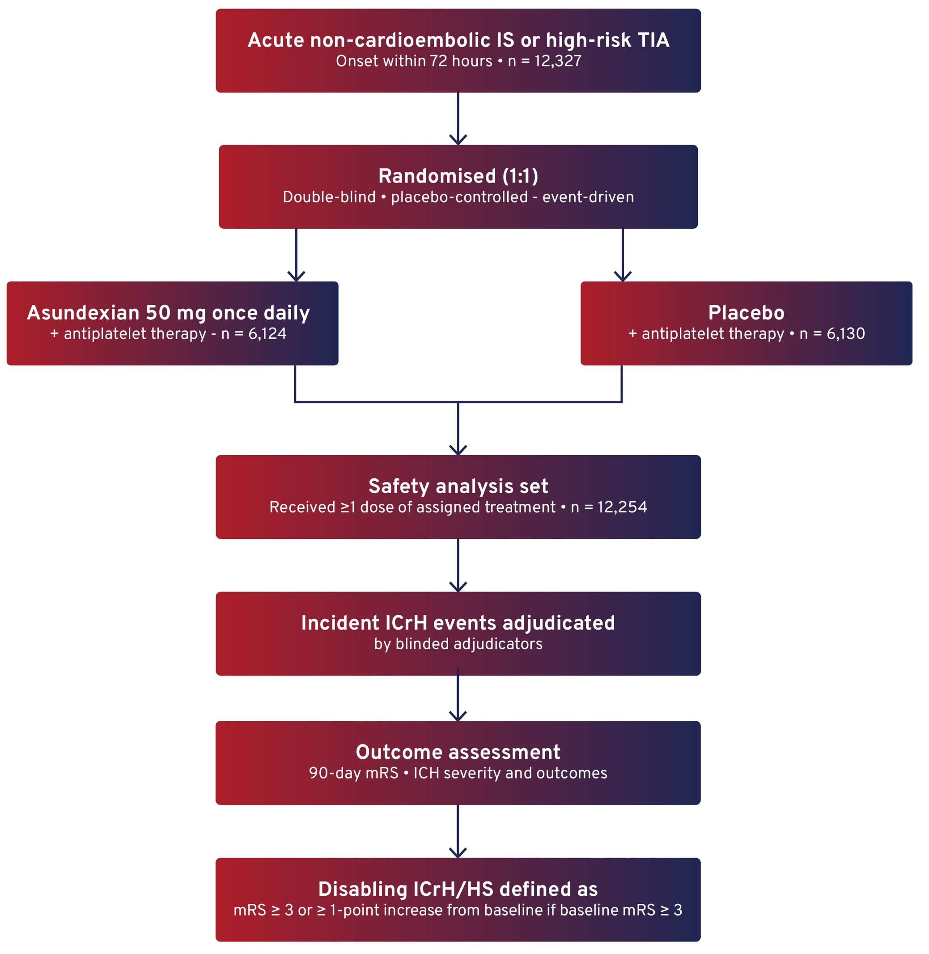
INTRACRANIAL HAEMORRHAGE IN PATIENTS WITH NON-CARDIOEMBOLIC ISCHAEMIC STROKE OR HIGH-RISK TIA: INSIGHTS FROM THE OCEANIC-STROKE RANDOMISED TRIAL OF ASUNDEXIAN FOR SECONDARY STROKE PREVENTION
Background
Secondary stroke prevention requires balancing efficacy and bleeding risk.
FXIa inhibition may reduce secondary stroke while limiting bleeding.
OCEANIC-STROKE previously showed reduced ischaemic stroke without increasing ICrH compared with placebo.
Aim
To evaluate rates, outcomes, and predictors of intracranial haemorrhage and haemorrhagic stroke in the OCEANIC-STROKE trial.
Methods
Notes:
Authorship: Ashkan Shoamanesh, Bruce Campbell, Andrea Zini, I Hui Lee, Martin Kovar, Robert Mikulík, Robin Lemmens, Eva Muehlhofer, Karleen Schulze, Mukul Sharma on behalf of OCEANIC-STROKE Steering Committee and Investigators
Abbreviations: CI, confidence interval; csHR, cause-specific hazard ratio; HS, haemorrhagic stroke; ICrH, intracranial haemorrhage; IS, ischaemic stroke; mRS, modified Rankin Scale; TIA, transient ischaemic attack.
Abstract Number: ESOC2026LB160
Abstract Title: INTRACRANIAL HAEMORRHAGE IN PATIENTS WITH NON-CARDIOEMBOLIC ISCHAEMIC STROKE OR HIGH-RISK TIA: INSIGHTS FROM THE OCEANIC-STROKE RANDOMISED TRIAL OF ASUNDEXIAN FOR SECONDARY STROKE PREVENTION
Abstract Category: 05.00 - RISK FACTORS AND PREVENTION (PRIMARY AND SECONDARY) - 05.02 - SECONDARY PREVENTION
Background and aims:
In the OCEANIC-STROKE trial, asundexian 50 mg once daily added to antiplatelet therapy reduced ischaemic stroke (IS) compared with placebo (cause-specific hazard ratio [HR] 0.74; 95% confidence interval [CI]: 0.65, 0.84) in patients with non-cardioembolic IS or high-risk transient ischaemic attack (TIA).1 We examined baseline predictors of recurrent IS and whether these modified the treatment effect of asundexian.
Methods:
We randomised 12,327 participants within 72 hours of acute non-cardioembolic IS or high-risk TIA to asundexian or placebo. The primary efficacy endpoint was time to first IS. Multivariable logistic regression identified baseline predictors of recurrent IS in patients with qualifying IS at study entry. Potential interactions between these variables and the treatment effect of asundexian for the primary efficacy endpoint were explored using the intention-to-treat principle.
Results:
Among 11,677 participants with index stroke, 843 IS occurred over a median follow-up of 1.6 years; the annualised rate of IS was 7.2%. In multivariable analysis, assignment to asundexian was associated with lower risk of recurrent IS (HR 0.73; 95% CI: 0.64, 0.84). Older age (per year; HR 1.01; 95% CI: 1.00, 1.02), Black race (HR 1.67; 95% CI: 1.14, 2.45) and Other race (HR 1.68; 95% CI: 1.22, 2.32) versus White race, history of diabetes (HR 1.39; 95% CI: 1.21, 1.60), previous stroke or TIA (HR 2.05; 95% CI: 1.77, 2.36), index IS attributed to large-artery atherosclerosis (HR 1.41; 95% CI: 1.23, 1.62), and medical history of atherosclerosis (HR 1.26; 95% CI: 1.09, 1.46) were associated with higher risk of recurrent IS. No heterogeneity in the treatment effect of asundexian was observed across these variables for the primary efficacy endpoint
Conclusions:
Baseline characteristics identify patients with acute non-cardioembolic IS at increased risk of IS recurrence. Asundexian, when added to standard antiplatelet therapy, reduced IS compared with placebo, with a consistent effect across multiple identified high-risk subgroups.

Slide 33
INTRACRANIAL HAEMORRHAGE IN PATIENTS WITH NON-CARDIOEMBOLIC ISCHAEMIC STROKE OR HIGH-RISK TIA: INSIGHTS FROM THE OCEANIC-STROKE RANDOMISED TRIAL OF ASUNDEXIAN FOR SECONDARY STROKE PREVENTION
Results
Median time on treatment was 1.2 years, during which 74 ICrH events occurred, including, including 33 haemorrhagic strokes.
Annualised ICrH rates were identical between groups:
0.5% vs 0.5%
csHR 1.07 (95% CI: 0.68–1.68)
Haemorrhagic stroke rates were similarly low:
0.2% vs 0.3%
csHR 0.66 (95% CI: 0.33–1.32)
Rates of disabling and fatal ICrH and HS remained low and comparable between groups.
Older age and Asian race independently predicted ICrH.
Conclusion
Intracranial haemorrhage and haemorrhagic stroke were infrequent and showed similar severity and outcomes between treatment groups.
Findings support the potential of asundexian as a novel secondary stroke prevention strategy that reduces ischaemic stroke without an apparent increase in incident, disabling, or fatal intracranial haemorrhage.
Notes:
Authorship: Ashkan Shoamanesh, Bruce Campbell, Andrea Zini, I Hui Lee, Martin Kovar, Robert Mikulík, Robin Lemmens, Eva Muehlhofer, Karleen Schulze, Mukul Sharma on behalf of OCEANIC-STROKE Steering Committee and Investigators
Abbreviations: CI, confidence interval; csHR, cause-specific hazard ratio; HS, haemorrhagic stroke; ICrH, intracranial haemorrhage; IS, ischaemic stroke; mRS, modified Rankin Scale; TIA, transient ischaemic attack.
Abstract Number: ESOC2026LB160
Abstract Title: INTRACRANIAL HAEMORRHAGE IN PATIENTS WITH NON-CARDIOEMBOLIC ISCHAEMIC STROKE OR HIGH-RISK TIA: INSIGHTS FROM THE OCEANIC-STROKE RANDOMISED TRIAL OF ASUNDEXIAN FOR SECONDARY STROKE PREVENTION
Abstract Category: 05.00 - RISK FACTORS AND PREVENTION (PRIMARY AND SECONDARY) - 05.02 - SECONDARY PREVENTION
Background and aims:
In the OCEANIC-STROKE trial, asundexian 50 mg once daily added to antiplatelet therapy reduced ischaemic stroke (IS) compared with placebo (cause-specific hazard ratio [HR] 0.74; 95% confidence interval [CI]: 0.65, 0.84) in patients with non-cardioembolic IS or high-risk transient ischaemic attack (TIA).1 We examined baseline predictors of recurrent IS and whether these modified the treatment effect of asundexian.
Methods:
We randomised 12,327 participants within 72 hours of acute non-cardioembolic IS or high-risk TIA to asundexian or placebo. The primary efficacy endpoint was time to first IS. Multivariable logistic regression identified baseline predictors of recurrent IS in patients with qualifying IS at study entry. Potential interactions between these variables and the treatment effect of asundexian for the primary efficacy endpoint were explored using the intention-to-treat principle.
Results:
Among 11,677 participants with index stroke, 843 IS occurred over a median follow-up of 1.6 years; the annualised rate of IS was 7.2%. In multivariable analysis, assignment to asundexian was associated with lower risk of recurrent IS (HR 0.73; 95% CI: 0.64, 0.84). Older age (per year; HR 1.01; 95% CI: 1.00, 1.02), Black race (HR 1.67; 95% CI: 1.14, 2.45) and Other race (HR 1.68; 95% CI: 1.22, 2.32) versus White race, history of diabetes (HR 1.39; 95% CI: 1.21, 1.60), previous stroke or TIA (HR 2.05; 95% CI: 1.77, 2.36), index IS attributed to large-artery atherosclerosis (HR 1.41; 95% CI: 1.23, 1.62), and medical history of atherosclerosis (HR 1.26; 95% CI: 1.09, 1.46) were associated with higher risk of recurrent IS. No heterogeneity in the treatment effect of asundexian was observed across these variables for the primary efficacy endpoint
Conclusions:
Baseline characteristics identify patients with acute non-cardioembolic IS at increased risk of IS recurrence. Asundexian, when added to standard antiplatelet therapy, reduced IS compared with placebo, with a consistent effect across multiple identified high-risk subgroups.

