Slide 1
ESOC 2026 Best of:
Neurointerventional Treatment

Slide 2
Disclaimer
This slide deck is designed for personal educational purposes only and should not be utilised for making patient management decisions. It is important to verify all information provided before treating patients or applying any therapies mentioned in these materials.

Slide 3

Information
This slide deck showcases the latest data presented at the 12th European Stroke Organisation Conference (ESOC 2026). All abbreviations displayed on these slides, along with a complete copy of the original abstract text, can be found in the slide notes. Click on the Home symbol to return to the content page.
Supported with an unrestricted educational grant by Stryker:

Slide 4
Content
Abstract number | Abstract title
ESOC2026A1252 | INTRAVENOUS THROMBOLYSIS IN ACUTE ISCHEMIC STROKE PATIENTS ON DIRECT ORAL ANTICOAGULANTS UNDERGOING ENDOVASCULAR THROMBECTOMY
ESOC2026A2017 | SELECTIVE INTRA-ARTERIAL MILD COOLING VERSUS SYSTEMIC DEEP HYPOTHERMIA POST-EVT: A SYSTEMATIC REVIEW AND META-ANALYSIS
ESOC2026A2070 | IMPACT-EVT: CONCEPTUAL RISK SCORE FOR IN-HOSPITAL MORTALITY AFTER MECHANICAL THROMBECTOMY
ESOC2026A1149 | FINAL RESULTS OF THE MARRS PIVOTAL STUDY: IMPACT OF A NOVEL 0.088” CORRUGATED SUPERBORE ASPIRATION CATHETER ON REPERFUSION IN LARGE VESSEL OCCLUSIONS
ESOC2026A1805 | ENDOVASCULAR THERAPY VERSUS MEDICAL MANAGEMENT FOR LARGE ISCHEMIC CORE STROKE IDENTIFIED AT PRIMARY STROKE CENTERS: A SUBANALYSIS OF THE LASTE TRIAL
ESOC2026A419 | FINAL RESULTS OF THE PHASE II ARG-007-002 SEANCON TRIAL OF ARG-007 IN ACUTE ISCHAEMIC STROKE PATIENTS UNDERGOING ENDOVASCULAR THROMBECTOMY

Slide 5
Content
Abstract number | Abstract title
ESOC2026A943 | MEDICAL MANAGEMENT AND REVASCULARIZATION FOR ASYMPTOMATIC CAROTID STENOSIS: A META-ANALYSIS OF RANDOMIZED CONTROLLED TRIALS
ESOC2026A1114 | ANTITHROMBOTIC REGIMEN AFTER EMERGENT CAROTID ARTERY STENTING AND RISK OF EARLY COMPLICATIONS: RESULTS FROM A POPULATION-BASED STUDY
ESOC2026A2203 | ENDOVASCULAR STROKE TREATMENT PERFORMED BY INTERVENTIONAL CARDIOLOGISTS: A SYSTEMATIC REVIEW AND META-ANALYSIS
ESOC2026A1562 | MICROSURGICAL REVASCULARIZATION AS SALVAGE TREATMENT AFTER FAILED ENDOVASCULAR THERAPY IN ACUTE INTRACRANIAL ARTERIAL OCCLUSION
ESOC2026A1728 | EVT IN PATIENTS WITH TANDEM LESIONS: EFFECT OF CAS AND EVT DEVICES
ESOC2026A557 | ADJUNCTIVE HYPOTHERMIA AFTER ENDOVASCULAR REPERFUSION THERAPY FOR ACUTE ISCHEMIC STROKE: EVIDENCE FROM A META-ANALYSIS

Slide 6
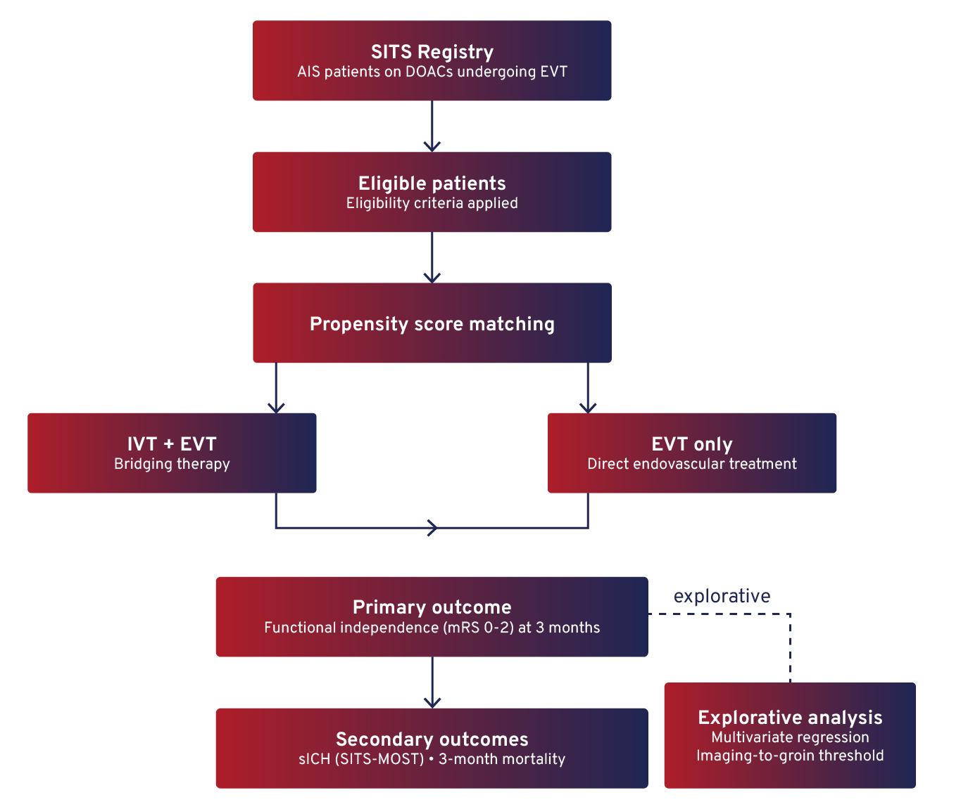
INTRAVENOUS THROMBOLYSIS IN ACUTE ISCHEMIC STROKE PATIENTS ON DIRECT ORAL ANTICOAGULANTS UNDERGOING ENDOVASCULAR THROMBECTOMY
Background
The necessity of bridging endovascular thrombectomy (EVT) with intravenous thrombolysis (IVT) in acute ischemic stroke (AIS) is debated.
Observational studies indicate IVT may be safe in AIS patients on direct oral anticoagulants (DOACs).
Aim
To investigate the risk-benefit of bridging therapy (IVT + EVT) versus EVT alone in AIS patients on DOACs.
Methods
Notes:
Authorship: Marius Matusevicius, Ana Paiva Nunes, Andrea Zini, Guido Bigliardi, André Peeters, Danilo Toni, Niaz Ahmed
Abbreviations: AIS, acute ischemic stroke; DOACs, direct oral anticoagulants; EVT, endovascular thrombectomy; IVT, intravenous thrombolysis; NIHSS, National Institutes of Health Stroke Scale; PSM, propensity score matching; SICH, symptomatic intracerebral haemorrhage; SITS, Safe Implementation of Treatments in Stroke; SITS-MOST, Safe Implementation of Treatments in Stroke-Monitoring Study.
Abstract Number: ESOC2026A1252
Abstract Title: INTRAVENOUS THROMBOLYSIS IN ACUTE ISCHEMIC STROKE PATIENTS ON DIRECT ORAL ANTICOAGULANTS UNDERGOING ENDOVASCULAR THROMBECTOMY
Abstract Category: 01.00 - ACUTE ISCHEMIC STROKE MANAGEMENT - 01.04 - THROMBOLYSIS
Background:
The necessity of bridging endovascular thrombectomy (EVT) with intravenous thrombolysis (IVT) in acute ischemic stroke (AIS) has been questioned. Recent observational studies suggest that IVT is safe in AIS patients on direct oral anticoagulants (DOAC). We aimed to investigate the risk-benefit of bridging therapy in AIS patients on DOAC.
Methods:
We used the SITS international Treatment registry to include AIS patients on DOAC that received EVT. We compared bridging therapy with EVT alone using propensity score matching (PSM). Primary outcome was 3-month functional independency (modified Rankin scale 0-2). Secondary outcomes were symptomatic intracerebral hemorrhage (SICH) per SITS-MOST definition and death by 3 months. We performed explorative multivariate regression of quadratically modelled imaging-to-groin time, investigating any cut-offs for functional independence.
Results:
Of 1,991 DOAC treated EVT patients, 317 received IVT. After PSM, we included 294 bridging therapy patients and 587 EVT only patients. After PSM, the groups were well balanced for baseline and demographic characteristics (median NIHSS 17 vs. 16, age 76 and onset to imaging time 99 min in both groups). There were no statistically significant differences in functional independence (36% vs. 35%), SICH (1.5% vs. 2.2%) and mortality (34% vs. 30%) between bridging and EVT only. Explorative analyses found imaging-to-groin time within 66 min favors EVT only while imaging-to-groin time beyond 185 min favors bridging.
Conclusions:
We found no differences in safety and outcomes between bridging therapy and EVT only in AIS patients on DOAC. Explorative analyses suggesting shorter imaging-to-groin times favor direct EVT while longer times favor bridging.

Slide 7
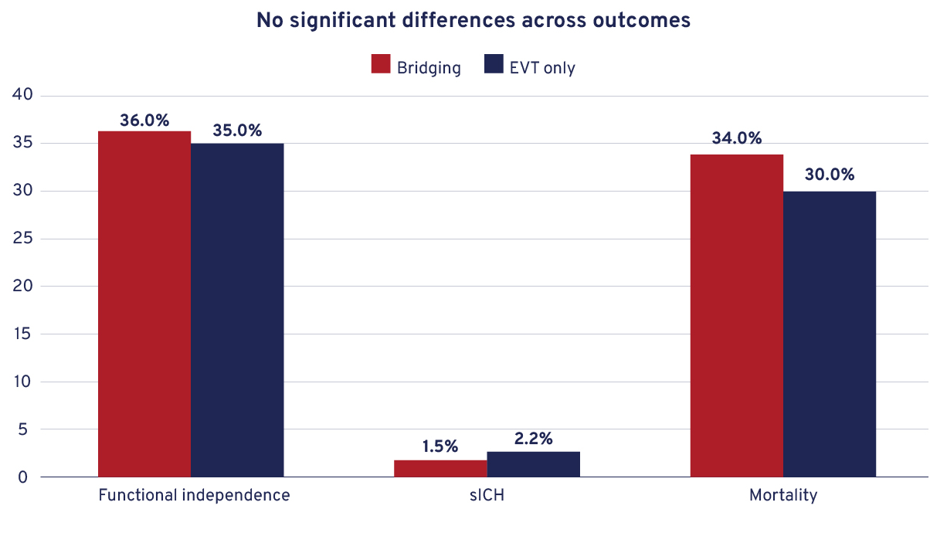
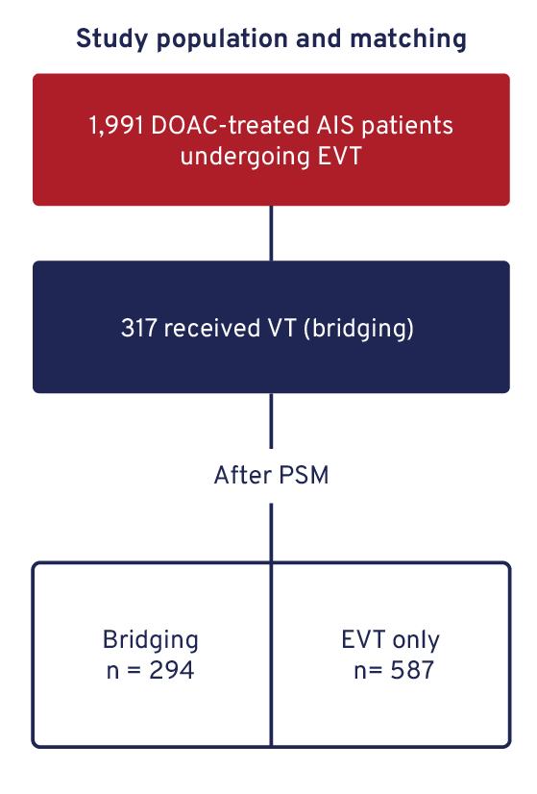
INTRAVENOUS THROMBOLYSIS IN ACUTE ISCHEMIC STROKE PATIENTS ON DIRECT ORAL ANTICOAGULANTS UNDERGOING ENDOVASCULAR THROMBECTOMY
Results
Groups were well balanced after PSM (median NIHSS 17 vs 16; age 76; onset-to-imaging 99 min).
Explorative analysis: imaging-to-groin ≤66 min favours EVT only; >185 min favours bridging.
Conclusion
Bridging and EVT alone show no differences in safety and functional outcomes in AIS patients on DOACs.
Shorter imaging-to-groin times may favour direct EVT, whereas longer times may benefit from bridging.
Notes:
Authorship: Marius Matusevicius, Ana Paiva Nunes, Andrea Zini, Guido Bigliardi, André Peeters, Danilo Toni, Niaz Ahmed
Abbreviations: AIS, acute ischemic stroke; DOACs, direct oral anticoagulants; EVT, endovascular thrombectomy; IVT, intravenous thrombolysis; NIHSS, National Institutes of Health Stroke Scale; PSM, propensity score matching; SICH, symptomatic intracerebral haemorrhage; SITS, Safe Implementation of Treatments in Stroke; SITS-MOST, Safe Implementation of Treatments in Stroke-Monitoring Study.
Abstract Number: ESOC2026A1252
Abstract Title: INTRAVENOUS THROMBOLYSIS IN ACUTE ISCHEMIC STROKE PATIENTS ON DIRECT ORAL ANTICOAGULANTS UNDERGOING ENDOVASCULAR THROMBECTOMY
Abstract Category: 01.00 - ACUTE ISCHEMIC STROKE MANAGEMENT - 01.04 - THROMBOLYSIS
Background:
The necessity of bridging endovascular thrombectomy (EVT) with intravenous thrombolysis (IVT) in acute ischemic stroke (AIS) has been questioned. Recent observational studies suggest that IVT is safe in AIS patients on direct oral anticoagulants (DOAC). We aimed to investigate the risk-benefit of bridging therapy in AIS patients on DOAC.
Methods:
We used the SITS international Treatment registry to include AIS patients on DOAC that received EVT. We compared bridging therapy with EVT alone using propensity score matching (PSM). Primary outcome was 3-month functional independency (Modified Rankin Scale 0-2). Secondary outcomes were symptomatic intracerebral hemorrhage (SICH) per SITS-MOST definition and death by 3 months. We performed explorative multivariate regression of quadratically modelled imaging-to-groin time, investigating any cut-offs for functional independence.
Results:
Of 1,991 DOAC treated EVT patients, 317 received IVT. After PSM, we included 294 bridging therapy patients and 587 EVT only patients. After PSM, the groups were well balanced for baseline and demographic characteristics (median NIHSS 17 vs. 16, age 76 and onset to imaging time 99 min in both groups). There were no statistically significant differences in functional independence (36% vs. 35%), SICH (1.5% vs. 2.2%) and mortality (34% vs. 30%) between bridging and EVT only. Explorative analyses found imaging-to-groin time within 66 min favors EVT only while imaging-to-groin time beyond 185 min favors bridging.
Conclusions:
We found no differences in safety and outcomes between bridging therapy and EVT only in AIS patients on DOAC. Explorative analyses suggesting shorter imaging-to-groin times favor direct EVT while longer times favor bridging.

Slide 8
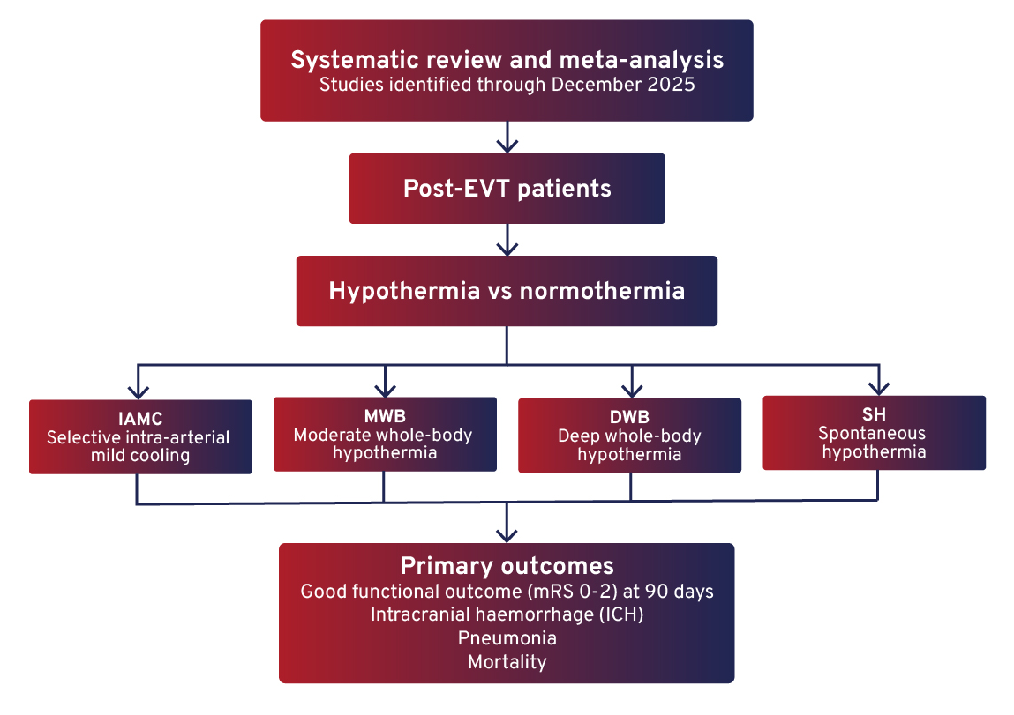
SELECTIVE INTRA-ARTERIAL MILD COOLING VERSUS SYSTEMIC DEEP HYPOTHERMIA POST-EVT: A SYSTEMATIC REVIEW AND META-ANALYSIS
Background
Therapeutic hypothermia is a neuroprotective strategy after endovascular thrombectomy (EVT) for large-vessel occlusion.
Clinical results are heterogeneous due to differences in cooling techniques and temperature targets.
Aim
To evaluate the efficacy and safety of different hypothermia methods post-EVT by stratifying hypothermia methods and temperature targets.
Methods
Notes:
Authorship: Amiel Aragon Cortes, Andrea Beltran, Rodrigo Pille Camarillo, Alondra Arely Silva Bracamontes, Ricardo Orozco, José Ixta, Andrea Yáñez Mata, Diana Perez Almaraz, Sandra Rodriguez, Alejandro Godinez, Dilmareth Natera-Rodriguez, Jose Gasca, Jesús Alejandro Ramírez Guzmán, Oscar Eduardo Camacho Hernández, Alonso Gutierrez-Romero, Diego López-Mena
Abbreviations: CI, confidence interval; DWB, Deep whole-body hypothermia; EVT, Endovascular thrombectomy; IAMC, Intra-arterial mild cooling ; ICH, Intracranial haemorrhage; mRS, Modified Rankin Scale; MWB, Moderate whole-body Hypothermia; SH, Spontaneous hypothermia; RR, relative risk.
Abstract Number: ESOC2026A2017
Abstract Title: SELECTIVE INTRA-ARTERIAL MILD COOLING VERSUS SYSTEMIC DEEP HYPOTHERMIA POST-EVT: A SYSTEMATIC REVIEW AND META-ANALYSIS
Abstract Category: 01.00 - ACUTE ISCHEMIC STROKE MANAGEMENT
Background and aims:
Therapeutic hypothermia has been explored as a neuroprotective strategy after endovascular therapy for large-vessel occlusion, but results remain heterogeneous due to different cooling techniques. This first meta-analysis evaluates efficacy and safety by stratifying hypothermia methods and temperature targets to reduce heterogeneity.
Methods:
We performed a systematic search through December 2025 to identify studies comparing selective hypothermia using intra-arterial mild cooling (IAMC), moderate whole-body hypothermia (MWB), deep whole-body hypothermia (DWB), and spontaneous hypothermia (SH) versus normothermia in post-EVT patients. Primary outcomes included good functional outcome at 90 days (mRS 0–2), intracranial hemorrhage (ICH), pneumonia, and mortality.
Results:
Twelve studies were included (5 RCTs and 7 observational; 1,935 patients). Compared with normothermia, IAMC was associated with a higher likelihood of achieving mRS 0–2 (RR 1.48, 95% CI 1.21–1.81, p=0.0001), with non-significant reductions in ICH (RR 0.79, p=0.30) and mortality (RR 0.91, p=0.66). DWB was associated with a reduced risk of intracranial hemorrhage (RR 0.33, p=0.004), MWB with increased pneumonia risk (RR 2.98, 95% CI 1.58–5.62, p=0.0007), and SH with increased mortality (RR 1.40, 95% CI 1.11–1.76, p=0.004).

Slide 9
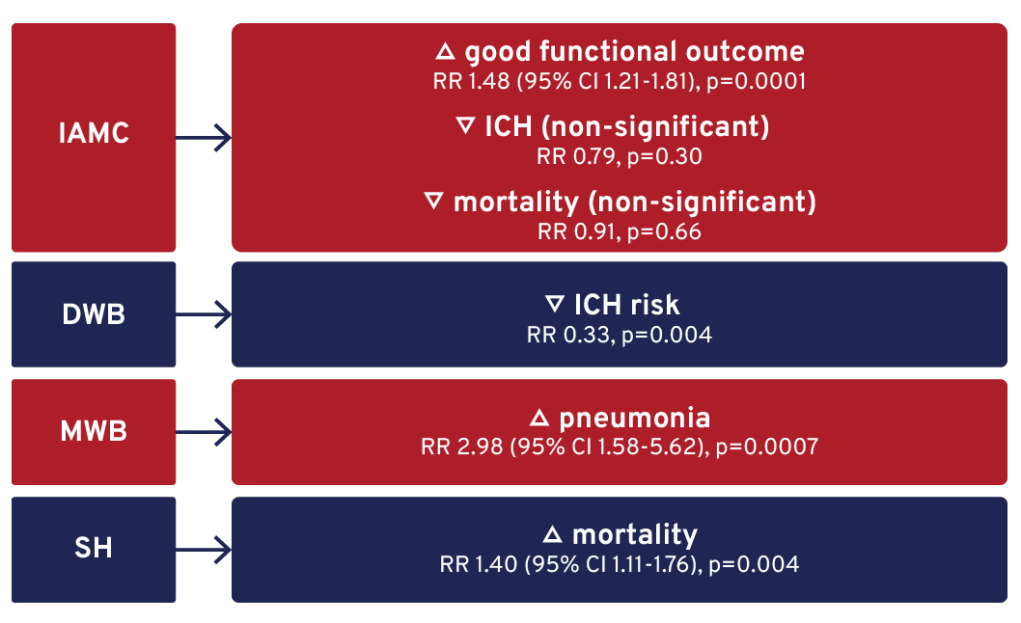
SELECTIVE INTRA-ARTERIAL MILD COOLING VERSUS SYSTEMIC DEEP HYPOTHERMIA POST-EVT: A SYSTEMATIC REVIEW AND META-ANALYSIS
Results
1,935 patients across 12 studies (5 RCTs, 7 observational).
Conclusion
Selective intra-arterial mild cooling post-EVT was associated with a higher likelihood of achieving good functional outcome (mRS 0–2), with non-significant reductions in ICH and mortality.
Deep whole-body hypothermia was associated with reduced ICH, but moderate systemic hypothermia was associated with increased pneumonia, and spontaneous hypothermia was associated with increased mortality.
Notes:
Authorship: Amiel Aragon Cortes, Andrea Beltran, Rodrigo Pille Camarillo, Alondra Arely Silva Bracamontes, Ricardo Orozco, José Ixta, Andrea Yáñez Mata, Diana Perez Almaraz, Sandra Rodriguez, Alejandro Godinez, Dilmareth Natera-Rodriguez, Jose Gasca, Jesús Alejandro Ramírez Guzmán, Oscar Eduardo Camacho Hernández, Alonso Gutierrez-Romero, Diego López-Mena
Abbreviations: CI, confidence interval; DWB, Deep whole-body hypothermia; EVT, Endovascular thrombectomy; IAMC, Intra-arterial mild cooling ; ICH, Intracranial haemorrhage; mRS, Modified Rankin Scale; MWB, Moderate whole-body Hypothermia; SH, Spontaneous hypothermia; RR, relative risk.
Abstract Number: ESOC2026A2017
Abstract Title: SELECTIVE INTRA-ARTERIAL MILD COOLING VERSUS SYSTEMIC DEEP HYPOTHERMIA POST-EVT: A SYSTEMATIC REVIEW AND META-ANALYSIS
Abstract Category: 01.00 - ACUTE ISCHEMIC STROKE MANAGEMENT
Background and aims:
Therapeutic hypothermia has been explored as a neuroprotective strategy after endovascular therapy for large-vessel occlusion, but results remain heterogeneous due to different cooling techniques. This first meta-analysis evaluates efficacy and safety by stratifying hypothermia methods and temperature targets to reduce heterogeneity.
Methods:
We performed a systematic search through December 2025 to identify studies comparing selective hypothermia using intra-arterial mild cooling (IAMC), moderate whole-body hypothermia (MWB), deep whole-body hypothermia (DWB), and spontaneous hypothermia (SH) versus normothermia in post-EVT patients. Primary outcomes included good functional outcome at 90 days (mRS 0–2), intracranial hemorrhage (ICH), pneumonia, and mortality.
Results:
Twelve studies were included (5 RCTs and 7 observational; 1,935 patients). Compared with normothermia, IAMC was associated with a higher likelihood of achieving mRS 0–2 (RR 1.48, 95% CI 1.21–1.81, p=0.0001), with non-significant reductions in ICH (RR 0.79, p=0.30) and mortality (RR 0.91, p=0.66). DWB was associated with a reduced risk of intracranial hemorrhage (RR 0.33, p=0.004), MWB with increased pneumonia risk (RR 2.98, 95% CI 1.58–5.62, p=0.0007), and SH with increased mortality (RR 1.40, 95% CI 1.11–1.76, p=0.004).

Slide 10
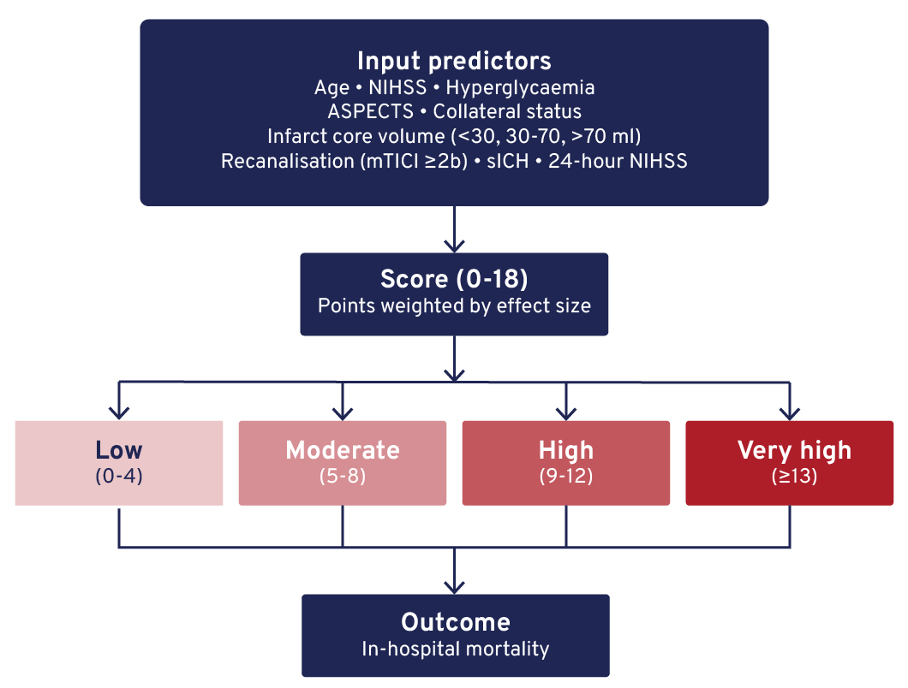
IMPACT-EVT: CONCEPTUAL RISK SCORE FOR IN-HOSPITAL MORTALITY AFTER MECHANICAL THROMBECTOMY
Background
Mechanical thrombectomy (MT) improves outcomes in large-vessel occlusion stroke, but in-hospital mortality remains significant.
Reliable, clinically practical tools for early mortality prediction are needed.
Aim
To develop a clinically intuitive risk score (IMPACT-EVT) to predict in-hospital mortality after MT using clinical, imaging, and procedural factors.
Methods
Score derived from multicentre registries (MR CLEAN, HERMES) and recent thrombectomy trials.
Notes:
Authorship: Dmytro Hrynykha, Dmytro Lebedynets, Yuliya Vlasiichuk, Olha Yasniy
Abbreviations: ASPECTS, Alberta Stroke Program Early CT Score; CTP, Computed Tomography Perfusion; DWI, Diffusion-Weighted Imaging; EVT, Endovascular thrombectomy; MT, Mechanical thrombectomy; mTICI, Modified Thrombolysis in Cerebral Infarction; NIHSS, NIH Stroke Scale/Score; sICH, Symptomatic intracerebral haemorrhage.
Abstract Number: ESOC2026A2070
Abstract Title: IMPACT-EVT: CONCEPTUAL RISK SCORE FOR IN-HOSPITAL MORTALITY AFTER MECHANICAL THROMBECTOMY - 01.05 - NEUROINTERVENTION
Abstract Category: 01.00 - ACUTE ISCHEMIC STROKE MANAGEMENT
Background and aims:
Mechanical thrombectomy (MT) improves outcomes in acute ischemic stroke due to large-vessel occlusion, yet in-hospital mortality remains substantial. We aimed to develop a clinically intuitive risk score—IMPACT-EVT—to predict in-hospital mortality after MT by integrating baseline clinical severity, neuroimaging tissue vulnerability, and early procedural outcomes.
Methods:
IMPACT-EVT was derived from published multicenter registries (MR CLEAN, HERMES) and recent thrombectomy trials. Variables with independent associations to in-hospital mortality were selected: age, baseline NIHSS, admission hyperglycemia, ASPECTS, collateral status, infarct core volume on CTP/DWI, recanalization success (mTICI ≥2b), symptomatic intracranial hemorrhage (sICH), and NIHSS at 24 hours. Infarct core volume was stratified as <30 ml, 30–70 ml, and >70 ml. Each variable was assigned points proportional to effect sizes reported in the literature. Total scores (0–18) were stratified into four risk categories: Low (0–4), Moderate (5–8), High (9–12), Very High (≥13).
Results:
Each domain independently contributed to mortality prediction. Baseline clinical factors, particularly age ≥80 and NIHSS >20, strongly influenced risk. Neuroimaging markers, including low ASPECTS, poor collaterals, and increasing core volume, enhanced discrimination. Procedural and early post-procedure factors, especially sICH and NIHSS at 24 h, were the most potent predictors. Risk categories corresponded with reported in-hospital mortality: Low (<5%), Moderate (5–15%), High (20–40%), Very High (>50%).
Conclusions:
IMPACT-EVT provides a practical, literature-based framework for early in-hospital mortality risk stratification after MT. Incorporating quantitative infarct core volume improves prognostic accuracy. External validation is required prior to clinical implementation.

Slide 11
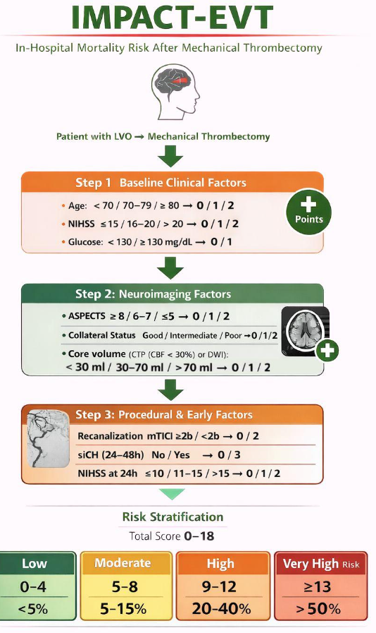
IMPACT-EVT: CONCEPTUAL RISK SCORE FOR IN-HOSPITAL MORTALITY AFTER MECHANICAL THROMBECTOMY
Results
All domains independently contributed to mortality prediction.
Strong predictors: age ≥80 and baseline NIHSS >20.
Imaging markers (low ASPECTS, poor collaterals, larger core volume) improved discrimination.
Most potent predictors: sICH and NIHSS at 24 hours.
Mortality by risk category:
  Low: <5%
  Moderate: 5-15%
  High: 20-40%
  Very High: >50%
Conclusion
IMPACT-EVT provides a practical, literature-based framework for early in-hospital mortality risk stratification after MT.
Incorporation of infarct core volume enhances prognostic accuracy.
External validation is required before clinical implementation.
Notes:
Authorship: Dmytro Hrynykha, Dmytro Lebedynets, Yuliya Vlasiichuk, Olha Yasniy
Abbreviations: ASPECTS, Alberta Stroke Program Early CT Score; CTP, Computed Tomography Perfusion; DWI, Diffusion-Weighted Imaging; EVT, Endovascular thrombectomy; MT, Mechanical thrombectomy; mTICI, Modified Thrombolysis in Cerebral Infarction; NIHSS, NIH Stroke Scale/Score; sICH, Symptomatic intracerebral haemorrhage.
Abstract Number: ESOC2026A2070
Abstract Title: IMPACT-EVT: CONCEPTUAL RISK SCORE FOR IN-HOSPITAL MORTALITY AFTER MECHANICAL THROMBECTOMY - 01.05 - NEUROINTERVENTION
Abstract Category: 01.00 - ACUTE ISCHEMIC STROKE MANAGEMENT
Background and aims:
Mechanical thrombectomy (MT) improves outcomes in acute ischemic stroke due to large-vessel occlusion, yet in-hospital mortality remains substantial. We aimed to develop a clinically intuitive risk score—IMPACT-EVT—to predict in-hospital mortality after MT by integrating baseline clinical severity, neuroimaging tissue vulnerability, and early procedural outcomes.
Methods:
IMPACT-EVT was derived from published multicenter registries (MR CLEAN, HERMES) and recent thrombectomy trials. Variables with independent associations to in-hospital mortality were selected: age, baseline NIHSS, admission hyperglycemia, ASPECTS, collateral status, infarct core volume on CTP/DWI, recanalization success (mTICI ≥2b), symptomatic intracranial hemorrhage (sICH), and NIHSS at 24 hours. Infarct core volume was stratified as <30 ml, 30–70 ml, and >70 ml. Each variable was assigned points proportional to effect sizes reported in the literature. Total scores (0–18) were stratified into four risk categories: Low (0–4), Moderate (5–8), High (9–12), Very High (≥13).
Results:
Each domain independently contributed to mortality prediction. Baseline clinical factors, particularly age ≥80 and NIHSS >20, strongly influenced risk. Neuroimaging markers, including low ASPECTS, poor collaterals, and increasing core volume, enhanced discrimination. Procedural and early post-procedure factors, especially sICH and NIHSS at 24 h, were the most potent predictors. Risk categories corresponded with reported in-hospital mortality: Low (<5%), Moderate (5–15%), High (20–40%), Very High (>50%).
Conclusions:
IMPACT-EVT provides a practical, literature-based framework for early in-hospital mortality risk stratification after MT. Incorporating quantitative infarct core volume improves prognostic accuracy. External validation is required prior to clinical implementation.

Slide 12
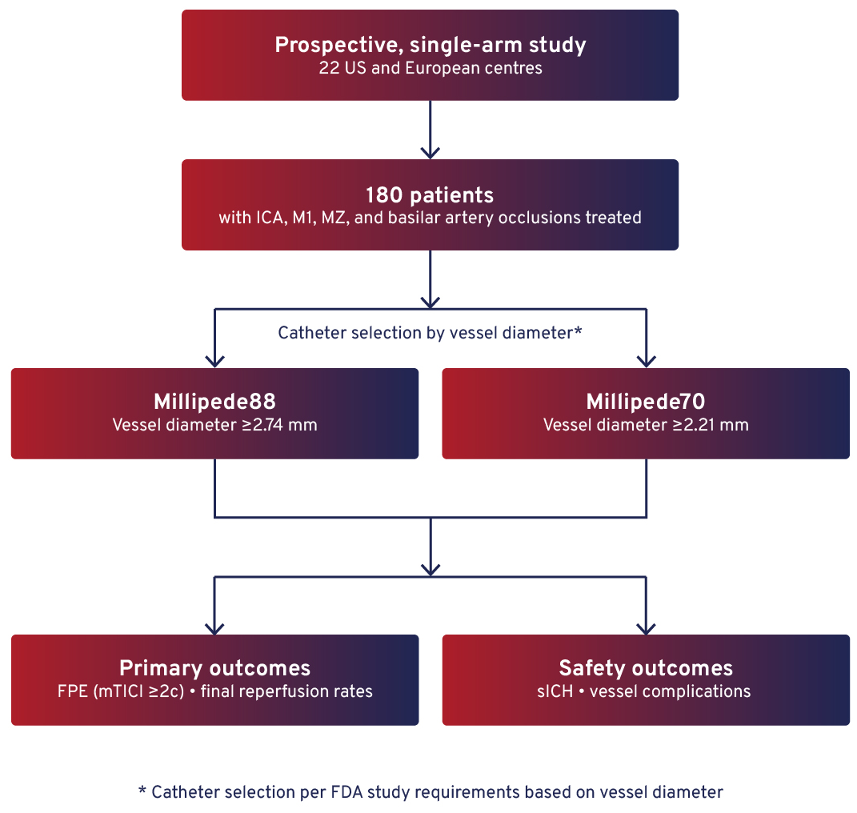
FINAL RESULTS OF THE MARRS PIVOTAL STUDY: IMPACT OF A NOVEL 0.088” CORRUGATED SUPERBORE ASPIRATION CATHETER ON REPERFUSION IN LARGE VESSEL OCCLUSIONS
Background
Large vessel occlusion (LVO) stroke outcomes are closely linked to rapid and complete reperfusion.
The Millipede AspiRation for Revascularization in Stroke (MARRS) pivotal study evaluates a novel 0.088” corrugated superbore aspiration catheter (Millipede System) designed to improve first-pass and overall reperfusion rates.
Aim
To assess the performance and safety of the Millipede System in acute ischaemic stroke patients with LVO within 8 hours of onset.
Methods
Notes:
Authorship: Raul Nogueira, Manuel Requena, Jaydevsinh Dolia, Syed Zaidi, Pedro Navia, Gaultier Marnat, Christophe Cognard, Tarun Bhalla, Alhamza R Al-Bayati, Charles Matouk, Michael Nahhas, Osama Zaidat, Romain Bourcier, Ryan Priest, Waldo Guerrero, Tareq Kass-Hout, Ameer Hassan, Ricardo Hanel, Benjamin Gory, Marc Ribo
Abbreviations: FPE, First-pass effect; ICA, Internal carotid artery; ITT, Intention-to-treat; LVO, Large vessel occlusion; MARRS, Millipede AspiRation for Revascularization in Stroke; mRS, Modified Rankin Scale; mTICI, Modified Thrombolysis in Cerebral Infarction; NIHSS, National Institutes of Health Stroke Scale; PP, Per-protocol; sICH, Symptomatic intracerebral haemorrhage.
Abstract Number: ESOC2026A1149
Abstract Title: FINAL RESULTS OF THE MARRS PIVOTAL STUDY: IMPACT OF A NOVEL 0.088” CORRUGATED SUPERBORE ASPIRATION CATHETER ON REPERFUSION IN LARGE VESSEL OCCLUSIONS
Abstract Category: 01.00 - ACUTE ISCHEMIC STROKE MANAGEMENT - 01.05 - NEUROINTERVENTION
Background and aims:
The Millipede AspiRation for Revascularization in Stroke (MARRS) pivotal study was a prospective, single-arm investigation to assess the performance and safety of the Millipede System in subjects with acute ischemic stroke due to large vessel occlusion (LVO) within 8 hours. This is the first presentation of the final study results.
Methods:
Enrolment occurred at 22 US and European sites. 180 subjects with ICA, M1, M2, and basilar artery occlusions were treated.
To meet FDA study requirements, users measured the target vessel and selected the catheter size ensuring the vessel diameter exceeded ≥2.74 mm for Millipede88 and ≥2.21 mm for Millipede70, respectively.
Results:
Median age was 69 years, 51% were male, with mean baseline NIHSS 17 and ASPECTS 8.6. M1 was the most common occlusion location (62%). Direct first-pass aspiration was performed using Millipede88 and Millipede70 in 115 and 64 subjects, respectively. Successful delivery of Superbore Millipede88 was 96%. In M1 occlusions, the FPE rate (mTICI ≥2c) with Millipede88 was 77% (PP). Overall Millipede88 FPE rate was 61% (PP), exceeding prior meta-analyses and large registries (27.0–46.6%). A final mTICI ≥2c rate of 85% was achieved (PP). Rates of sICH and intracranial dissection were low (2.3% and 1.1%, ITT). No significant differences in reperfusion success were observed between higher and lower- enrolling sites. 56% of patients treated with Millipede88 on first-pass (PP) achieved mRS 0-2 at 90 days.
Conclusions:
Millipede88 achieved the highest reperfusion rates reported among prospective thrombectomy trials to date. Outcomes were particularly favorable in M1 occlusions, likely reflecting optimal vessel-to-catheter diameter matching.

Slide 13

FINAL RESULTS OF THE MARRS PIVOTAL STUDY: IMPACT OF A NOVEL 0.088” CORRUGATED SUPERBORE ASPIRATION CATHETER ON REPERFUSION IN LARGE VESSEL OCCLUSIONS
Results
Median age 69; 51% male; NIHSS 17; ASPECTS 8.6; M1 occlusion 62%
Direct first-pass aspiration: 115 (Millipede88) vs 64 (Millipede70); delivery success 96%
FPE (mTICI ≥2c):
  77% in M1 occlusions
  61% overall (per protocol), higher than prior meta-analyses and registries (27.0–46.6%)
sICH 2.3% and intracranial dissection 1.1% (ITT).
No significant difference between high- and low-enrolling sites.
Conclusion
Millipede88 achieved the highest reperfusion rates reported among prospective thrombectomy trials to date.
Outcomes were particularly favourable in M1 occlusions, likely due to optimal vessel–catheter diameter matching.
Notes:
Authorship: Raul Nogueira, Manuel Requena, Jaydevsinh Dolia, Syed Zaidi, Pedro Navia, Gaultier Marnat, Christophe Cognard, Tarun Bhalla, Alhamza R Al-Bayati, Charles Matouk, Michael Nahhas, Osama Zaidat, Romain Bourcier, Ryan Priest, Waldo Guerrero, Tareq Kass-Hout, Ameer Hassan, Ricardo Hanel, Benjamin Gory, Marc Ribo
Abbreviations: FPE, First-pass effect; ICA, Internal carotid artery; ITT, Intention-to-treat; LVO, Large vessel occlusion; MARRS, Millipede AspiRation for Revascularization in Stroke; mRS, Modified Rankin Scale; mTICI, Modified Thrombolysis in Cerebral Infarction; NIHSS, National Institutes of Health Stroke Scale; PP, Per-protocol; sICH, Symptomatic intracerebral haemorrhage.
Abstract Number: ESOC2026A1149
Abstract Title: FINAL RESULTS OF THE MARRS PIVOTAL STUDY: IMPACT OF A NOVEL 0.088” CORRUGATED SUPERBORE ASPIRATION CATHETER ON REPERFUSION IN LARGE VESSEL OCCLUSIONS
Abstract Category: 01.00 - ACUTE ISCHEMIC STROKE MANAGEMENT - 01.05 - NEUROINTERVENTION
Background and aims:
The Millipede AspiRation for Revascularization in Stroke (MARRS) pivotal study was a prospective, single-arm investigation to assess the performance and safety of the Millipede System in subjects with acute ischemic stroke due to large vessel occlusion (LVO) within 8 hours. This is the first presentation of the final study results.
Methods:
Enrolment occurred at 22 US and European sites. 180 subjects with ICA, M1, M2, and basilar artery occlusions were treated.
To meet FDA study requirements, users measured the target vessel and selected the catheter size ensuring the vessel diameter exceeded ≥2.74 mm for Millipede88 and ≥2.21 mm for Millipede70, respectively.
Results:
Median age was 69 years, 51% were male, with mean baseline NIHSS 17 and ASPECTS 8.6. M1 was the most common occlusion location (62%). Direct first-pass aspiration was performed using Millipede88 and Millipede70 in 115 and 64 subjects, respectively. Successful delivery of Superbore Millipede88 was 96%. In M1 occlusions, the FPE rate (mTICI ≥2c) with Millipede88 was 77% (PP). Overall Millipede88 FPE rate was 61% (PP), exceeding prior meta-analyses and large registries (27.0–46.6%). A final mTICI ≥2c rate of 85% was achieved (PP). Rates of sICH and intracranial dissection were low (2.3% and 1.1%, ITT). No significant differences in reperfusion success were observed between higher and lower- enrolling sites. 56% of patients treated with Millipede88 on first-pass (PP) achieved mRS 0-2 at 90 days.
Conclusions:
Millipede88 achieved the highest reperfusion rates reported among prospective thrombectomy trials to date. Outcomes were particularly favorable in M1 occlusions, likely reflecting optimal vessel-to-catheter diameter matching.

Slide 14
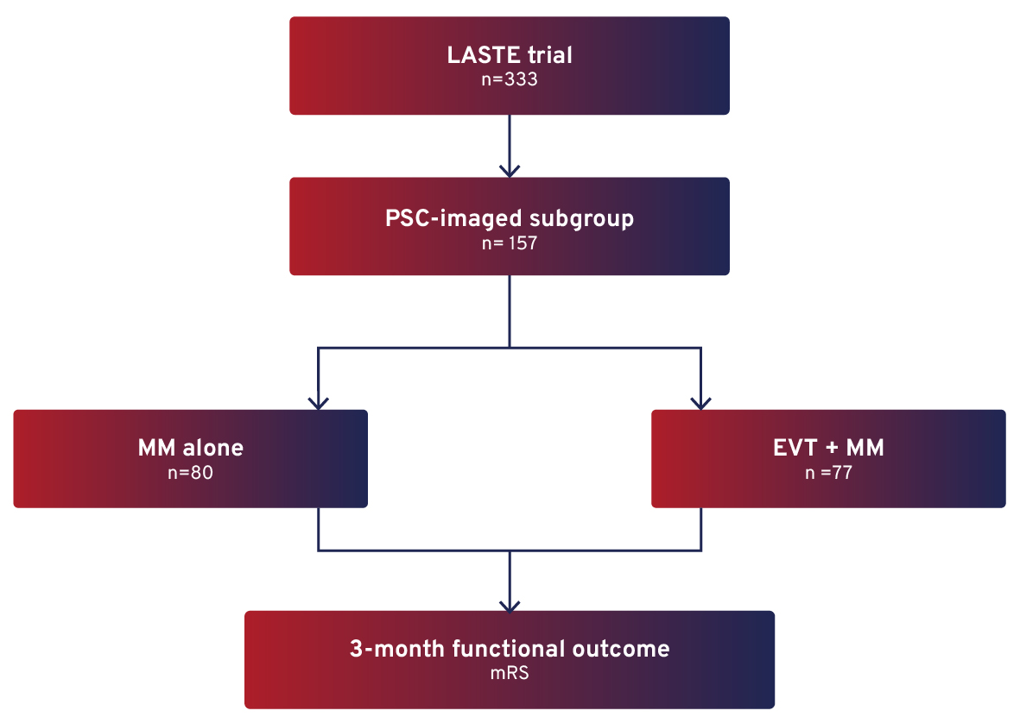
ENDOVASCULAR THERAPY VERSUS MEDICAL MANAGEMENT FOR LARGE ISCHEMIC CORE STROKE IDENTIFIED AT PRIMARY STROKE CENTERS: A SUBANALYSIS OF THE LASTE TRIAL
Background
The benefit of endovascular thrombectomy (EVT) in acute ischaemic stroke with large infarct core (ASPECTS 0-5) remains uncertain, particularly for patients presenting to primary stroke centres (PSC) without immediate EVT access.
Aim
To assess whether EVT improves functional outcomes compared with medical management (MM) in large-core AIS-LVO patients initially imaged at PSCs.
Methods
Post-hoc analysis of the LASTE randomised controlled trial in PSC-imaged AIS-LVO patients (ASPECTS 0–5, ≤6.5 h).
Notes:
Authorship: Pierre Seners, Adrien Ter Schiphorst, Bertrand Lapergue, Julien Labreuche, Hilde Henon, Jean Francois Albucher, Benjamin Gory, Tudor Jovin, Vincent Costalat, Caroline Arquizan
Abbreviations: AIS, acute ischemic stroke; CI, confidence interval; EVT, Endovascular thrombectomy; LASTE, Large Stroke Therapy Evaluation; LVO, large-vessel occlusion; MM, medical management; mRS, Modified Rankin Scale; OR, odds ratio; PSC, primary stroke centres; RR, relative risk.
Abstract Number: ESOC2026A1805
Abstract Title: ENDOVASCULAR THERAPY VERSUS MEDICAL MANAGEMENT FOR LARGE ISCHEMIC CORE STROKE
IDENTIFIED AT PRIMARY STROKE CENTERS: A SUBANALYSIS OF THE LASTE TRIAL
Abstract Category: 01.00 - ACUTE ISCHEMIC STROKE MANAGEMENT - 01.05 - NEUROINTERVENTION
Background and aims:
In acute ischemic stroke due to large-vessel occlusion (AIS-LVO) with a large ischemic core identified at primary stroke centers (PSC) −without rapid access to endovascular therapy (EVT)−, it remains uncertain whether EVT improves functional outcomes over medical management (MM).
Methods:
We performed a post-hoc analysis of the LASTE randomized controlled trial, which compared MM plus EVT and MM alone in anterior circulation AIS-LVO patients with a large ischemic core (ASPECTS 0-5) treated within 6.5 hours of last seen well. This analysis included patients whose baseline imaging was obtained at a PSC and already demonstrated an ASPECTS of 0-5, before inter-hospital transfer. The primary outcome was functional outcome at 3 months, assessed using the modified Rankin Scale (mRS).
Results:
Among the 333 patients enrolled in LASTE, 157 were included in this analysis; 80 received MM alone and 77 underwent EVT plus MM. Median age was 73 years, NIHSS score 20, and symptoms onset-to-PSC imaging time 120 minutes. PSC imaging was MRI in 99% of cases, showing ASPECTS 0-2 in 56% and 3-5 in 44%. Median time from PSC imaging to comprehensive center admission was 145 minutes. EVT resulted in better functional outcomes than MM alone (generalized odds ratio, 1.71; 95%CI 1.21-2.41; P=0.002). Death at 3-month (relative risk, 0.73; 95%CI 0.50-1.05; P=0.08) and symptomatic hemorrhagic transformation (relative risk, 1.85; 95%CI 0.64-5.26; P=0.24) was similar across groups.
Conclusions:
These findings support consideration of inter-hospital transfer for EVT in AIS-LVO patients with a large ischemic core admitted in PSC in the early time-window.

Slide 15
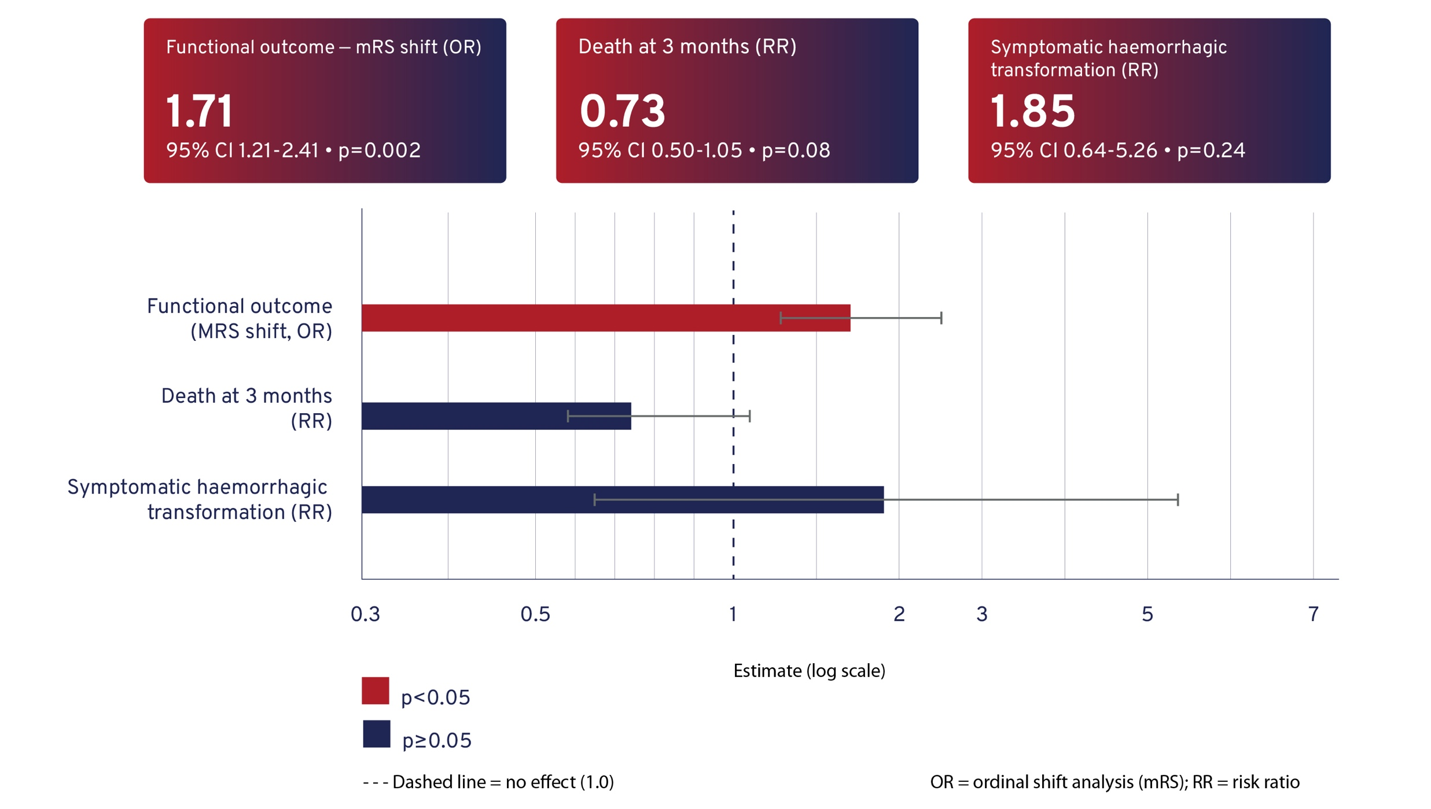
ENDOVASCULAR THERAPY VERSUS MEDICAL MANAGEMENT FOR LARGE ISCHEMIC CORE STROKE IDENTIFIED AT PRIMARY STROKE CENTERS: A SUBANALYSIS OF THE LASTE TRIAL
Results
157 of 333 enrolled patients (80 MM alone; 77 EVT + MM).
Median age 73; NIHSS 20; onset-to-PSC imaging: 120 min.
Imaging: MRI in 99%; ASPECTS 0–2 (56%), 3–5 (44%).
Median PSC-to-comprehensive centre transfer time: 145 min.
Conclusion
EVT improves functional outcomes in large-core AIS-LVO patients initially presenting to PSCs.
These findings support consideration of inter-hospital transfer for EVT in the early time window despite large infarct core.
Notes:
Authorship: Pierre Seners, Adrien Ter Schiphorst, Bertrand Lapergue, Julien Labreuche, Hilde Henon, Jean Francois Albucher, Benjamin Gory, Tudor Jovin, Vincent Costalat, Caroline Arquizan
Abbreviations: AIS, acute ischemic stroke; CI, confidence interval; EVT, Endovascular thrombectomy; LASTE, Large Stroke Therapy Evaluation; LVO, large-vessel occlusion; MM, medical management; mRS, Modified Rankin Scale; OR, odds ratio; PSC, primary stroke centres; RR, relative risk.
Abstract Number: ESOC2026A1805
Abstract Title: ENDOVASCULAR THERAPY VERSUS MEDICAL MANAGEMENT FOR LARGE ISCHEMIC CORE STROKE
IDENTIFIED AT PRIMARY STROKE CENTERS: A SUBANALYSIS OF THE LASTE TRIAL
Abstract Category: 01.00 - ACUTE ISCHEMIC STROKE MANAGEMENT - 01.05 - NEUROINTERVENTION
Background and aims:
In acute ischemic stroke due to large-vessel occlusion (AIS-LVO) with a large ischemic core identified at primary stroke centers (PSC) −without rapid access to endovascular therapy (EVT)−, it remains uncertain whether EVT improves functional outcomes over medical management (MM).
Methods:
We performed a post-hoc analysis of the LASTE randomized controlled trial, which compared MM plus EVT and MM alone in anterior circulation AIS-LVO patients with a large ischemic core (ASPECTS 0-5) treated within 6.5 hours of last seen well. This analysis included patients whose baseline imaging was obtained at a PSC and already demonstrated an ASPECTS of 0-5, before inter-hospital transfer. The primary outcome was functional outcome at 3 months, assessed using the modified Rankin Scale (mRS).
Results:
Among the 333 patients enrolled in LASTE, 157 were included in this analysis; 80 received MM alone and 77 underwent EVT plus MM. Median age was 73 years, NIHSS score 20, and symptoms onset-to-PSC imaging time 120 minutes. PSC imaging was MRI in 99% of cases, showing ASPECTS 0-2 in 56% and 3-5 in 44%. Median time from PSC imaging to comprehensive center admission was 145 minutes. EVT resulted in better functional outcomes than MM alone (generalized odds ratio, 1.71; 95%CI 1.21-2.41; P=0.002). Death at 3-month (relative risk, 0.73; 95%CI 0.50-1.05; P=0.08) and symptomatic hemorrhagic transformation (relative risk, 1.85; 95%CI 0.64-5.26; P=0.24) was similar across groups.
Conclusions:
These findings support consideration of inter-hospital transfer for EVT in AIS-LVO patients with a large ischemic core admitted in PSC in the early time-window.

Slide 16
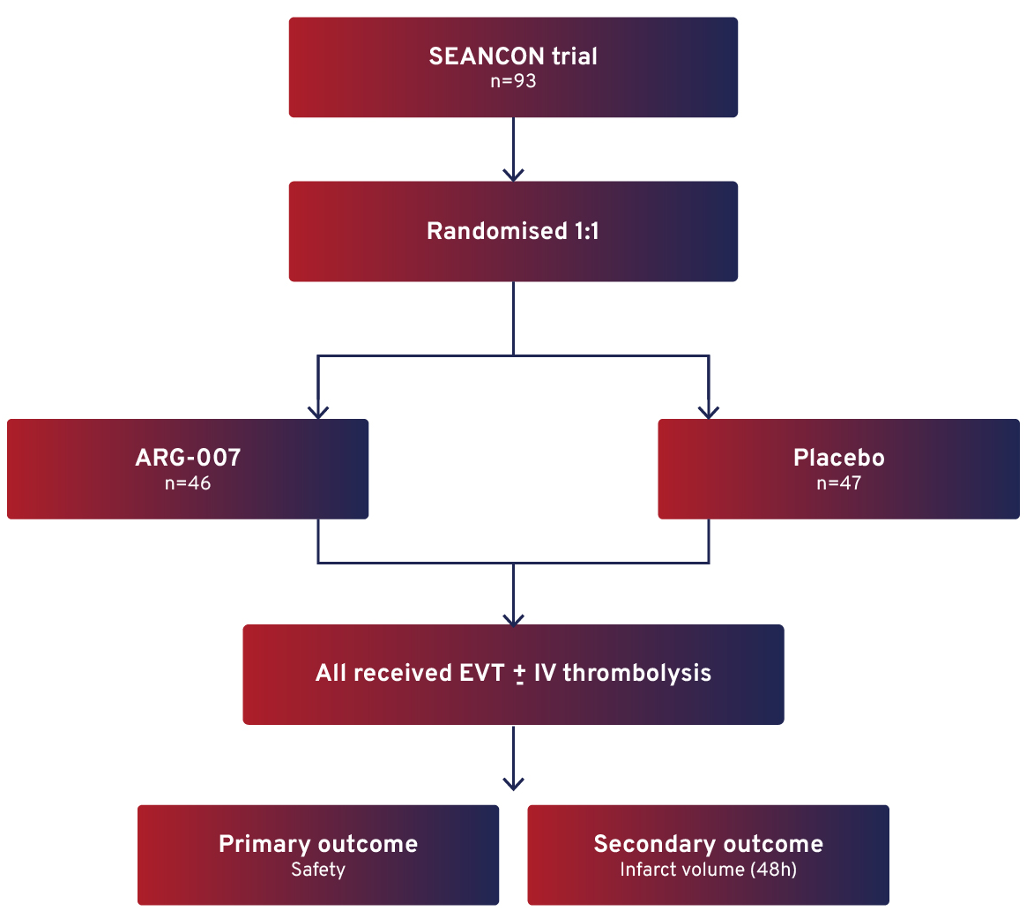
FINAL RESULTS OF THE PHASE II ARG-007-002 SEANCON TRIAL OF ARG-007 IN ACUTE ISCHAEMIC STROKE PATIENTS UNDERGOING ENDOVASCULAR THROMBECTOMY
Background
ARG-007, a cationic poly-arginine peptide, has demonstrated cerebro-protective effects in preclinical stroke models.
Its safety and potential efficacy in acute ischaemic stroke (AIS) patients undergoing thrombectomy remain to be established.
Aim
To evaluate the safety, tolerability, and preliminary efficacy of a single intravenous dose of ARG-007 in AIS patients undergoing endovascular thrombectomy (EVT).
Methods
Phase II, multicentre, randomised, double-blind, placebo-controlled trial (SEANCON) conducted at 10 Australian stroke centres. Patients with AIS-LVO eligible for EVT within 24 hours (NIHSS >5; prestroke mRS 0–3; ASPECTS 0–5 excluded).
Notes:
Authorship: Graeme Hankey, Peter Bailey, Bruce Campbell, Thomas Chemmanam, Dennis Cordato, Michael Devlin, Darshan Ghia, Timothy Kleinig, Christopher Levi, David Blacker
Abbreviations: AIS, acute ischemic stroke; CI, confidence interval; EVT, endovascular thrombectomy; IV, intravenous; mRS, Modified Rankin Scale; NIHSS, National Institutes of Health Stroke Scale; RR, risk ratio; sICH, symptomatic intracerebral haemorrhage.
Abstract Number: ESOC2026A419
Abstract Title: FINAL RESULTS OF THE PHASE II ARG-007-002 SEANCON TRIAL OF ARG-007 IN ACUTE ISCHAEMIC
STROKE PATIENTS UNDERGOING ENDOVASCULAR THROMBECTOMY
Abstract Category: 01.00 - ACUTE ISCHEMIC STROKE MANAGEMENT - 01.05 – NEUROINTERVENTION
Background and aims:
The Phase II SEANCON study aimed to evaluate the safety, tolerability, and preliminary efficacy of a single intravenous dose of ARG-007 (a cationic poly-arginine peptide with cerebroprotective effects in preclinical models) in patients with AIS undergoing revascularisation by endovascular thrombectomy.
Methods:
SEANCON was a multicentre, randomised, double-blind, placebo-controlled trial conducted at 10 Australian stroke centres. Large vessel occlusion AIS patients, eligible for endovascular thrombectomy within 24 hours of symptom onset, were enrolled and randomised 1:1 to ARG-007 or placebo. Enrolment criteria included baseline NIHSS >5 and prestroke mRS 0–3, site-assessed ASPECTS 0–5 were excluded. All participants received standard-of-care thrombectomy with/without intravenous thrombolysis. The primary outcomes were measures of safety. The secondary outcome was infarct volume at 48 hours.
Results:
93 participants were randomised (ARG-007 n=46; placebo n=47). Follow-up to day 90 was completed by 77 (83%) participants; 16 (17%) participants died before day 90. There was no significant difference between treatment groups in treatment-emergent adverse events (risk ratio [RR]:1.02, 95% CI: 0.91-1.15; p=0.72), mortality at day 90 (RR:1.70, 0.67-4.30, p=0.26), symptomatic intracranial haemorrhage (RR:4.09, 0.47-35.2, p=0.20), worsening of the index stroke (RR:2.04, 0.76-5.52, p=0.16), or functional independence at day 90 (mRS 0-2: odds ratio 0.92, 0.36-2.37, p=0.86). Infarct volume at 48 hours did not differ significantly between groups (ratio (adjusted): 1.65, 0.97–2.81, p=0.065). A potential subgroup signal favouring ARG-007 was observed in participants with poor collateral circulation.
Conclusions:
In AIS patients, ARG-007 was safe and well tolerated.

Slide 17
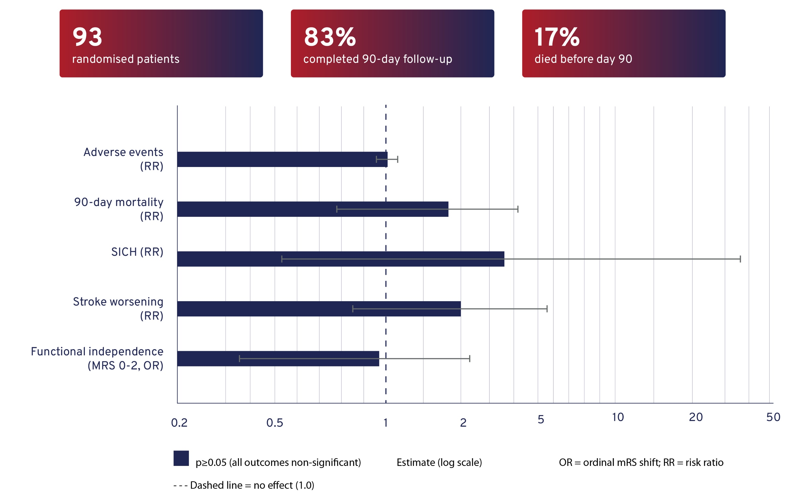
FINAL RESULTS OF THE PHASE II ARG-007-002 SEANCON TRIAL OF ARG-007 IN ACUTE ISCHAEMIC STROKE PATIENTS UNDERGOING ENDOVASCULAR THROMBECTOMY
Results
Infarct volume at 48h: no significant difference (Adjusted ratio: 1.65, 95% CI 0.97-2.81; p=0.065).
Exploratory subgroup: signal favouring ARG-007 in patients with poor collateral circulation.
Conclusion
In AIS patients, ARG-007 was safe and well tolerated.
Notes:
Authorship: Graeme Hankey, Peter Bailey, Bruce Campbell, Thomas Chemmanam, Dennis Cordato, Michael Devlin, Darshan Ghia, Timothy Kleinig, Christopher Levi, David Blacker
Abbreviations: AIS, acute ischemic stroke; CI, confidence interval; EVT, endovascular thrombectomy; IV, intravenous; mRS, modified Rankin Scale; NIHSS, National Institutes of Health Stroke Scale; RR, risk ratio; sICH, symptomatic intracerebral haemorrhage.
Abstract Number: ESOC2026A419
Abstract Title: FINAL RESULTS OF THE PHASE II ARG-007-002 SEANCON TRIAL OF ARG-007 IN ACUTE ISCHAEMIC
STROKE PATIENTS UNDERGOING ENDOVASCULAR THROMBECTOMY
Abstract Category: 01.00 - ACUTE ISCHEMIC STROKE MANAGEMENT - 01.05 – NEUROINTERVENTION
Background and aims:
The Phase II SEANCON study aimed to evaluate the safety, tolerability, and preliminary efficacy of a single intravenous dose of ARG-007 (a cationic poly-arginine peptide with cerebroprotective effects in preclinical models) in patients with AIS undergoing revascularisation by endovascular thrombectomy.
Methods:
SEANCON was a multicentre, randomised, double-blind, placebo-controlled trial conducted at 10 Australian stroke centres. Large vessel occlusion AIS patients, eligible for endovascular thrombectomy within 24 hours of symptom onset, were enrolled and randomised 1:1 to ARG-007 or placebo. Enrolment criteria included baseline NIHSS >5 and prestroke mRS 0–3, site-assessed ASPECTS 0–5 were excluded. All participants received standard-of-care thrombectomy with/without intravenous thrombolysis. The primary outcomes were measures of safety. The secondary outcome was infarct volume at 48 hours.
Results:
93 participants were randomised (ARG-007 n=46; placebo n=47). Follow-up to day 90 was completed by 77 (83%) participants; 16 (17%) participants died before day 90. There was no significant difference between treatment groups in treatment-emergent adverse events (risk ratio [RR]:1.02, 95% CI: 0.91-1.15; p=0.72), mortality at day 90 (RR:1.70, 0.67-4.30, p=0.26), symptomatic intracranial haemorrhage (RR:4.09, 0.47-35.2, p=0.20), worsening of the index stroke (RR:2.04, 0.76-5.52, p=0.16), or functional independence at day 90 (mRS 0-2: odds ratio 0.92, 0.36-2.37, p=0.86). Infarct volume at 48 hours did not differ significantly between groups (ratio (adjusted): 1.65, 0.97–2.81, p=0.065). A potential subgroup signal favouring ARG-007 was observed in participants with poor collateral circulation.
Conclusions:
In AIS patients, ARG-007 was safe and well tolerated.

Slide 18
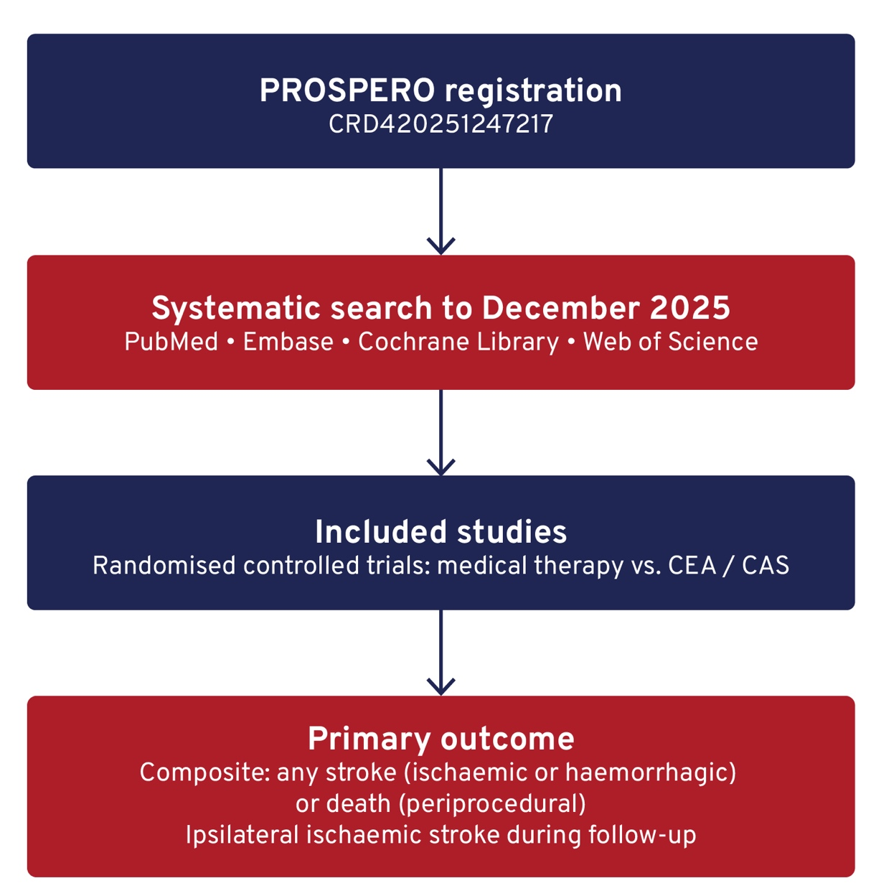
MEDICAL MANAGEMENT AND REVASCULARIZATION FOR ASYMPTOMATIC CAROTID STENOSIS: A META-ANALYSIS OF RANDOMIZED CONTROLLED TRIALS
Background
Early trials (ACAS/ACST) supported revascularisation for asymptomatic carotid stenosis.
Contemporary medical therapy, such as statins, antithrombotics, and blood pressure control, may reduce stroke risk and challenge this approach.
Aim
To compare outcomes of medical management versus revascularisation (carotid endarterectomy [CEA] or carotid artery stenting [CAS]) in patients with asymptomatic carotid stenosis.
Methods
Notes:
Authorship: Lijun Wang, Yu Gao, Yongwei Zhang, Lei Zhang, Pengfei Yang, Jianmin Liu
Abbreviations: ACAS, Asymptomatic Carotid Atherosclerosis Study; ACST, Asymptomatic Carotid Surgery Trial; CAS, Carotid artery stenting; CEA, Carotid endarterectomy; CI, confidence interval; CREST, Carotid Revascularization Endarterectomy vs. Stenting Trial; ECST, European Carotid Surgery Trial; RCT, Randomised controlled trials; RR, risk ratio; SPACE, Stent-Protected Angioplasty versus Carotid Endarterectomy.
Abstract Number: ESOC2026A943
Abstract Title: MEDICAL MANAGEMENT AND REVASCULARIZATION FOR ASYMPTOMATIC CAROTID STENOSIS: A META-ANALYSIS OF RANDOMIZED CONTROLLED TRIALS
Abstract Category: 01.00 - ACUTE ISCHEMIC STROKE MANAGEMENT - 01.05 - NEUROINTERVENTION
Background and aims:
Historical trials (ACAS/ACST) supported revascularization for asymptomatic carotid stenosis, but contemporary medical management with statins, antithrombotics, and blood pressure control may reduce stroke risk. This meta-analysis compares medical management versus revascularization (carotid endarterectomy [CEA] or stenting [CAS]) in current practice.
Methods:
We searched the PubMed, Embase, Cochrane Library and Web of Science databases to obtain articles related to "Asymptomatic Carotid Stenosis", "Medical Management" and "Revascularization" until December 5, 2025. The primary outcome was a composite of any stroke (ischemic or hemorrhagic) or death, assessed from randomization to periprocedural period, or ipsilateral ischemic stroke, assessed during the remaining follow-up. This study was registered in PROSPERO, CRD420251247217.
Results:
Three RCTs (SPACE-2, ECST-2, CREST-2; 3,426 patients) were included. For the primary outcome, no significant difference existed between revascularization (CEA/CAS) and medical management: 4.76% (88/1,847) vs. 6.40% (101/1,579); RR 0.91 (95% CI 0.47–1.74, P=0.77), though heterogeneity was high (I²=74%). All-cause mortality also did not differ: 7.7% vs. 9.50%; RR 0.83 (95% CI 0.67 1.04, P=0.77). Subgroup analyses showed no benefit for CEA (RR 0.73, 95% CI 0.45–1.19) or CAS (RR 0.72, 95% CI 0.23–2.27) over medical management alone.
Conclusions:
The present meta-analysis demonstrates that, among patients with asymptomatic carotid stenosis, the risk of stroke and mortality with contemporary medical management is comparable to that with revascularization (CEA or CAS). These findings validate current guideline recommendations, which emphasize stringent patient selection and prioritize the optimization of medical therapy prior to any revascularization procedure.

Slide 19
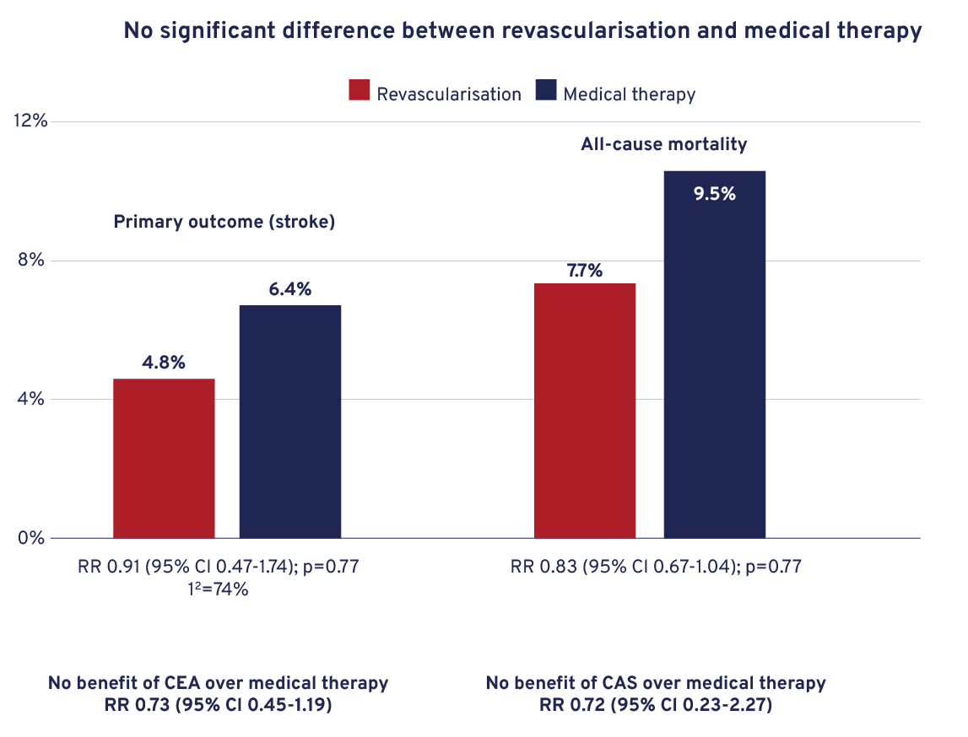
MEDICAL MANAGEMENT AND REVASCULARIZATION FOR ASYMPTOMATIC CAROTID STENOSIS: A META-ANALYSIS OF RANDOMIZED CONTROLLED TRIALS
Results
3 RCTs included (SPACE-2, ECST-2, CREST-2); n=3,426 patients.
Conclusion
In asymptomatic carotid stenosis, the risk of stroke and mortality with contemporary medical management is comparable to that with revascularisation.
These findings validate current guideline recommendations emphasising optimal medical therapy and careful patient selection prior to considering CEA or CAS.
Notes:
Authorship: Lijun Wang, Yu Gao, Yongwei Zhang, Lei Zhang, Pengfei Yang, Jianmin Liu
Abbreviations: ACAS, Asymptomatic Carotid Atherosclerosis Study; ACST, Asymptomatic Carotid Surgery Trial; CAS, Carotid artery stenting; CEA, Carotid endarterectomy; CI, confidence interval; CREST, Carotid Revascularization Endarterectomy vs. Stenting Trial; ECST, European Carotid Surgery Trial; RCT, Randomised controlled trials; RR, risk ratio; SPACE, Stent-Protected Angioplasty versus Carotid Endarterectomy.
Abstract Number: ESOC2026A943
Abstract Title: MEDICAL MANAGEMENT AND REVASCULARIZATION FOR ASYMPTOMATIC CAROTID STENOSIS: A META-ANALYSIS OF RANDOMIZED CONTROLLED TRIALS
Abstract Category: 01.00 - ACUTE ISCHEMIC STROKE MANAGEMENT - 01.05 - NEUROINTERVENTION
Background and aims:
Historical trials (ACAS/ACST) supported revascularization for asymptomatic carotid stenosis, but contemporary medical management with statins, antithrombotics, and blood pressure control may reduce stroke risk. This meta-analysis compares medical management versus revascularization (carotid endarterectomy [CEA] or stenting [CAS]) in current practice.
Methods:
We searched the PubMed, Embase, Cochrane Library and Web of Science databases to obtain articles related to "Asymptomatic Carotid Stenosis", "Medical Management" and "Revascularization" until December 5, 2025. The primary outcome was a composite of any stroke (ischemic or hemorrhagic) or death, assessed from randomization to periprocedural period, or ipsilateral ischemic stroke, assessed during the remaining follow-up. This study was registered in PROSPERO, CRD420251247217.
Results:
Three RCTs (SPACE-2, ECST-2, CREST-2; 3,426 patients) were included. For the primary outcome, no significant difference existed between revascularization (CEA/CAS) and medical management: 4.76% (88/1,847) vs. 6.40% (101/1,579); RR 0.91 (95% CI 0.47–1.74, P=0.77), though heterogeneity was high (I²=74%). All-cause mortality also did not differ: 7.7% vs. 9.50%; RR 0.83 (95% CI 0.67 1.04, P=0.77). Subgroup analyses showed no benefit for CEA (RR 0.73, 95% CI 0.45–1.19) or CAS (RR 0.72, 95% CI 0.23–2.27) over medical management alone.
Conclusions:
The present meta-analysis demonstrates that, among patients with asymptomatic carotid stenosis, the risk of stroke and mortality with contemporary medical management is comparable to that with revascularization (CEA or CAS). These findings validate current guideline recommendations, which emphasize stringent patient selection and prioritize the optimization of medical therapy prior to any revascularization procedure.

Slide 20
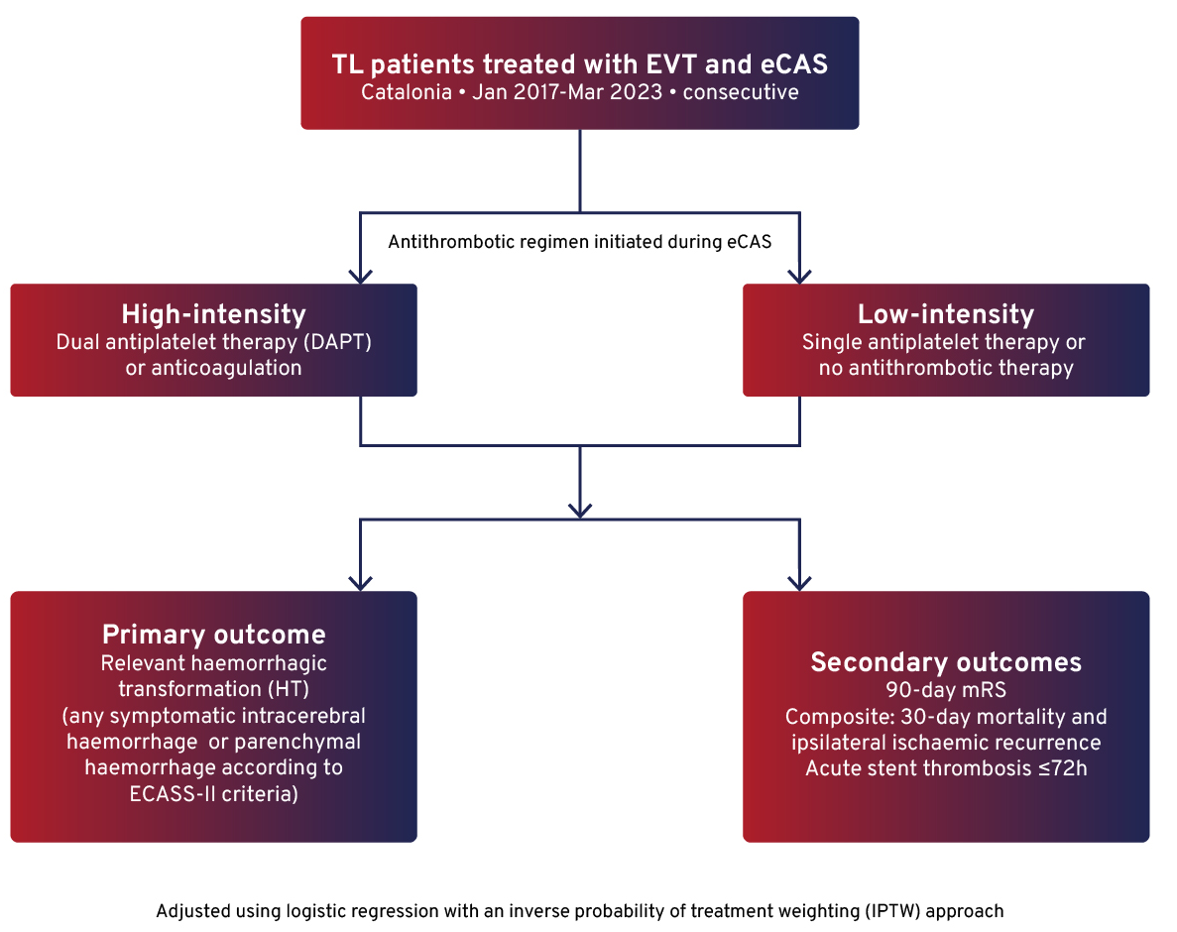
ANTITHROMBOTIC REGIMEN AFTER EMERGENT CAROTID ARTERY STENTING AND RISK OF EARLY COMPLICATIONS: RESULTS FROM A POPULATION-BASED STUDY
Background
Optimal periprocedural antithrombotic management during emergent carotid artery stenting (eCAS) for tandem lesions (TL) in acute ischaemic stroke remains controversial.
Aim
To assess the safety and outcomes of high- versus low-intensity antithrombotic regimens initiated during eCAS in patients with TL undergoing endovascular therapy (EVT).
Methods
Population-based observational study:
Notes:
Authorship: Garbiñe Ezcurra-Díaz, Noelia Rodriguez-Villatoro, Pere Cardona, Antonio Doncel-Moriano, Belén Flores-Pina, Georgina Laia Figueras-Aguirre, Isabel Fernandez Perez, Tomàs Xuclà Ferrarons, Francisco Purroy, Pol Camps-Renom
Abbreviations: aOR, Adjusted odds ratio; CI, confidence interval; DAPT, dual antiplatelet therapy; eCAS, emergent carotid artery stenting; ECASS-II, Second European-Australasian Acute Stroke Study; EVT, Endovascular therapy; HT, haemorrhagic transformation; ICH, intracranial haemorrhage; IPTW, inverse probability of treatment weighting; mRS, Modified Rankin Scale; TL, tandem lesions.
Abstract Number: ESOC2026A1114
Abstract Title: ANTITHROMBOTIC REGIMEN AFTER EMERGENT CAROTID ARTERY STENTING AND RISK OF EARLY COMPLICATIONS: RESULTS FROM A POPULATION-BASED STUDY
Abstract Category: 01.00 - ACUTE ISCHEMIC STROKE MANAGEMENT - 01.05 - NEUROINTERVENTION
Background and aims:
Optimal periprocedural antithrombotic management during emergent carotid artery stenting (eCAS) for acute ischemic stroke due to tandem lesions (TL) remains controversial.
Methods:
We conducted a population-based observational study in Catalonia, including consecutive patients with anterior circulation TL treated with endovascular therapy (EVT) and eCAS between January 2017 and March 2023. Emergent antithrombotic regimen initiated during eCAS was classified as high-intensity (dual antiplatelet therapy [DAPT] or anticoagulation) or low- intensity (single antiplatelet therapy or no antithrombotic therapy). The primary outcome was the presence of a relevant haemorrhagic transformation (HT) (any symptomatic intracerebral haemorrhage or parenchymal haemorrhage according to ECASS-II criteria). Secondary outcomes included 90-day modified Rankin Scale (mRS), a composite of 30-day mortality and ipsilateral ischaemic recurrence, and acute stent thrombosis within 72 hours. Logistic regression with an Inverse Probability of Treatment Weighting approach was used to adjust for confounding.
Results:
Among 335 patients (mean age 70.4±10.2 years), 110 (32.8%) received high-intensity regimens. Relevant HT occurred in 57 (17.1%) patients and was less frequent in the high-intensity group (aOR 0.55, 95%CI 0.35–0.86). There were not significant differences after adjustment in functional outcome, 30-day composite outcome or acute stent thrombosis. The results remained after including only patients receiving DAPT at 24 hours.
Conclusions:
In patients with TL treated with EVT and eCAS, emergent initiation of high-intensity antithrombotic therapy was not associated with increased HT risk. Both strategies (emergent initiation of high intensity regimen vs. deferred initiation at 24h) were similar in terms of functional outcome or early ischemic recurrences and mortality.

Slide 21
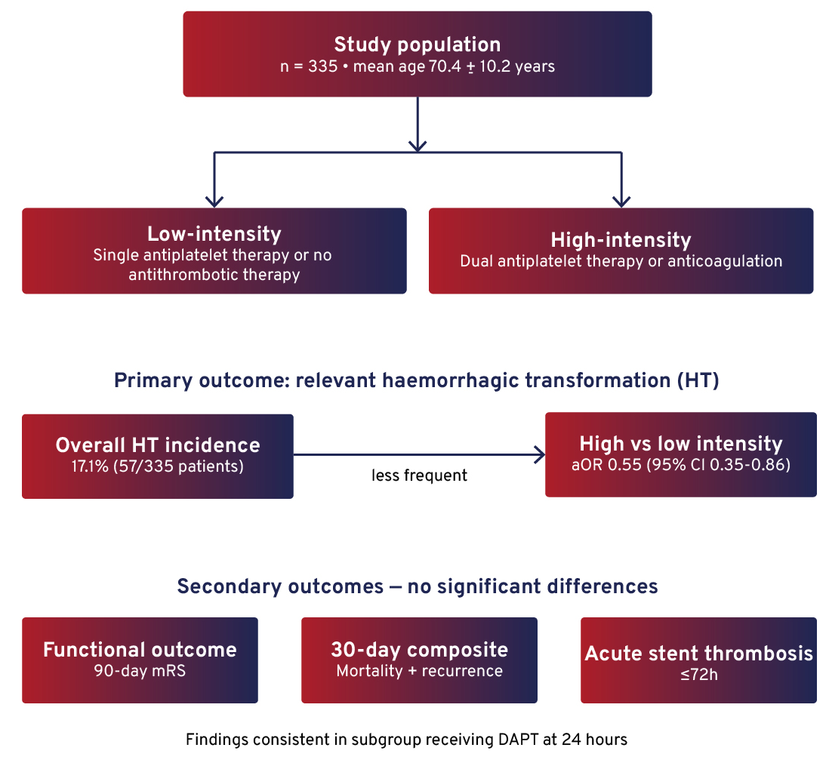
ANTITHROMBOTIC REGIMEN AFTER EMERGENT CAROTID ARTERY STENTING AND RISK OF EARLY COMPLICATIONS: RESULTS FROM A POPULATION-BASED STUDY
Results
Conclusion
Emergent initiation of high-intensity antithrombotic therapy during eCAS was not associated with increased haemorrhagic transformation risk.
Both strategies (early high-intensity vs. deferred initiation) presented similar outcomes.
Notes:
Authorship: Garbiñe Ezcurra-Díaz, Noelia Rodriguez-Villatoro, Pere Cardona, Antonio Doncel-Moriano, Belén Flores-Pina, Georgina Laia Figueras-Aguirre, Isabel Fernandez Perez, Tomàs Xuclà Ferrarons, Francisco Purroy, Pol Camps-Renom
Abbreviations: aOR, Adjusted odds ratio; CI, confidence interval; DAPT, dual antiplatelet therapy; eCAS, emergent carotid artery stenting; ECASS-II, Second European-Australasian Acute Stroke Study; EVT, Endovascular therapy; HT, haemorrhagic transformation; ICH, intracranial haemorrhage; IPTW, inverse probability of treatment weighting; mRS, Modified Rankin Scale; TL, tandem lesions.
Abstract Number: ESOC2026A1114
Abstract Title: ANTITHROMBOTIC REGIMEN AFTER EMERGENT CAROTID ARTERY STENTING AND RISK OF EARLY COMPLICATIONS: RESULTS FROM A POPULATION-BASED STUDY
Abstract Category: 01.00 - ACUTE ISCHEMIC STROKE MANAGEMENT - 01.05 - NEUROINTERVENTION
Background and aims:
Optimal periprocedural antithrombotic management during emergent carotid artery stenting (eCAS) for acute ischemic stroke due to tandem lesions (TL) remains controversial.
Methods:
We conducted a population-based observational study in Catalonia, including consecutive patients with anterior circulation TL treated with endovascular therapy (EVT) and eCAS between January 2017 and March 2023. Emergent antithrombotic regimen initiated during eCAS was classified as high-intensity (dual antiplatelet therapy [DAPT] or anticoagulation) or low- intensity (single antiplatelet therapy or no antithrombotic therapy). The primary outcome was the presence of a relevant haemorrhagic transformation (HT) (any symptomatic intracerebral haemorrhage or parenchymal haemorrhage according to ECASS-II criteria). Secondary outcomes included 90-day modified Rankin Scale (mRS), a composite of 30-day mortality and ipsilateral ischaemic recurrence, and acute stent thrombosis within 72 hours. Logistic regression with an Inverse Probability of Treatment Weighting approach was used to adjust for confounding.
Results:
Among 335 patients (mean age 70.4±10.2 years), 110 (32.8%) received high-intensity regimens. Relevant HT occurred in 57 (17.1%) patients and was less frequent in the high-intensity group (aOR 0.55, 95%CI 0.35–0.86). There were not significant differences after adjustment in functional outcome, 30-day composite outcome or acute stent thrombosis. The results remained after including only patients receiving DAPT at 24 hours.
Conclusions:
In patients with TL treated with EVT and eCAS, emergent initiation of high-intensity antithrombotic therapy was not associated with increased HT risk. Both strategies (emergent initiation of high intensity regimen vs. deferred initiation at 24h) were similar in terms of functional outcome or early ischemic recurrences and mortality.

Slide 22
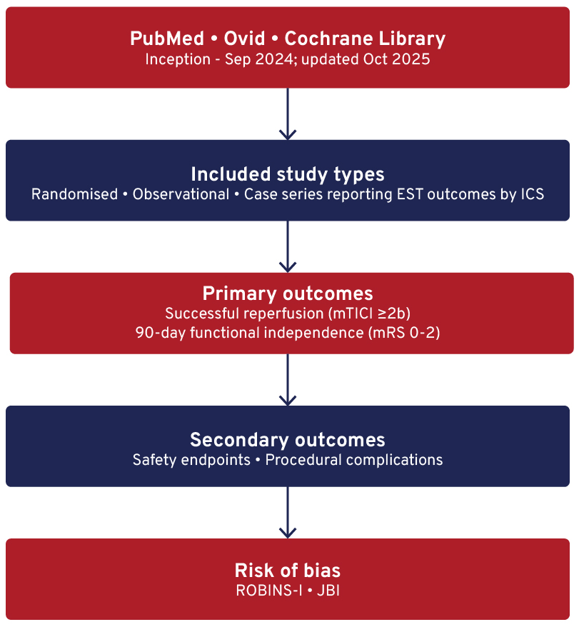
ENDOVASCULAR STROKE TREATMENT PERFORMED BY INTERVENTIONAL CARDIOLOGISTS: A SYSTEMATIC REVIEW AND META-ANALYSIS
Background
Endovascular stroke therapy (EST) is a level 1A, time-critical treatment for acute ischaemic stroke (AIS).
Global access remains limited (<5% of eligible patients), driving increasing involvement of interventional cardiologists (ICs).
Aim
To evaluate the efficacy and safety of EST performed by ICs against established guideline benchmarks.
Methods
Systematic review and meta-analysis following PRISMA guidelines.
Notes:
Authorship: Anna Podlasek, Ka Yow, Wei Wei, Aloysius Leow, Piotr Musialek, Iris Grunwald, Jacopo Imberti, Gregory Lip, Benjamin Yq Tan
Abbreviations: AIS, Acute ischemic stroke; EST, Endovascular stroke therapy; ICs, Interventional cardiologists; ICH, Intracranial haemorrhage; JBI, Joanna Briggs Institute; mRS, Modified Rankin Scale; mTICI, Modified thrombolysis in cerebral infarction; PRISMA, Preferred Reporting Items for Systematic Reviews and Meta-Analyses; ROBINS-I, Risk Of Bias In Non-randomised Studies – of Interventions.
Abstract Number: ESOC2026A2203
Abstract Title: ENDOVASCULAR STROKE TREATMENT PERFORMED BY INTERVENTIONAL CARDIOLOGISTS: A SYSTEMATIC REVIEW AND META-ANALYSIS
Abstract Category: 01.00 - ACUTE ISCHEMIC STROKE MANAGEMENT - 01.05 - NEUROINTERVENTION
Background and aims:
Endovascular stroke therapy (EST) is a level 1A, time-critical intervention for acute ischemic stroke (AIS). Despite compelling evidence of benefit, worldwide access remains below 5% of eligible patients. Interventional cardiologists (ICs) have increasingly contributed to EST delivery and this systematic review and meta analysis aims to compare their results against guidelines.
Methods:
We conducted a systematic review and meta-analysis following PRISMA guidelines. PubMed, OVID, and Cochrane were searched from inception to September 2024 and updated in October 2025. Eligible studies reported outcomes of EST performed by ICs. Randomised and non-randomised designs, observational cohorts, and case series were included; animal studies, conference abstracts, and non-English reports were excluded. Primary outcomes were successful reperfusion (mTICI ≥2b) and functional independence (mRS 0–2) at 90 days. Secondary outcomes included safety endpoints and procedural
complications. Risk of bias was assessed with ROBINS-I or JBI tools.
Results:
Twenty-eight studies comprising 1,846 patients were included. The pooled rate of successful reperfusion was 82.9% (95%CI 78.8-86.8) and functional independence at 90 days was 60.5% (95%CI 52.8–67.9). Safety outcomes were within guideline benchmarks: symptomatic intracranial haemorrhage 8.0% (95%CI 6.5-9.7), embolisation to new territory 3.4% (95%CI 2.2- 4.9), and 90-day mortality 22.1% (95%CI 17.9-26.6).
Conclusions:
ICs can deliver EST with outcomes within required standards. This collaborative model offers a pragmatic strategy to expand access to life-saving reperfusion, particularly in regions with limited neurointerventional capacity

Slide 23
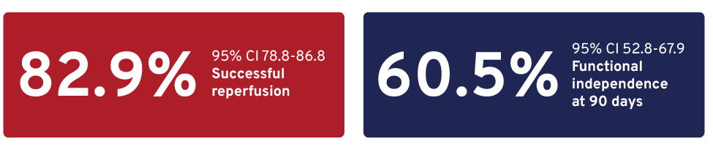
ENDOVASCULAR STROKE TREATMENT PERFORMED BY INTERVENTIONAL CARDIOLOGISTS: A SYSTEMATIC REVIEW AND META-ANALYSIS
Results
Outcomes were within established guideline benchmarks.
28 studies; n=1,846 patients.
Safety outcomes:
  Symptomatic ICH: 8.0% (95% CI 6.5-9.7)
  Embolisation to new territory: 3.4% (95% CI 2.2-4.9)
  90-day mortality: 22.1% (95% CI 17.9–26.6)
Conclusion
ICs can deliver EST with efficacy and safety outcomes within guideline standards.
This collaborative model offers a pragmatic strategy to expand access to reperfusion therapies, particularly in regions with limited neurointerventional capacity.
Notes:
Authorship: Anna Podlasek, Ka Yow, Wei Wei, Aloysius Leow, Piotr Musialek, Iris Grunwald, Jacopo Imberti, Gregory Lip, Benjamin Yq Tan
Abbreviations: AIS, Acute ischemic stroke; EST, Endovascular stroke therapy; ICs, Interventional cardiologists; ICH, Intracranial haemorrhage; JBI, Joanna Briggs Institute; mRS, Modified Rankin Scale; mTICI, Modified thrombolysis in cerebral infarction; PRISMA, Preferred Reporting Items for Systematic Reviews and Meta-Analyses; ROBINS-I, Risk Of Bias In Non-randomised Studies – of Interventions.
Abstract Number: ESOC2026A2203
Abstract Title: ENDOVASCULAR STROKE TREATMENT PERFORMED BY INTERVENTIONAL CARDIOLOGISTS: A SYSTEMATIC REVIEW AND META-ANALYSIS
Abstract Category: 01.00 - ACUTE ISCHEMIC STROKE MANAGEMENT - 01.05 - NEUROINTERVENTION
Background and aims:
Endovascular stroke therapy (EST) is a level 1A, time-critical intervention for acute ischemic stroke (AIS). Despite compelling evidence of benefit, worldwide access remains below 5% of eligible patients. Interventional cardiologists (ICs) have increasingly contributed to EST delivery and this systematic review and meta analysis aims to compare their results against guidelines.
Methods:
We conducted a systematic review and meta-analysis following PRISMA guidelines. PubMed, OVID, and Cochrane were searched from inception to September 2024 and updated in October 2025. Eligible studies reported outcomes of EST performed by ICs. Randomised and non-randomised designs, observational cohorts, and case series were included; animal studies, conference abstracts, and non-English reports were excluded. Primary outcomes were successful reperfusion (mTICI ≥2b) and functional independence (mRS 0–2) at 90 days. Secondary outcomes included safety endpoints and procedural
complications. Risk of bias was assessed with ROBINS-I or JBI tools.
Results:
Twenty-eight studies comprising 1,846 patients were included. The pooled rate of successful reperfusion was 82.9% (95%CI 78.8-86.8) and functional independence at 90 days was 60.5% (95%CI 52.8–67.9). Safety outcomes were within guideline benchmarks: symptomatic intracranial haemorrhage 8.0% (95%CI 6.5-9.7), embolisation to new territory 3.4% (95%CI 2.2- 4.9), and 90-day mortality 22.1% (95%CI 17.9-26.6).
Conclusions:
ICs can deliver EST with outcomes within required standards. This collaborative model offers a pragmatic strategy to expand access to life-saving reperfusion, particularly in regions with limited neurointerventional capacity

Slide 24
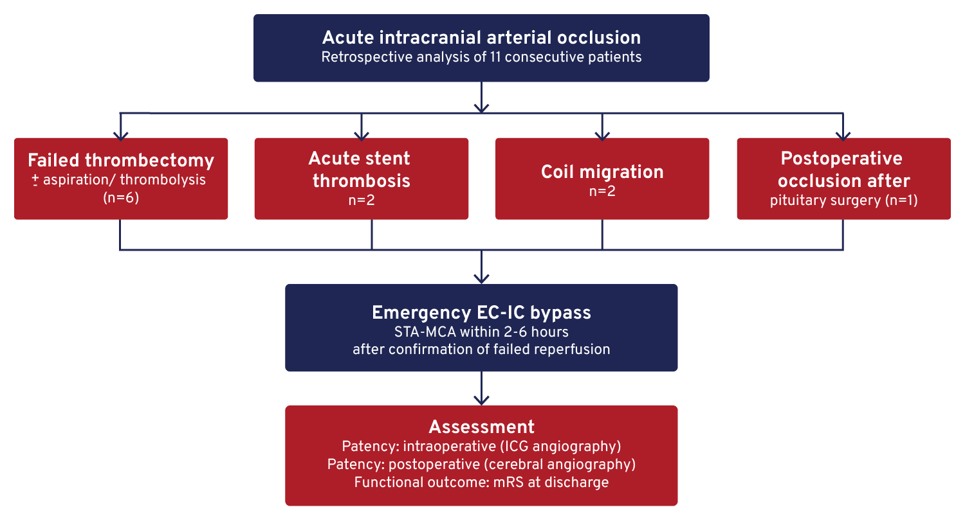
MICROSURGICAL REVASCULARIZATION AS SALVAGE TREATMENT AFTER FAILED ENDOVASCULAR THERAPY IN ACUTE INTRACRANIAL ARTERIAL OCCLUSION
Background
Endovascular reperfusion is the first-line treatment for acute intracranial arterial occlusion.
Recanalisation fails in up to 15% of cases and is associated with poor outcomes.
Evidence for rescue surgical strategies remains limited.
Aim
To evaluate the feasibility, safety, and short-term outcomes of emergency extracranial-intracranial (EC-IC) bypass after failed endovascular therapy.
Methods
Notes:
Authorship: Chingiz Nurimanov, Karashash Menlibayeva, Iroda Mammadinova, Yerbol Makhambetov, Ainur Turzhanova, Assel Kabykenova, Seitzhan Aidarov, Daultai Batyrkhanov, Assylbek Kaliyev
Abbreviations: EC-IC, extracranial-intracrania; MCA, middle cerebral artery; MRI, Magnetic resonance imaging; mRS, modified Rankin Scale; STA, Superficial temporal artery
Abstract Number: ESOC2026A1562
Abstract Title: MICROSURGICAL REVASCULARIZATION AS SALVAGE TREATMENT AFTER FAILED ENDOVASCULAR THERAPY IN ACUTE INTRACRANIAL ARTERIAL OCCLUSION
Abstract Category: 01.00 - ACUTE ISCHEMIC STROKE MANAGEMENT - 01.05 - NEUROINTERVENTION
Background and aims:
Endovascular reperfusion, including mechanical thrombectomy and aspiration, is the first-line treatment for acute intracranial arterial occlusion. Despite technical advances, recanalization fails in up to 15% of cases and is associated with poor neurological outcomes. Evidence supporting rescue microsurgical revascularization in this setting remains limited. This study evaluated the feasibility, safety, and short-term outcomes of emergency extracranial–intracranial (EC–IC) bypass after failed endovascular therapy.
Methods:
We retrospectively analyzed eleven consecutive patients with acute intracranial arterial occlusion treated with emergency EC–IC bypass. Indications included acute intracranial stent thrombosis (n=2), persistent occlusion after unsuccessful thrombectomy with or without aspiration and intra-arterial thrombolysis (n=6), acute postoperative occlusion after transnasal endoscopic pituitary surgery (n=1), and coil migration following aneurysm embolization (n=2). All patients underwent superficial temporal artery–to–middle cerebral artery end-to-side anastomosis within 2–6 hours after confirmation of failed endovascular reperfusion. Bypass patency was assessed intraoperatively using indocyanine green angiography and postoperatively by selective cerebral angiography. Functional outcome was evaluated using the modified Rankin Scale (mRS) at discharge.
Results:
All bypasses were patent on postoperative angiography. Seven patients (63.6%) achieved favorable neurological outcomes (mRS 1), two (18.2%) had mild deficits (mRS 2), and two (18.2%) had moderate deficits (mRS 3). No bypass-related complications occurred. Follow-up MRI demonstrated no progression of ischemic infarction.
Conclusions:
Emergency EC–IC bypass is a feasible and safe salvage option in selected patients with failed endovascular reperfusion, supporting its role within comprehensive acute stroke management.

Slide 25
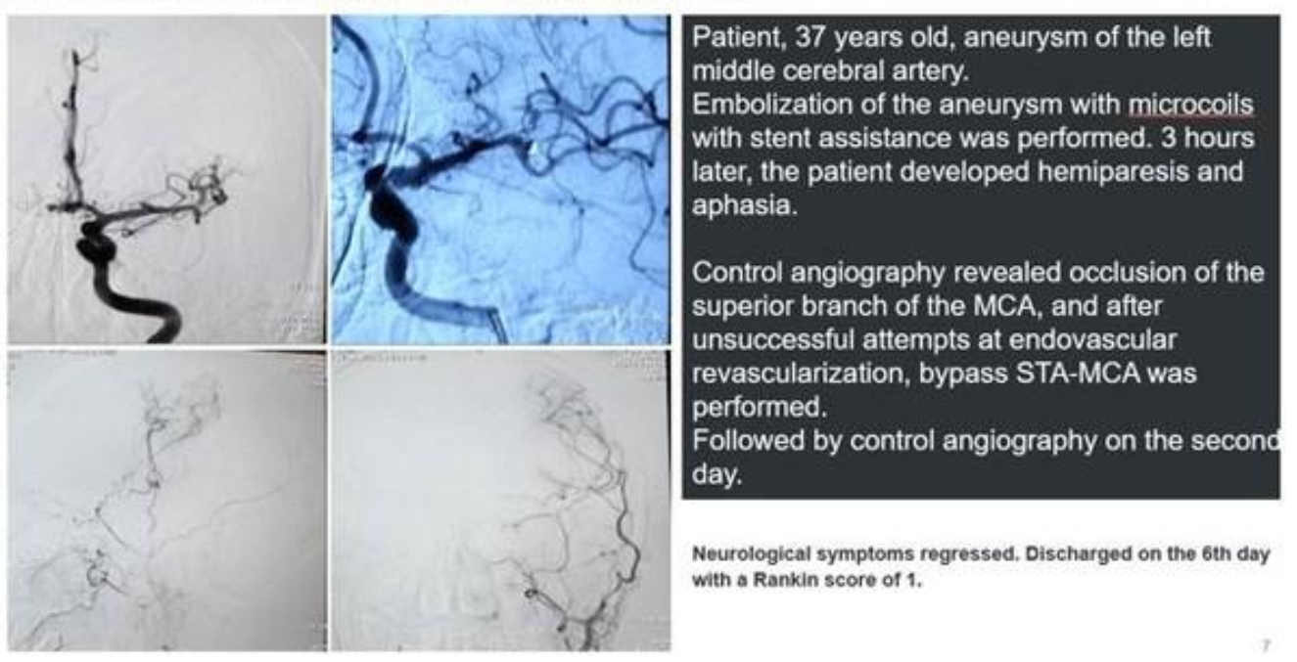
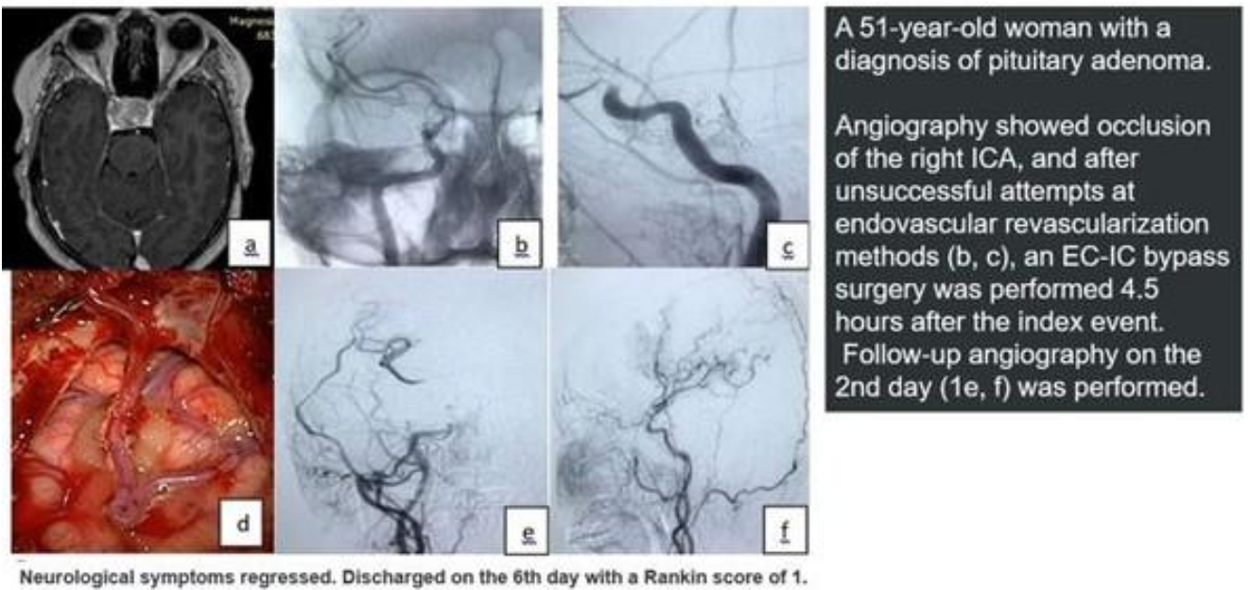
MICROSURGICAL REVASCULARIZATION AS SALVAGE TREATMENT AFTER FAILED ENDOVASCULAR THERAPY IN ACUTE INTRACRANIAL ARTERIAL OCCLUSION
Results
100% bypass patency on postoperative angiography.
Favourable neurological outcomes:
  mRS 1: 63.6% (7/11)
  mRS 2: 18.2% (2/11)
  mRS 3: 18.2% (2/11)
No bypass-related complications reported.
Follow-up MRI showed no progression of infarction
Conclusion
Emergency EC–IC bypass is a feasible and safe salvage option in selected patients with failed endovascular reperfusion, supporting its role in comprehensive acute stroke management.
Notes:
Authorship: Chingiz Nurimanov, Karashash Menlibayeva, Iroda Mammadinova, Yerbol Makhambetov, Ainur Turzhanova, Assel Kabykenova, Seitzhan Aidarov, Daultai Batyrkhanov, Assylbek Kaliyev
Abbreviations: EC-IC, extracranial-intracrania; MCA, middle cerebral artery; MRI, Magnetic resonance imaging; mRS, modified Rankin Scale; STA, Superficial temporal artery
Abstract Number: ESOC2026A1562
Abstract Title: MICROSURGICAL REVASCULARIZATION AS SALVAGE TREATMENT AFTER FAILED ENDOVASCULAR THERAPY IN ACUTE INTRACRANIAL ARTERIAL OCCLUSION
Abstract Category: 01.00 - ACUTE ISCHEMIC STROKE MANAGEMENT - 01.05 - NEUROINTERVENTION
Background and aims:
Endovascular reperfusion, including mechanical thrombectomy and aspiration, is the first-line treatment for acute intracranial arterial occlusion. Despite technical advances, recanalization fails in up to 15% of cases and is associated with poor neurological outcomes. Evidence supporting rescue microsurgical revascularization in this setting remains limited. This study evaluated the feasibility, safety, and short-term outcomes of emergency extracranial–intracranial (EC–IC) bypass after failed endovascular therapy.
Methods:
We retrospectively analyzed eleven consecutive patients with acute intracranial arterial occlusion treated with emergency EC–IC bypass. Indications included acute intracranial stent thrombosis (n=2), persistent occlusion after unsuccessful thrombectomy with or without aspiration and intra-arterial thrombolysis (n=6), acute postoperative occlusion after transnasal endoscopic pituitary surgery (n=1), and coil migration following aneurysm embolization (n=2). All patients underwent superficial temporal artery–to–middle cerebral artery end-to-side anastomosis within 2–6 hours after confirmation of failed endovascular reperfusion. Bypass patency was assessed intraoperatively using indocyanine green angiography and postoperatively by selective cerebral angiography. Functional outcome was evaluated using the modified Rankin Scale (mRS) at discharge.
Results:
All bypasses were patent on postoperative angiography. Seven patients (63.6%) achieved favorable neurological outcomes (mRS 1), two (18.2%) had mild deficits (mRS 2), and two (18.2%) had moderate deficits (mRS 3). No bypass-related complications occurred. Follow-up MRI demonstrated no progression of ischemic infarction.
Conclusions:
Emergency EC–IC bypass is a feasible and safe salvage option in selected patients with failed endovascular reperfusion, supporting its role within comprehensive acute stroke management.

Slide 26
EVT IN PATIENTS WITH TANDEM LESIONS: EFFECT OF CAS AND EVT DEVICES
Background
15–20% of patients with acute ischemic stroke due to anterior large vessel occlusion present with tandem lesions (TLs).
The optimal endovascular treatment (EVT) strategy for tandem lesions (TLs) remains uncertain, particularly regarding carotid artery stenting (CAS) and thrombectomy technique.
Aim
To compare outcomes in TL patients treated with or without CAS, and to evaluate the impact of thrombectomy technique:
  Aspiration alone (AA)
  Stent retriever alone (SRA)
  Combined approach (CA)
Methods
EVA-TRISP is an international multicentre cohort (2016–2023) including consecutive AIS patients treated with EVT.
Outcomes:
  3-month mRS
  Good functional outcome (mRS 0-2)
  Complete recanalisation
  Symptomatic intracranial haemorrhage (sICH)
  All-cause mortality
Notes:
Authorship: Theodora van Elk, Nabila Wali, Maarten Uyttenboogaart, Henrik Gensicke, Stefan Engelter, Paul Nederkoorn
Abbreviations: AA, Aspiration alone; AOR, Adjusted odds ratio; CA, Combined approach; CAS, Carotid artery stenting; EVT, Endovascular treatment; mRS, modified Rankin Scale; sICH, Symptomatic intracerebral haemorrhage; SRA, Stent retriever alone; TL, Tandem lesions.
Abstract Number: ESOC2026A1728
Abstract Title: EVT IN PATIENTS WITH TANDEM LESIONS: EFFECT OF CAS AND EVT DEVICES
Abstract Category: 01.00 - ACUTE ISCHEMIC STROKE MANAGEMENT - 01.05 - NEUROINTERVENTION
Background and aims:
15–20% of patients with acute ischemic stroke (AIS) due to anterior large vessel occlusion present with ipsilateral extracranial carotid artery stenosis >50% or occlusion, termed tandem lesions (TLs). The optimal endovascular treatment (EVT) strategy for TLs remains uncertain, particularly regarding carotid artery stenting (CAS) and thrombectomy technique. This study compared outcomes in TL patients treated with or without CAS during EVT and the impact of different thrombectomy approaches (aspiration alone [AA], stent retriever alone [SRA], or combined approach [CA]).
Methods:
EVA-TRISP is a large international multicenter cohort study including consecutive AIS patients treated with EVT, 2016- 2023. Outcomes included 3-month modified Rankin Scale (mRS), good functional outcome (mRS 0–2), complete angiographic recanalization, symptomatic intracranial hemorrhage (sICH), and all-cause mortality.
Results:
Among 13,702 EVT-treated patients, 1,545 (11.3%) had TLs; 596/1,545 (39%) underwent CAS. CAS was associated with higher odds of better functional outcome (adjusted odds ratio [aOR] 1.33, 95% CI 1.09–1.62) without increased sICH or mortality. AA was used in 28.1%, SRA in 26.8%, and CA in 45.1%. SRA and CA were associated with higher odds of complete recanalization (aOR 1.96 [95% CI 1.38–2.78] & 1.99 [95% CI 1.48–2.67]), compared to AA. CA was not associated with functional benefit but rather with sICH (aOR 2.50, 95% CI 1.28–4.89).
Conclusions:
CAS during EVT was associated with improved functional outcomes in TL patients without increased hemorrhagic risk or
mortality. Stent retriever use improved recanalization, while combined techniques increased sICH risk without added clinical benefit.

Slide 27
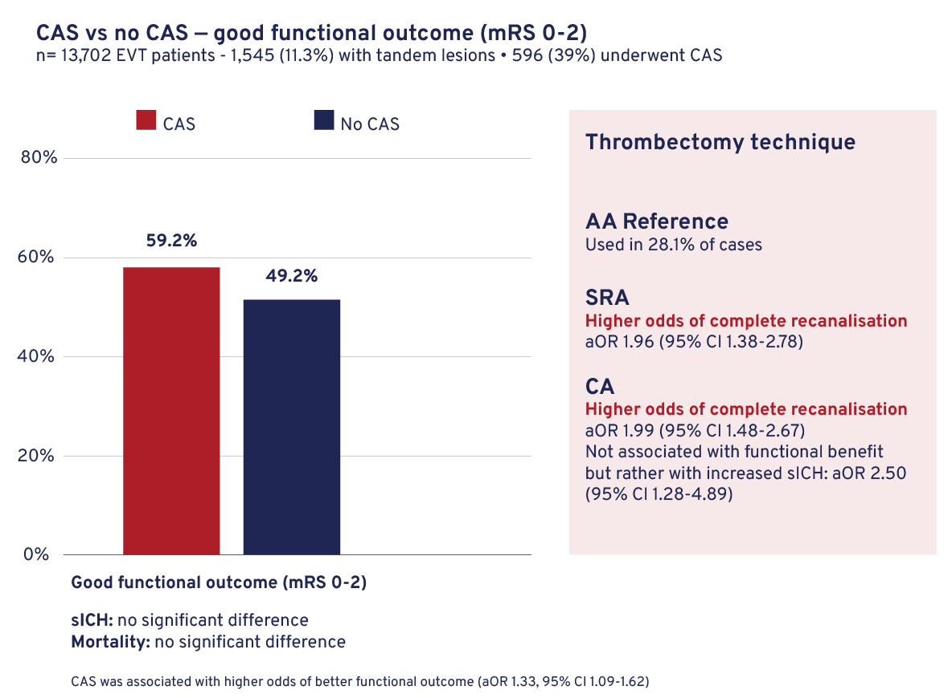
EVT IN PATIENTS WITH TANDEM LESIONS: EFFECT OF CAS AND EVT DEVICES
Results
13,702 EVT patients; 1,545 (11.3%) with TLs; 39% (596) underwent CAS.
Conclusion
CAS during EVT was associated with improved functional outcomes in TL patients, without increasing haemorrhagic risk or mortality.
Stent retriever use was associated with improved recanalisation, while combined techniques were associated with increased sICH risk without added clinical benefit.
Notes:
Authorship: Theodora van Elk, Nabila Wali, Maarten Uyttenboogaart, Henrik Gensicke, Stefan Engelter, Paul Nederkoorn
Abbreviations: AA, Aspiration alone; AOR, Adjusted odds ratio; CA, Combined approach; CAS, Carotid artery stenting; EVT, Endovascular treatment; mRS, modified Rankin Scale; sICH, Symptomatic intracerebral haemorrhage; SRA, Stent retriever alone; TL, Tandem lesions.
Abstract Number: ESOC2026A1728
Abstract Title: EVT IN PATIENTS WITH TANDEM LESIONS: EFFECT OF CAS AND EVT DEVICES
Abstract Category: 01.00 - ACUTE ISCHEMIC STROKE MANAGEMENT - 01.05 - NEUROINTERVENTION
Background and aims:
15–20% of patients with acute ischemic stroke (AIS) due to anterior large vessel occlusion present with ipsilateral extracranial carotid artery stenosis >50% or occlusion, termed tandem lesions (TLs). The optimal endovascular treatment (EVT) strategy for TLs remains uncertain, particularly regarding carotid artery stenting (CAS) and thrombectomy technique. This study compared outcomes in TL patients treated with or without CAS during EVT and the impact of different thrombectomy approaches (aspiration alone [AA], stent retriever alone [SRA], or combined approach [CA]).
Methods:
EVA-TRISP is a large international multicenter cohort study including consecutive AIS patients treated with EVT, 2016- 2023. Outcomes included 3-month modified Rankin Scale (mRS), good functional outcome (mRS 0–2), complete angiographic recanalization, symptomatic intracranial hemorrhage (sICH), and all-cause mortality.
Results:
Among 13,702 EVT-treated patients, 1,545 (11.3%) had TLs; 596/1,545 (39%) underwent CAS. CAS was associated with higher odds of better functional outcome (adjusted odds ratio [aOR] 1.33, 95% CI 1.09–1.62) without increased sICH or mortality. AA was used in 28.1%, SRA in 26.8%, and CA in 45.1%. SRA and CA were associated with higher odds of complete recanalization (aOR 1.96 [95% CI 1.38–2.78] & 1.99 [95% CI 1.48–2.67]), compared to AA. CA was not associated with functional benefit but rather with sICH (aOR 2.50, 95% CI 1.28–4.89).
Conclusions:
CAS during EVT was associated with improved functional outcomes in TL patients without increased hemorrhagic risk or
mortality. Stent retriever use improved recanalization, while combined techniques increased sICH risk without added clinical benefit.

Slide 28
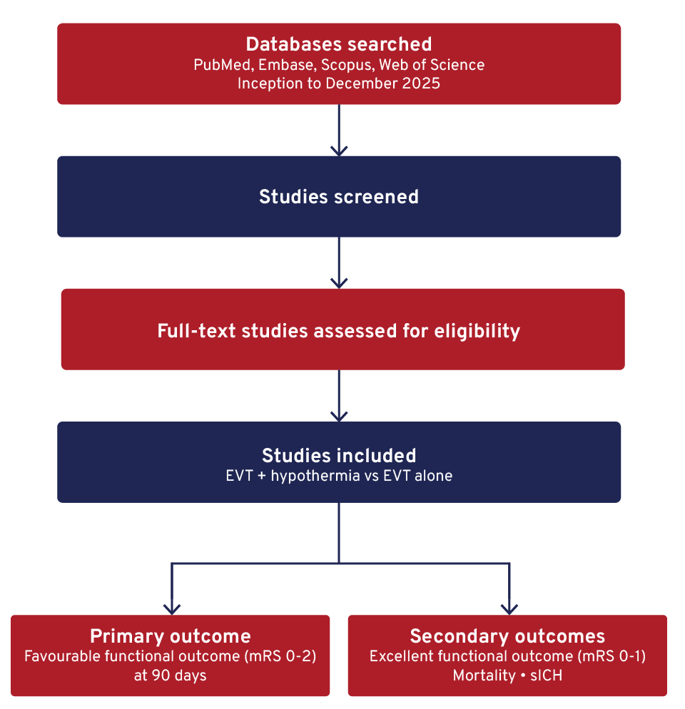
ADJUNCTIVE HYPOTHERMIA AFTER ENDOVASCULAR REPERFUSION THERAPY FOR ACUTE ISCHEMIC STROKE: EVIDENCE FROM A META-ANALYSIS
Background
Endovascular thrombectomy (EVT) is standard of care for large vessel occlusion stroke, but reperfusion injury may limit recovery.
Selective or mild therapeutic hypothermia has emerged as a potential neuroprotective adjunct to reduce ischaemia–reperfusion injury.
Aim
To evaluate the efficacy and safety of therapeutic hypothermia combined with EVT in acute ischaemic stroke.
Methods
Systematic review and meta-analysis of clinical studies in patients with acute ischaemic stroke.
Notes:
Authorship: Khalid Sarhan, Rashad G. Mohamed
Abbreviations: CI, confidence interval; EVT, Endovascular thrombectomy; mRS, Modified Rankin Scale; RR, risk ratio; sICH, symptomatic intracerebral haemorrhage.
Abstract Number: ESOC2026A557
Abstract Title: ADJUNCTIVE HYPOTHERMIA AFTER ENDOVASCULAR REPERFUSION THERAPY FOR ACUTE ISCHEMIC STROKE: EVIDENCE FROM A META-ANALYSIS
Abstract Category: 01.00 - ACUTE ISCHEMIC STROKE MANAGEMENT - 01.05 - NEUROINTERVENTION
Background and aims:
Endovascular thrombectomy (EVT) is the standard of care for acute ischemic stroke due to large vessel occlusion; however, reperfusion injury limits neurological recovery. Selective or mild therapeutic hypothermia has emerged as a potential neuroprotective adjunct to EVT, aiming to mitigate ischemia-reperfusion injury while preserving procedural safety.
Methods:
We conducted a systematic review and meta-analysis of clinical studies evaluating therapeutic hypothermia combined with EVT in patients with acute ischemic stroke. PubMed, Embase, Scopus, and Web of Science were searched from inception to December 2025. Primary outcomes were favorable functional outcome (modified Rankin Scale [mRS] 0–2 at 90 days). Secondary outcomes included excellent functional outcome (mRS 0–1), mortality, and symptomatic intracranial hemorrhage (sICH).
Results:
Seven studies comprising 603 patients were included, of whom 294 received therapeutic hypothermia combined with EVT and 309 underwent thrombectomy alone. The addition of hypothermia was associated with a significantly higher rate of favorable functional outcome at 90 days (mRS 0–2: 59.2% vs 49.2%; RR= 1.23, 95% CI 1.06–1.42). Patients treated with hypothermia also demonstrated a greater likelihood of excellent functional recovery (mRS 0–1: 48.6% vs 33.1%; RR= 1.45, 95% CI 1.12–1.88). There were no significant differences between groups in mortality (RR= 0.97, 95% CI 0.75–1.26) or symptomatic intracranial hemorrhage (RR= 0.78, 95% CI 0.50–1.21). Statistical heterogeneity was low to moderate across outcomes.
Conclusions:
Therapeutic hypothermia combined with EVT is associated with improved functional outcomes without increased mortality or hemorrhagic risk. Larger randomized trials are needed to confirm efficacy and optimize cooling strategies.

Slide 29
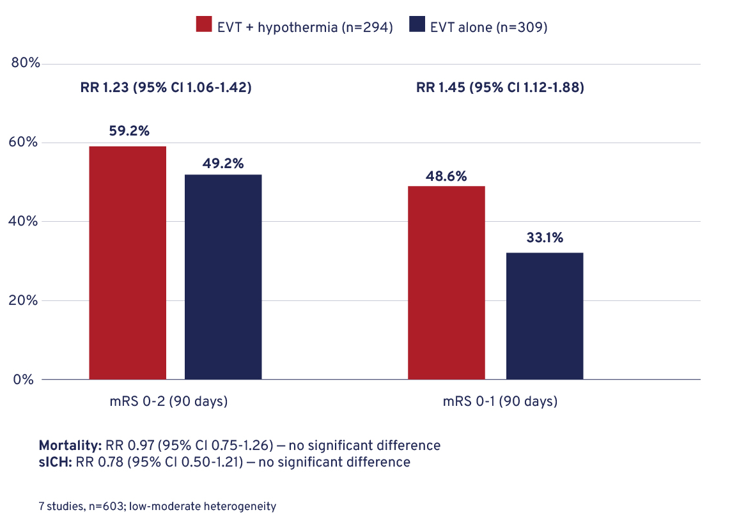
ADJUNCTIVE HYPOTHERMIA AFTER ENDOVASCULAR REPERFUSION THERAPY FOR ACUTE ISCHEMIC STROKE: EVIDENCE FROM A META-ANALYSIS
Results
Conclusion
Therapeutic hypothermia combined with EVT is associated with improved functional outcomes without increased mortality or haemorrhagic risk.
Larger randomised trials are required to confirm benefit and define optimal cooling strategies.
Notes:
Authorship: Khalid Sarhan, Rashad G. Mohamed
Abbreviations: CI, confidence interval; EVT, Endovascular thrombectomy; mRS, Modified Rankin Scale; RR, risk ratio; sICH, symptomatic intracerebral haemorrhage.
Abstract Number: ESOC2026A557
Abstract Title: ADJUNCTIVE HYPOTHERMIA AFTER ENDOVASCULAR REPERFUSION THERAPY FOR ACUTE ISCHEMIC STROKE: EVIDENCE FROM A META-ANALYSIS
Abstract Category: 01.00 - ACUTE ISCHEMIC STROKE MANAGEMENT - 01.05 - NEUROINTERVENTION
Background and aims:
Endovascular thrombectomy (EVT) is the standard of care for acute ischemic stroke due to large vessel occlusion; however, reperfusion injury limits neurological recovery. Selective or mild therapeutic hypothermia has emerged as a potential neuroprotective adjunct to EVT, aiming to mitigate ischemia-reperfusion injury while preserving procedural safety.
Methods:
We conducted a systematic review and meta-analysis of clinical studies evaluating therapeutic hypothermia combined with EVT in patients with acute ischemic stroke. PubMed, Embase, Scopus, and Web of Science were searched from inception to December 2025. Primary outcomes were favorable functional outcome (modified Rankin Scale [mRS] 0–2 at 90 days). Secondary outcomes included excellent functional outcome (mRS 0–1), mortality, and symptomatic intracranial hemorrhage (sICH).
Results:
Seven studies comprising 603 patients were included, of whom 294 received therapeutic hypothermia combined with EVT and 309 underwent thrombectomy alone. The addition of hypothermia was associated with a significantly higher rate of favorable functional outcome at 90 days (mRS 0–2: 59.2% vs 49.2%; RR= 1.23, 95% CI 1.06–1.42). Patients treated with hypothermia also demonstrated a greater likelihood of excellent functional recovery (mRS 0–1: 48.6% vs 33.1%; RR= 1.45, 95% CI 1.12–1.88). There were no significant differences between groups in mortality (RR= 0.97, 95% CI 0.75–1.26) or symptomatic intracranial hemorrhage (RR= 0.78, 95% CI 0.50–1.21). Statistical heterogeneity was low to moderate across outcomes.
Conclusions:
Therapeutic hypothermia combined with EVT is associated with improved functional outcomes without increased mortality or hemorrhagic risk. Larger randomized trials are needed to confirm efficacy and optimize cooling strategies.

