Slide 1
Expedited recommendation on intravenous thrombolysis before mechanical thrombectomy in patients with acute ischaemic stroke and anterior circulation large vessel occlusion
Turc G, Tsivgoulis G, Audebert HJ, Boogarts H, Bhogal P, De Marchis GM, Fonseca AC, Khatri P, Mazighi M, Pérez de la Ossa N, Schellinger PD, Strbian D, Toni D, White P, Whiteley W, Zini A, van Zwam W, and Fiehler J
Guideline Webinar – 3 February 2022

Slide 2
Disclosures
Disclosures of the 18 module working group members are provided in Suppl. Table I of the Recommendations
Personal Intellectual Disclosures:
Chairman of the ESO Guideline board
Co-chairman of the 2019 ESO-ESMINT Guidelines on mechanical thrombectomy
Co-chairman of the 2021 ESO Guidelines on intravenous thrombolysis
Financial Disclosures:
Lecturing fees for Guerbet France

Slide 3
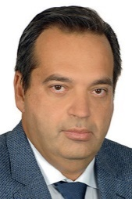
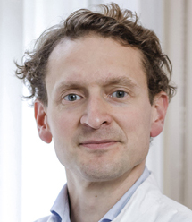
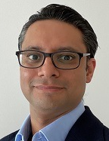
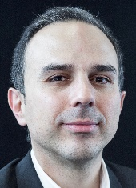
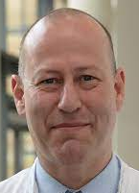
Module Working Group Members
Module Working Group Members
TURC
Guillaume
France
(Co-Chair)
TSIVGOULIS
Georgios
Greece
AUDEBERT
Heinrich
Germany
BOOGARTS
Hieronymus
The Netherlands
BHOGAL
Pervinder
UK
DE MARCHIS
Gian Marco
Switzerland
FONSECA
Ana Catarina
Portugal
KHATRI
Pooja
USA
MAZIGHI
Mikaël
France
PEREZ DE LA OSSA
Natalia
Spain
SCHELLINGER
Peter
Germany
STRBIAN
Daniel
Finland
TONI
Danilo
Italy
WHITE
Philip
UK
WHITELEY
William
UK
ZINI
Andrea
Italy
van ZWAM
Wim
The Netherlands
FIEHLER
Jens
Germany
(Co-Chair)

Slide 4
Background
Do we still need IVT before MT in patients with large vessel occlusion?
In favour of direct MT (MT alone)
IVT is associated with low rates of successful reperfusion before MT
Risk of intracranial haemorrhage
Thrombus fragmentation
May delay MT
Substantial costs
In favour of bridging therapy (IVT + MT)
A minority of LVO patients recanalize early with IVT
IVT may improve the rate of successful reperfusion after MT
Fewer recanalization attempts?
May reduce microvascular thrombosis
Beneficial in patients with unsuccessful MT?
Fischer U et al, Stroke 2017 & 2018; Seners P et al, Stroke 2016 & 2018; Tsivgoulis G et al, Stroke 2018; Desilles JP et al, Stroke 2015; Ospel JM et al, JNIS 2021;
Rozes C et al, JNIS 2021

Slide 5
Methodology
ESO Standard Operating Procedure
Evidence-based recommendations
GRADE methodology
2 PICO Questions: mothership, drip-and-ship
Rating of the importance of outcomes of interest
Systematic review and meta-analyses
Quality of evidence / Strength of recommendations
Expert Consensus Statements
Secret ballot voting, Delphi method
Steiner T et al, Eur Stroke J 2021 ;6(3):CXXII-CXXXIV

Slide 6
PICO Question
Mothership, ≤4.5 hrs of symptom onset
PICO 1: For large vessel occlusion acute ischaemic stroke (≤ 4.5 hrs of symptom onset) patients directly admitted to a thrombectomy capable centre and eligible for both treatments, does mechanical thrombectomy alone compared with intravenous thrombolysis plus mechanical thrombectomy lead to:
a) a non-inferior proportion of patients with good outcome (mRS 0-2) at 90 days? b) non-inferior or better results on other efficacy outcomes (whole range of the mRS; mRS 0-1; successful reperfusion)? c) a reduction in the risk of adverse events (mortality at 90 days, intracranial haemorrhage)?

Slide 7
Methodology
Pre-defined non-inferiority margin
Primary endpoint: Pooled unadjusted ‘Risk’ Difference (%) in mRS 0-2 at 90 days
Random-effects meta-analysis
Secret ballot voting: non-inferiority margin:
1.3% (range: 1.0% to 5.0%)
Non-inferiority demonstrated
Non-inferiority not demonstrated
Inferiority
Non-inferiority
← Favours IVT + MT
- 1.3%
0%
Favours MT alone →

Slide 8
Randomized controlled clinical trials
Mothership, ≤4.5 hrs of symptom onset
Trial | Status | N | Location | Non-inferiority margin | Conclusion of non inferiority
DIRECT-MT | Published | 654 | China | Relative, cOR 0.80 | Yes
DEVT | Published | 234 | China | Absolute, 10% mRS 0-2 | Yes
SKIP | Published | 204 | Japan | Relative, OR 0.74 mRS 0-2 | No
MR CLEAN No IV | Published | 539 | Europe | Relative, cOR 0.80 | No
SWIFT DIRECT | Results presented | 404 | Europe & North America | Absolute, 12% mRS 0-2 | No
DIRECT-SAFE | Results presented | 293 | Oceania & Asia | Absolute, 10% mRS 0-2 | No
Yang P et al, NEJM 2020; Zi W et al, JAMA 2021; Suzuki K et al, JAMA 2021 LeCouffe N et al, NEJM 2021; Fischer U et al, ESOC 2021; Mitchell PJ et al, WSC 2021

Slide 9
Randomized controlled clinical trials
Mothership, ≤4.5 hrs of symptom onset
Trial | Status | N | Location | Non-inferiority margin | Conclusion of non inferiority
DIRECT-MT | Published | 654 | China | Relative, cOR 0.80 | Yes
DEVT | Published | 234 | China | Absolute, 10% mRS 0-2 | Yes
SKIP | Published | 204 | Japan | Relative, OR 0.74 mRS 0-2 | No
MR CLEAN No IV | Published | 539 | Europe | Relative, cOR 0.80 | No
SWIFT DIRECT | Results presented | 404 | Europe & North America | Absolute, 12% mRS 0-2 | No
DIRECT-SAFE | Results presented | 293 | Oceania & Asia | Absolute, 10% mRS 0-2 | No
Yang P et al, NEJM 2020; Zi W et al, JAMA 2021; Suzuki K et al, JAMA 2021 LeCouffe N et al, NEJM 2021; Fischer U et al, ESOC 2021; Mitchell PJ et al, WSC 2021

Slide 10
Randomized controlled clinical trials
Mothership, ≤4.5 hrs of symptom onset
Trial | Status | N | Location | Non-inferiority margin | Conclusion of non inferiority
DIRECT-MT | Published | 654 | China | Relative, cOR 0.80 | Yes
DEVT | Published | 234 | China | Absolute, 10% mRS 0-2 | Yes
SKIP | Published | 204 | Japan | Relative, OR 0.74 mRS 0-2 | No
MR CLEAN No IV | Published | 539 | Europe | Relative, cOR 0.80 | No
SWIFT DIRECT | Results presented | 404 | Europe & North America | Absolute, 12% mRS 0-2 | No
DIRECT-SAFE | Results presented | 293 | Oceania & Asia | Absolute, 10% mRS 0-2 | No
Yang P et al, NEJM 2020; Zi W et al, JAMA 2021; Suzuki K et al, JAMA 2021 LeCouffe N et al, NEJM 2021; Fischer U et al, ESOC 2021; Mitchell PJ et al, WSC 2021

Slide 11
Randomized controlled clinical trials
Mothership, ≤4.5 hrs of symptom onset
Trial | Status | N | Location | Non-inferiority margin | Conclusion of non inferiority
DIRECT-MT | Published | 654 | China | Relative, cOR 0.80 | Yes
DEVT | Published | 234 | China | Absolute, 10% mRS 0-2 | Yes
SKIP | Published | 204 | Japan | Relative, OR 0.74 mRS 0-2 | No
MR CLEAN No IV | Published | 539 | Europe | Relative, cOR 0.80 | No
SWIFT DIRECT | Results presented | 404 | Europe & North America | Absolute, 12% mRS 0-2 | No
DIRECT-SAFE | Results presented | 293 | Oceania & Asia | Absolute, 10% mRS 0-2 | No
Yang P et al, NEJM 2020; Zi W et al, JAMA 2021; Suzuki K et al, JAMA 2021 LeCouffe N et al, NEJM 2021; Fischer U et al, ESOC 2021; Mitchell PJ et al, WSC 2021

Slide 12
Randomized controlled clinical trials
Mothership, ≤4.5 hrs of symptom onset
Trial | Status | N | Location | Non-inferiority margin | Conclusion of non inferiority
DIRECT-MT | Published | 654 | China | Relative, cOR 0.80 | Yes
DEVT | Published | 234 | China | Absolute, 10% mRS 0-2 | Yes
SKIP | Published | 204 | Japan | Relative, OR 0.74 mRS 0-2 | No
MR CLEAN No IV | Published | 539 | Europe | Relative, cOR 0.80 | No
SWIFT DIRECT | Results presented | 404 | Europe & North America | Absolute, 12% mRS 0-2 | No
DIRECT-SAFE | Results presented | 293 | Oceania & Asia | Absolute, 10% mRS 0-2 | No
Yang P et al, NEJM 2020; Zi W et al, JAMA 2021; Suzuki K et al, JAMA 2021 LeCouffe N et al, NEJM 2021; Fischer U et al, ESOC 2021; Mitchell PJ et al, WSC 2021

Slide 13
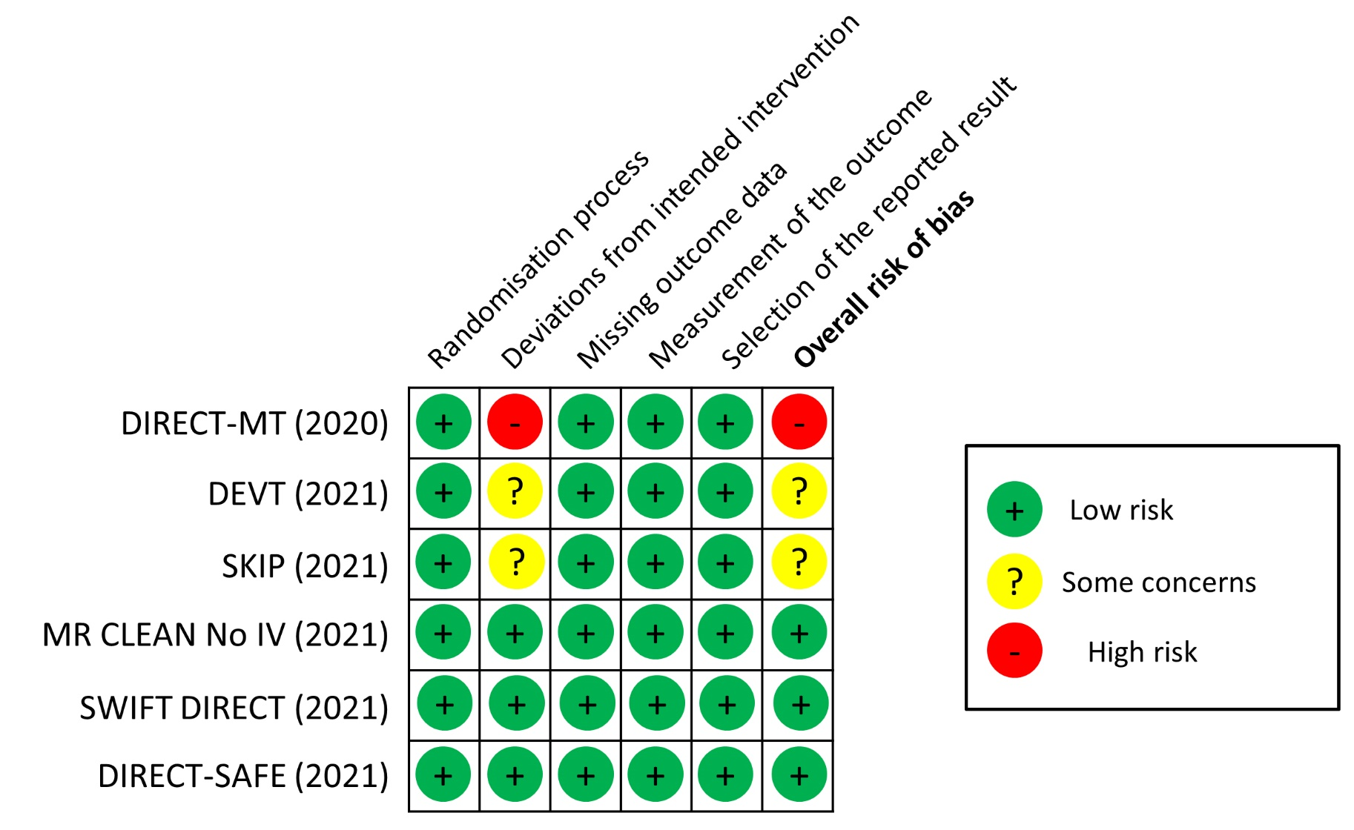
Quality of evidence
Outcome: mRS score at 90 days

Slide 14
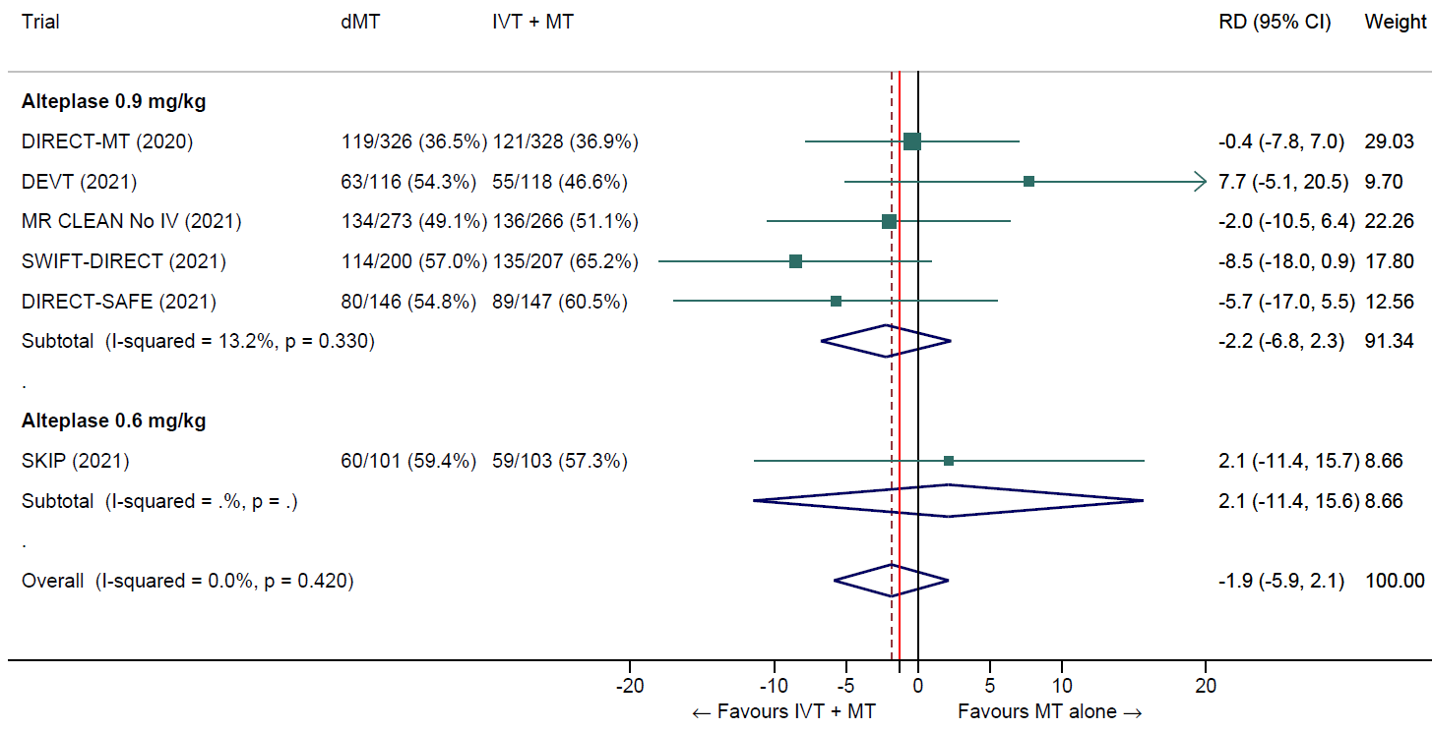
Direct MT vs. IVT plus MT
Good functional outcome (mRS 0-2 at 90 days)
Unadj. RD -1.9% (95% CI -5.9% to 2.1%)

Slide 15
Direct MT vs. IVT plus MT
Good functional outcome (mRS 0-2 at 90 days)
Unadj. RD -1.9% (95% CI -5.9% to 2.1%)
Inferiority
Non-inferiority
-1.3%

Slide 16
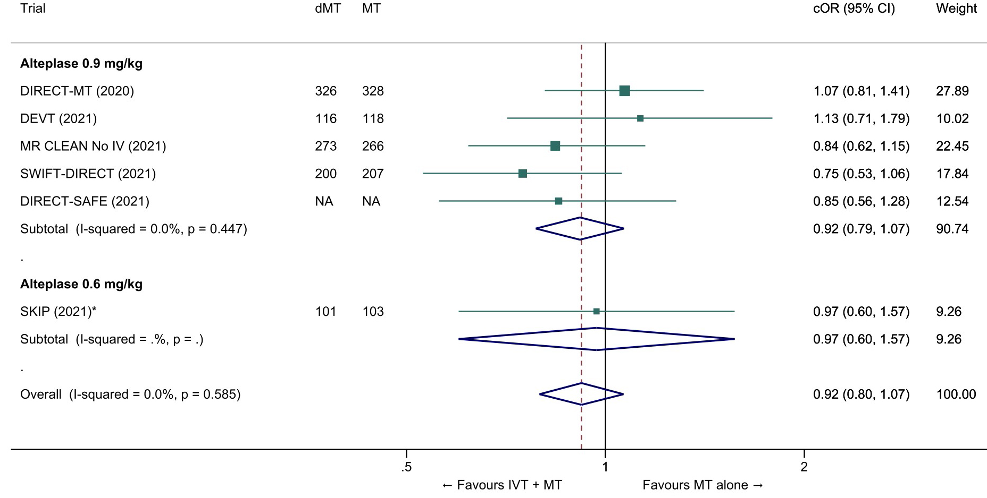
Direct MT vs. IVT plus MT
Reduced disability (whole range of the mRS at 90 days)
Adj. common OR 0.92 (95% CI 0.80 to 1.07)

Slide 17
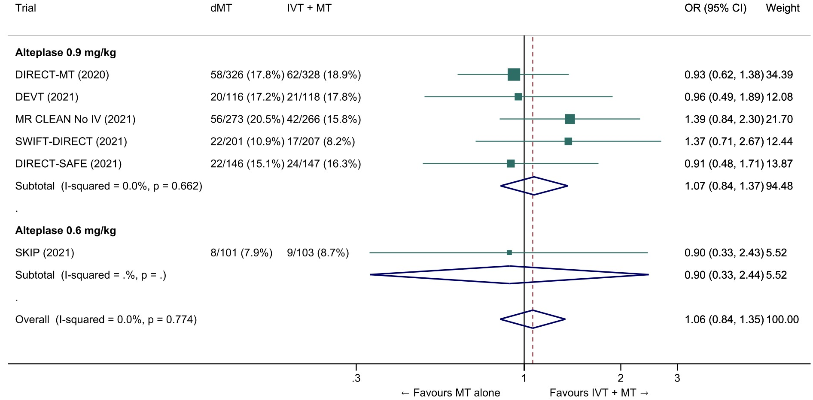
Direct MT vs. IVT plus MT
Death at 90 days
Unadj. OR 1.06 (95% CI 0.84 to 1.35)

Slide 18
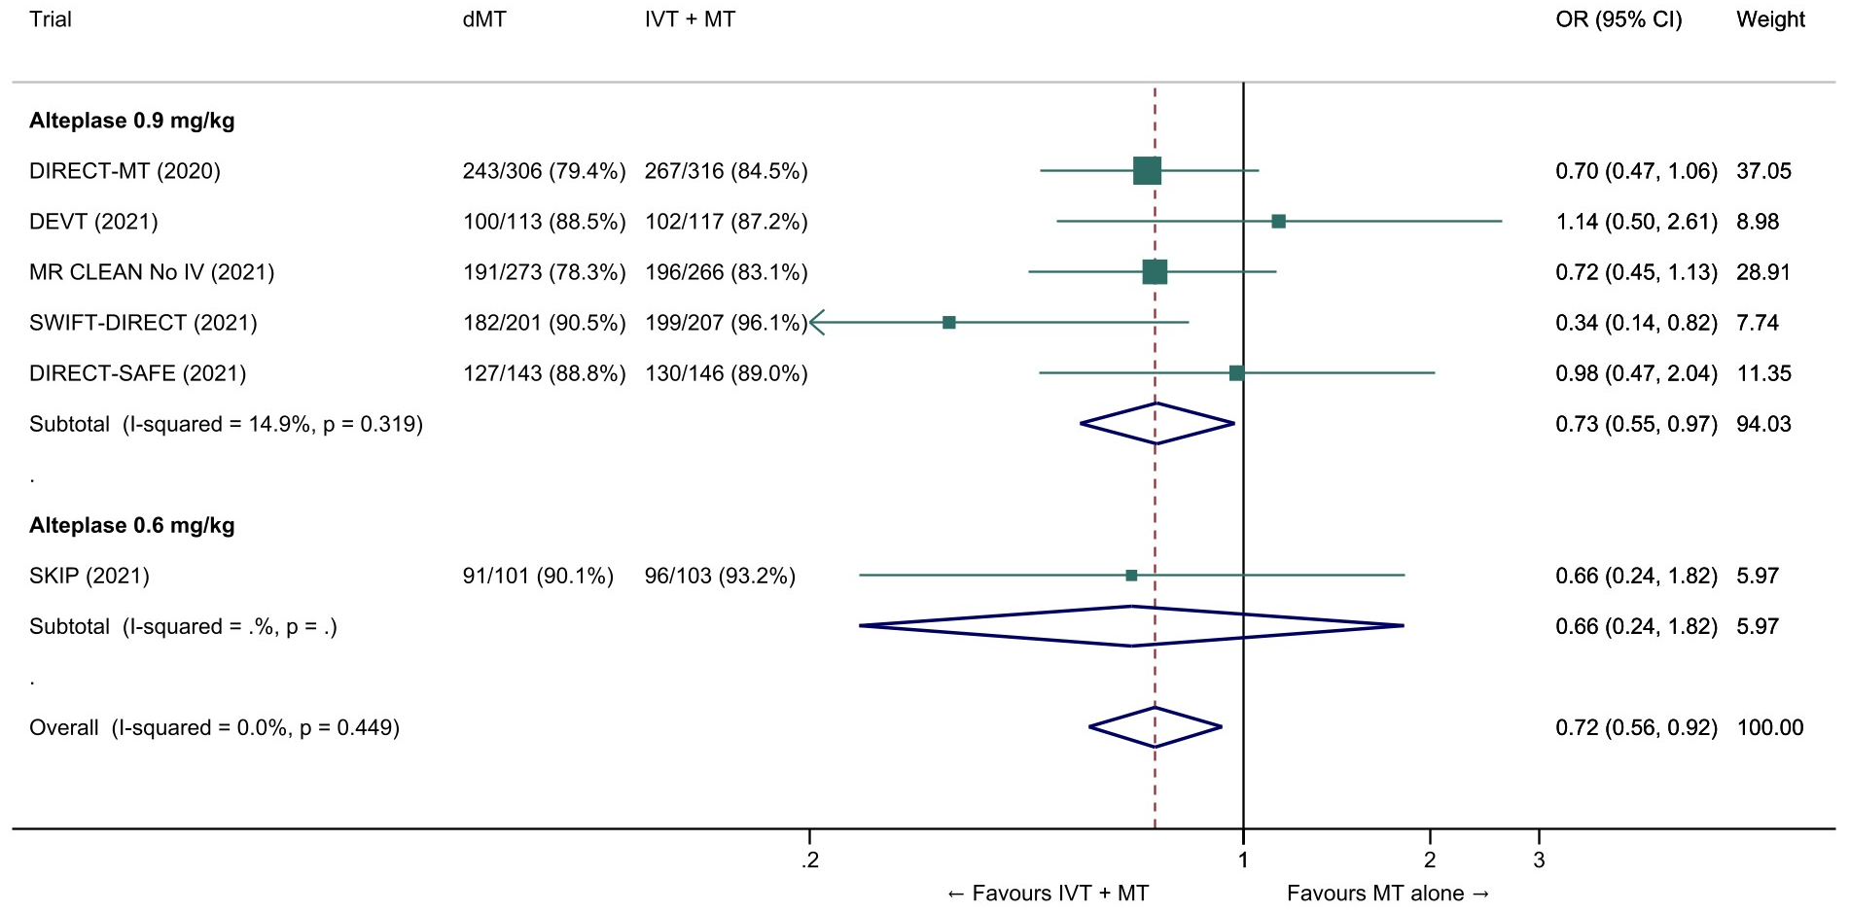
Direct MT vs. IVT plus MT
Succesful reperfusion (mTICI ≥2b) at the end of the endovascular procedure
Unadj. OR 0.72 (95% CI 0.56 to 0.92)

Slide 19
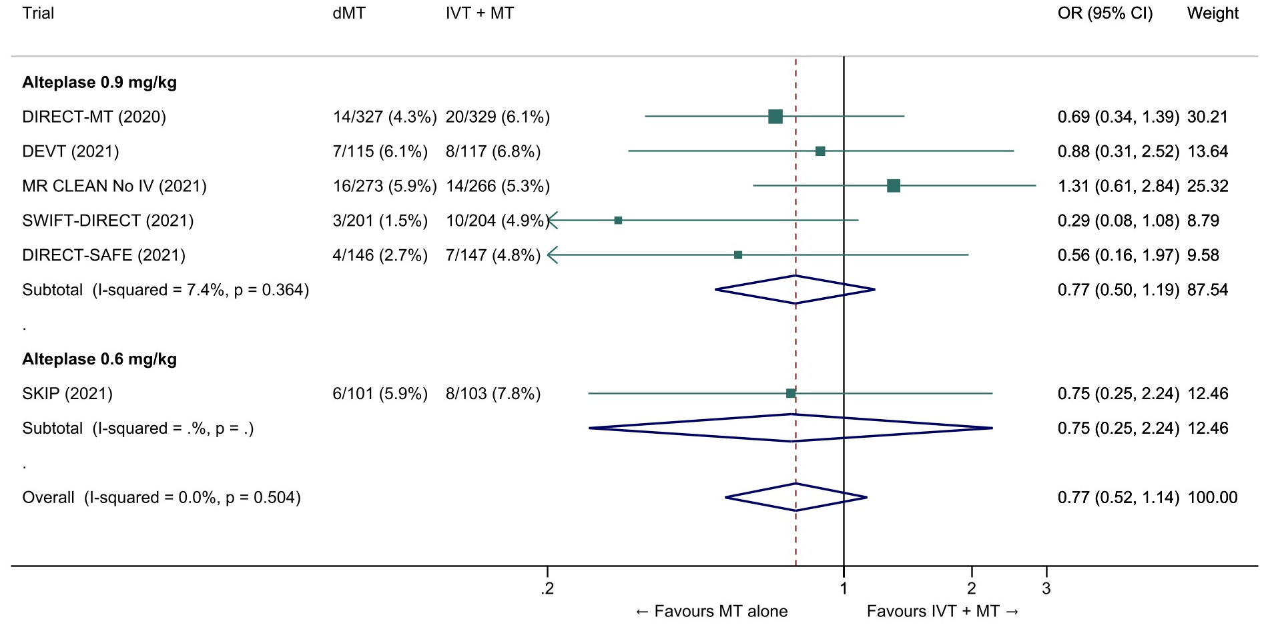
Direct MT vs. IVT plus MT
Symptomatic intracranial haemorrhage
Unadj. OR 0.77 (95% CI 0.52 to 1.14)

Slide 20
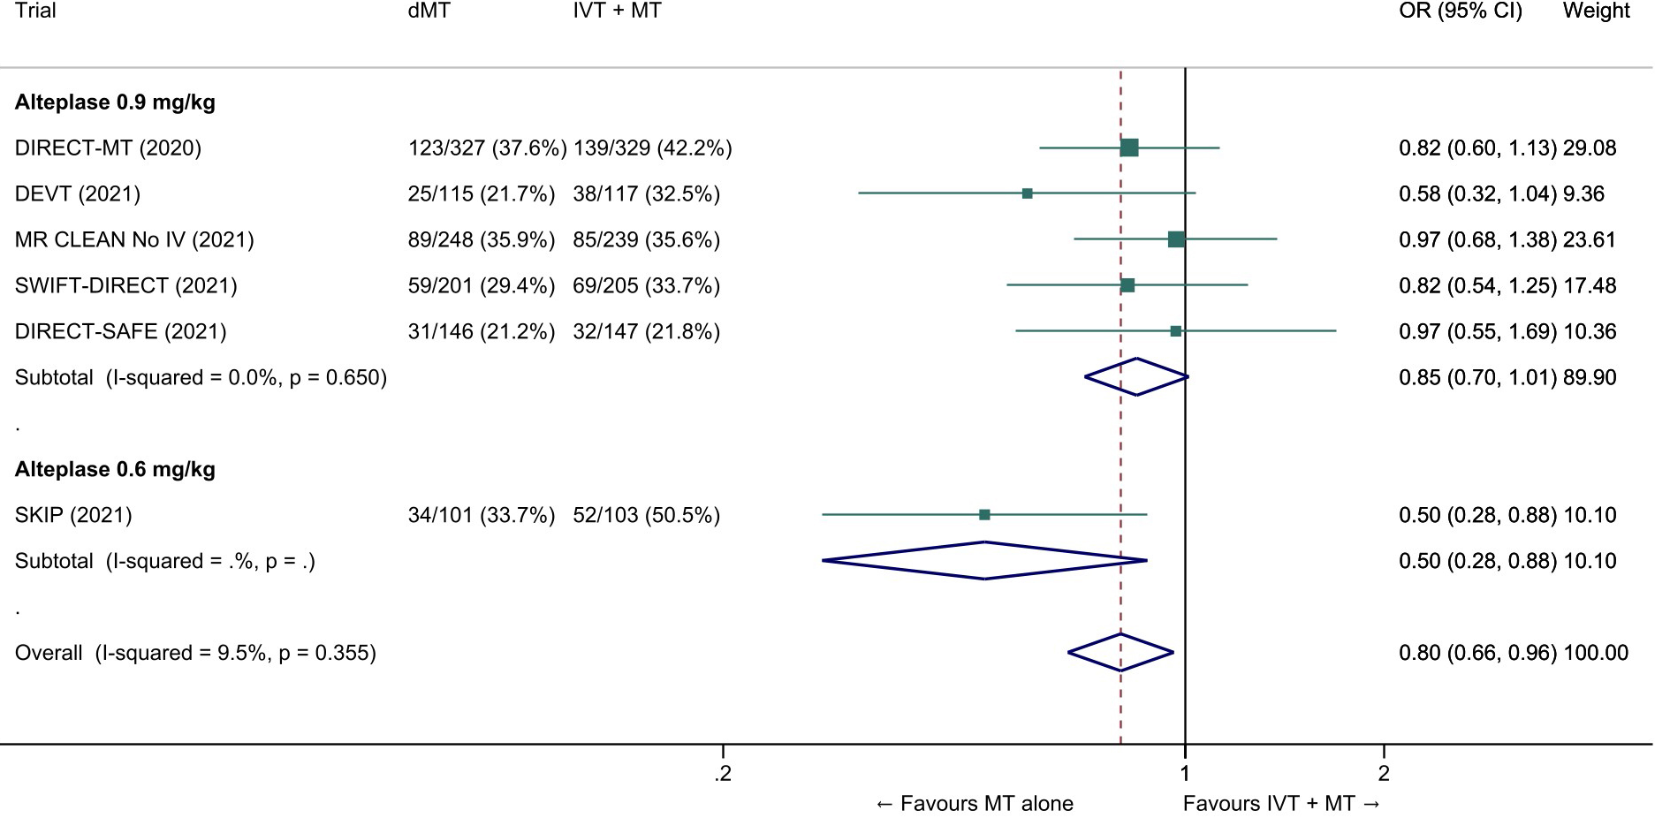
Direct MT vs. IVT plus MT
Any intracranial haemorrhage
Unadj. OR 0.80 (95% CI 0.66 to 0.96)

Slide 21
Evidence-based Recommendation
Mothership, ≤4.5 hrs of symptom onset
For patients directly admitted to a thrombectomy-capable centre for an acute ischaemic stroke (≤4.5 hrs of symptom onset) with anterior circulation large vessel occlusion and who are eligible for both treatments, we recommend intravenous thrombolysis plus mechanical thrombectomy over mechanical thrombectomy alone.
Both treatments should be performed as early as possible after hospital arrival. Mechanical thrombectomy should not prevent the initiation of intravenous thrombolysis, and intravenous thrombolysis should not delay mechanical thrombectomy.
Quality of evidence: Moderate ⊕⊕⊕
Strength of recommendation: Strong ↑↑

Slide 22
Expert Consensus Statement
Mothership, wake-up stroke
For patients directly admitted to a thrombectomy-capable centre within 4.5 hours of symptom recognition after wake-up stroke caused by anterior circulation large vessel occlusion, we suggest intravenous thrombolysis plus mechanical thrombectomy over mechanical thrombectomy alone in selected patients.
The selection criteria are detailed in the corresponding European Guidelines. Notably, eligibility imaging criteria for IVT include DWI-FLAIR mismatch or perfusion core/penumbra mismatch*.
*Perfusion core/penumbra mismatch:
- Infarct core** volume < 70 ml
- and Critically hypoperfused† volume / Infarct core** volume > 1.2
- and Mismatch volume > 10 ml
** rCBF <30% (CT perfusion) or ADC < 620 µm²/s (Diffusion MRI)
† Tmax >6s (perfusion CT or perfusion MRI)
2019 ESO-ESMINT Guidelines on mechanical thrombectomy (Turc G et al, Eur J Stroke 4(1):6-12)
2021 ESO Guidelines on intravenous thrombolysis (Berge E et al, Eur J Stroke 6(1):I-LXII)

Slide 23
PICO Question
Drip-and-ship, ≤4.5 hrs of symptom onset
PICO 2: For large vessel occlusion acute ischaemic stroke (≤ 4.5 hrs of symptom onset) patients admitted to a non-thrombectomy capable centre and eligible for both treatments, does mechanical thrombectomy alone compared with intravenous thrombolysis plus mechanical thrombectomy lead to:
a) a non-inferior proportion of patients with good outcome (mRS 0-2) at 90 days? b) non-inferior or better results on other efficacy outcomes (whole range of the mRS; mRS 0-1; successful reperfusion)? c) a reduction in the risk of adverse events (mortality at 90 days, intracranial haemorrhage)?

Slide 24
Evidence-based Recommendation
Drip-and-ship, ≤4.5 hrs of symptom onset
For patients admitted to a non-thrombectomy-capable centre for an acute ischaemic stroke (≤4.5 hrs of symptom onset) with anterior circulation large vessel occlusion and who are eligible for both treatments, we recommend intravenous thrombolysis followed by rapid transfer to a centre with thrombectomy facilities over omitting intravenous thrombolysis and transfer to a centre with thrombectomy facilities.
Intravenous thrombolysis should not delay the transfer to a centre with thrombectomy facilities.
Quality of evidence: Low ⊕⊕
Strength of recommendation: Strong ↑↑

Slide 25
Expert Consensus Statement
Drip-and-ship, wake-up stroke
For patients admitted to a non-thrombectomy capable centre within 4.5 hours of symptom recognition after wake-up stroke caused by anterior circulation large vessel occlusion, we suggest intravenous thrombolysis plus mechanical thrombectomy over mechanical thrombectomy alone in selected patients.
The selection criteria are detailed in the corresponding European Guidelines. Notably, eligibility imaging criteria for IVT include DWI-FLAIR mismatch or perfusion core/penumbra mismatch*.
*Perfusion core/penumbra mismatch:
- Infarct core** volume < 70 ml
- and Critically hypoperfused† volume / Infarct core** volume > 1.2
- and Mismatch volume > 10 ml
** rCBF <30% (CT perfusion) or ADC < 620 µm²/s (Diffusion MRI)
† Tmax >6s (perfusion CT or perfusion MRI)
2019 ESO-ESMINT Guidelines on mechanical thrombectomy (Turc G et al, Eur J Stroke 4(1):6-12)
2021 ESO Guidelines on intravenous thrombolysis (Berge E et al, Eur J Stroke 6(1):I-LXII)

Slide 26
Discussion
Choice of the non-inferiority margin
Is 1.3% too stringent?
Only accepting a margin of 5.9% would lead to the conclusion of non-inferiority
…is it really acceptable?
Historical trials | Intervention | Control | Unadj. ‘risk’ difference (mRS 0-2) | NNT
MR CLEAN | MT + Best medical therapy | Best medical therapy | 13.5% | 7
NINDS tPA trial | IVT | Placebo | 11.9% | 8
EXTEND | IVT | Placebo | 6.7% | 15
ECASS-3 | IVT | Placebo | 5.0% | 20

Slide 27
Conclusions
Randomized trials only included:
Patients with anterior circulation large vessel occlusion strokes
Eligible for alteplase within 4.5hrs of symptom onset
Admitted to a thrombectomy-capable centre
In that setting, non-inferiority of direct MT has not been demonstrated (1.3%, or even 5%)
Therefore, in the absence of contraindication, we recommend IVT before MT
IVT should not delay MT or the transfer to a center with MT facilities
We also suggest IVT before MT in selected patients with wake-up stroke (expert opinion)
These recommendations may be updated in case IPD meta-analyses disclose subgroups of ‘mothership’ patients in whom direct MT is superior to IVT + MT

